Slide 1


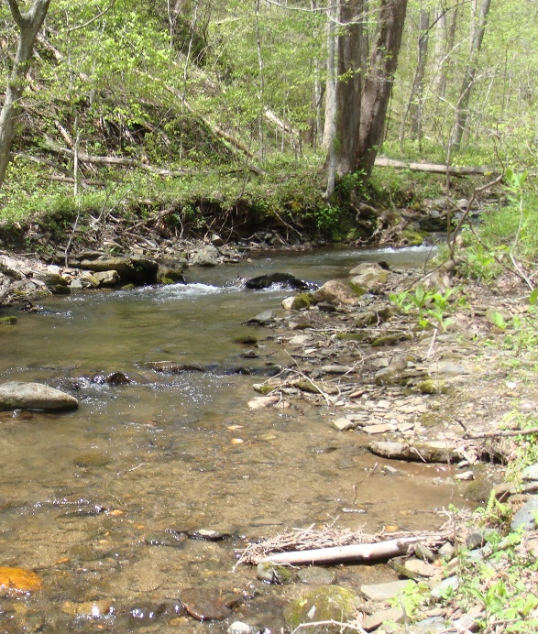
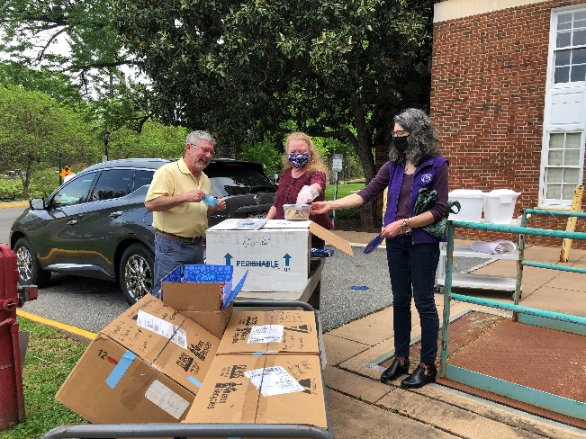
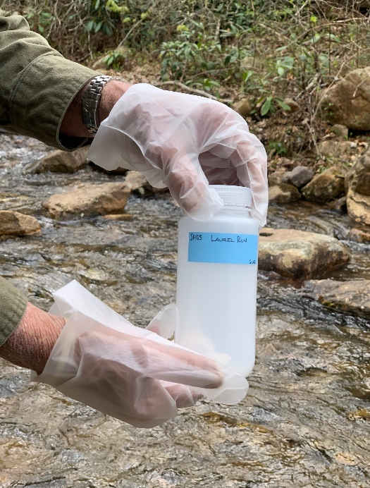
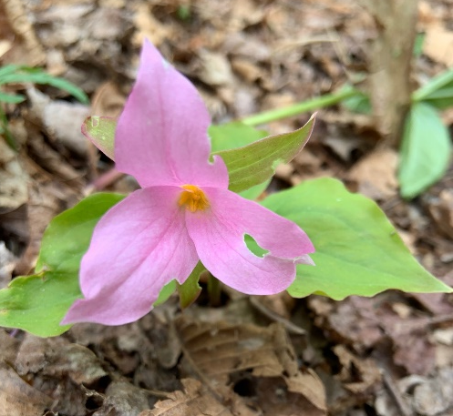
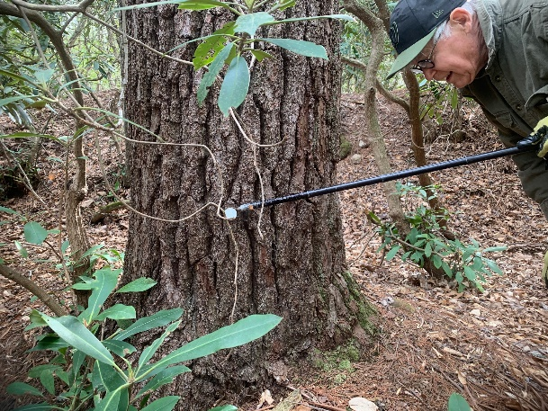
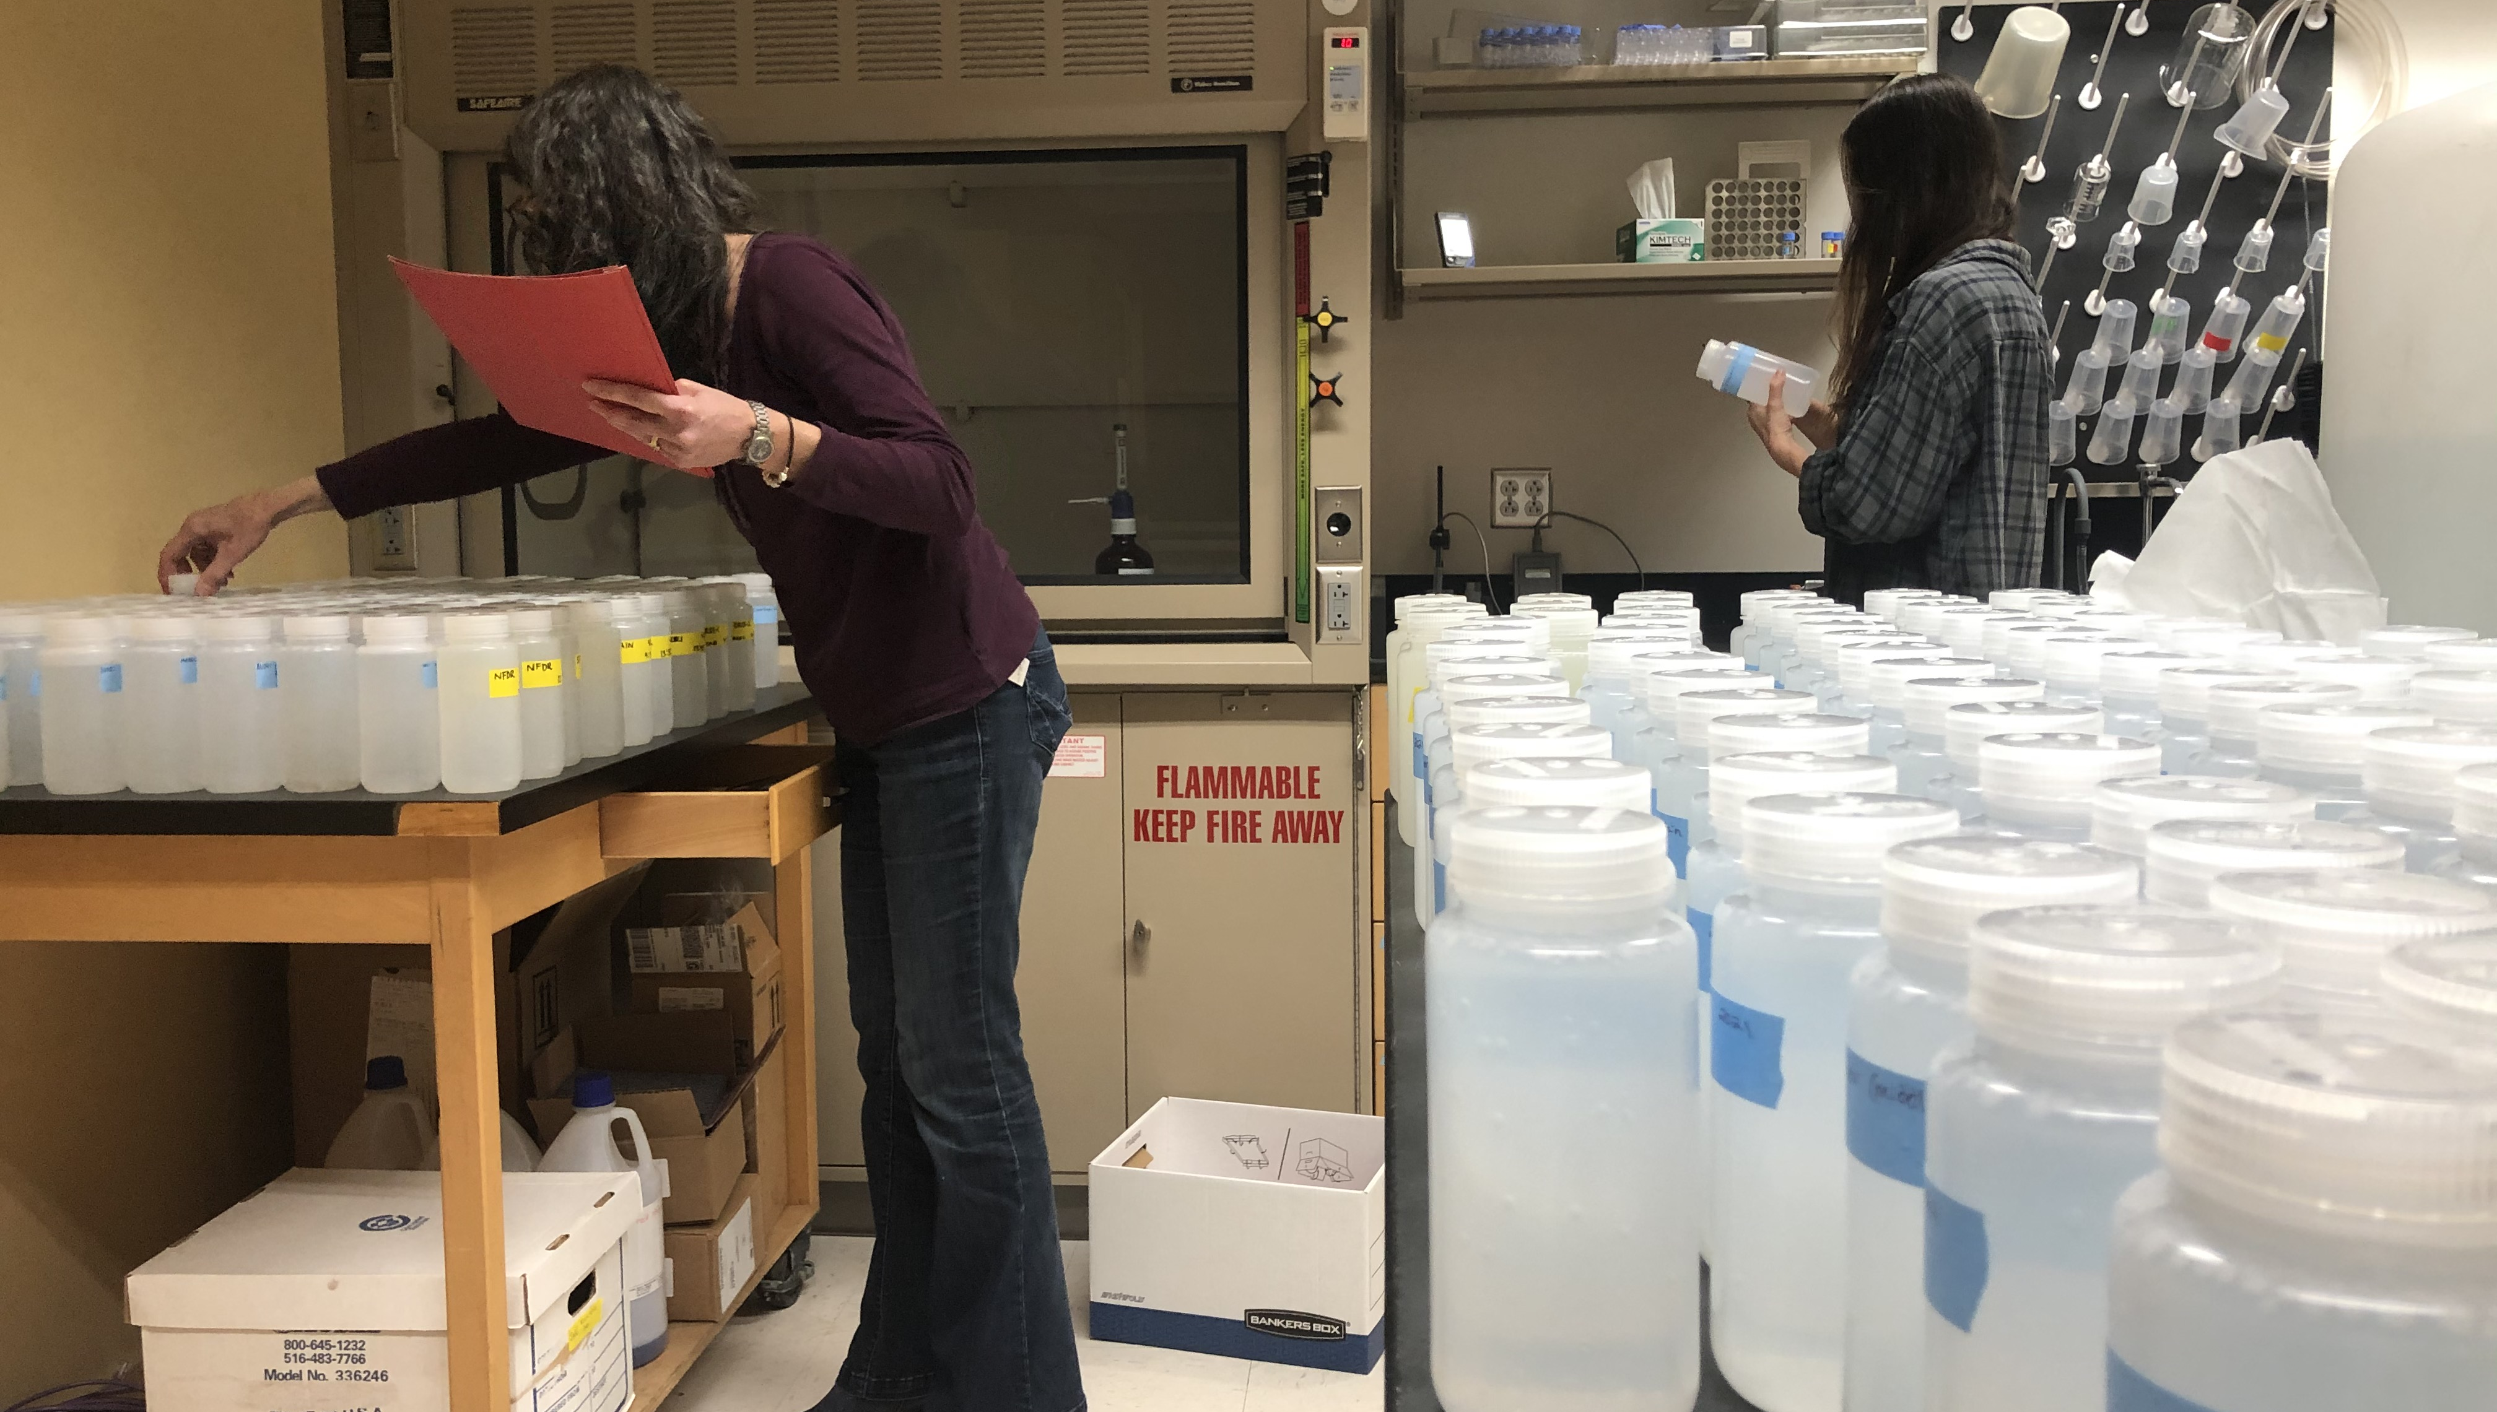
Virginia Trout Stream Sensitivity Study
VTSSS 2021
Rodney Minor
Brynna Strand
Pink Trillium
Photo by Rob Cain
Susie Maben
Stan Ikonen
Results Summary

Slide 2
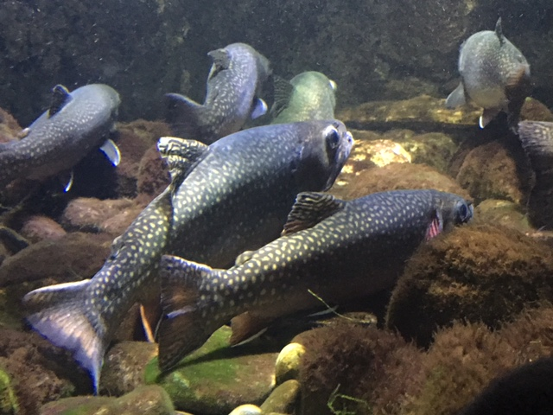
Presentation Outline
Review of how acid deposition impacts fish
Review of VTSSS program
2021 VTSSS – Sampling summary, names and photos
Stream chemistry data/findings
Summary
Emerging threats and future climate

Slide 3
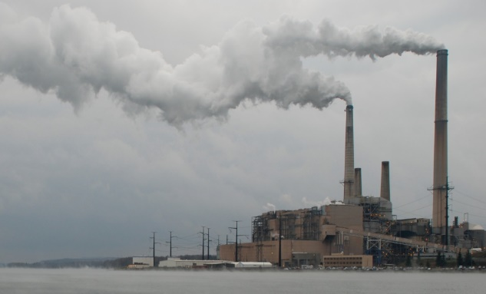
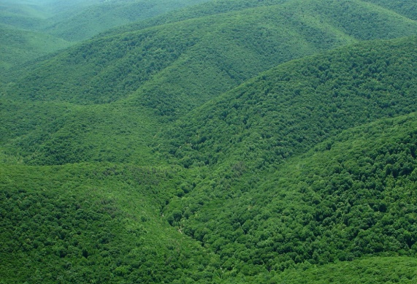
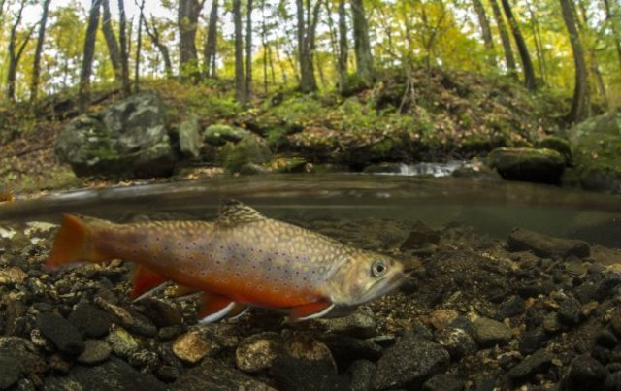
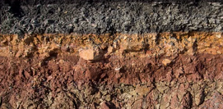
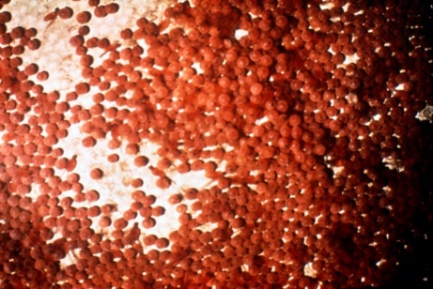
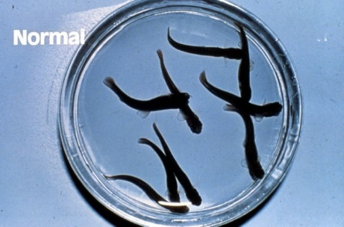
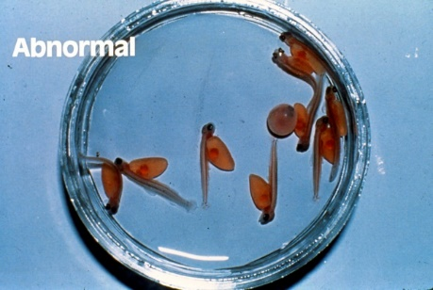
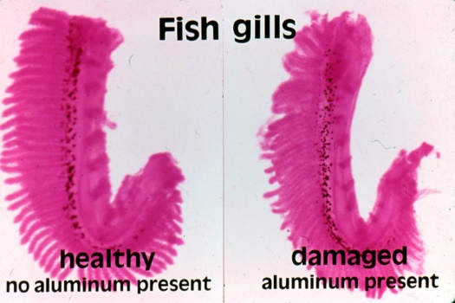
Acid deposition and relationship to native trout stream
H₂SO₄ “sulfuric acid”
SO₂ “sulfur dioxide”
pH
pH
SO₄²⁻
H⁺
H⁺
Base cations – Ca²⁺
SO₄²⁻
Carbonates- ANC
Al³⁺
Al³⁺
Impacts developing fish
pH 6.0
pH 5.0
Impacts adult fish
H⁺ and Al³⁺ bind to iono-regulation sites on gills
Disrupt salt and water balance in blood

Slide 4
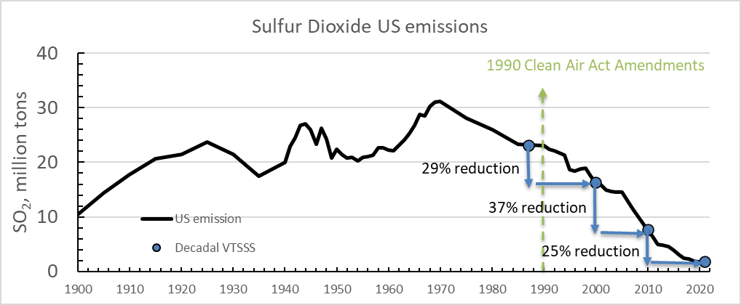
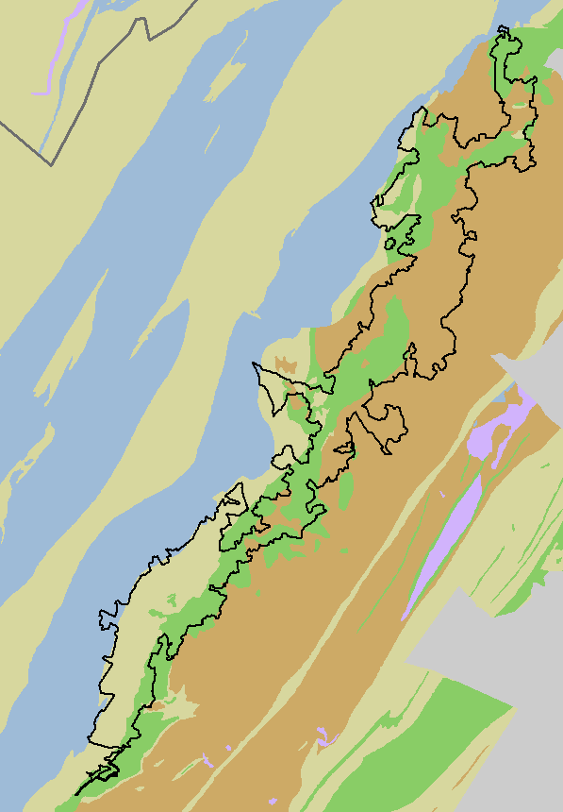
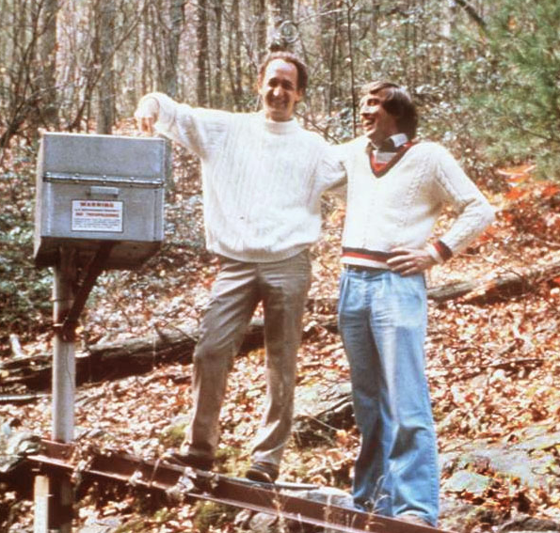
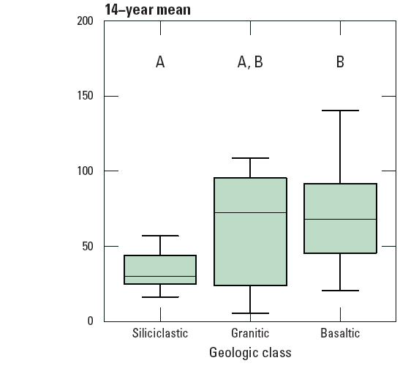
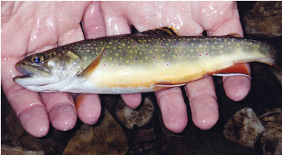
Decadal VTSSS, purpose & history
Acid emission and subsequent deposition has resulted in acidification of many streams in the Eastern US.
Map source: NADP/NTN
Variability in bedrock composition was found to be a key control on stream response to acid deposition in Shenandoah National Park.
Mafic bedrock: well buffered, moderate pH, diverse fish species present, abundant brook trout.
Silicate bedrock: not buffered, low pH, few fish species present, less abundant brook trout.
Shenandoah National Park
Data from Shenandoah National Park
Brook Trout abundance
Jim Galloway
1979- SWAS
acidic moderate suitable
(silicate) (felsic) (mafic)
Notes:
Begs the question, what is the status for the entire region? Necessary to evaluate and pick sites to monitor in the long-term.

Slide 5
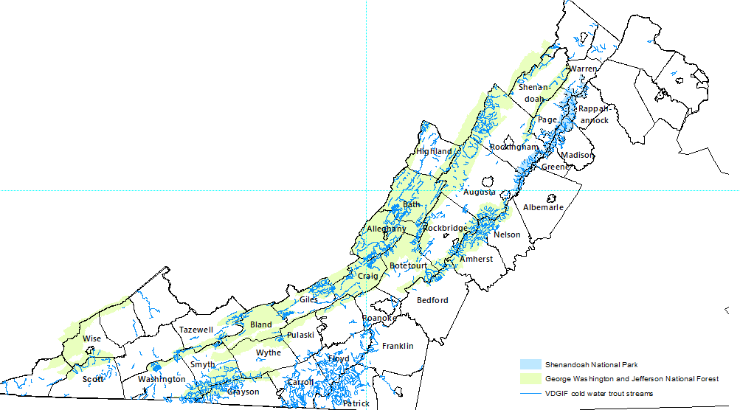


Decadal VTSSS, purpose & history
Acid emission and subsequent deposition has resulted in acidification of many streams in the Eastern US.
Map source: NADP/NTN
What is the acid/base status of native trout streams throughout Virginia?
1987 VTSSS – 367 native trout streams assessed for acid/base chemistry in VA mountains by TU, UVA and collaborators
Paul Bugas, VDWR (retired)
Rick Webb, UVA (retired)

Slide 6

Decadal VTSSS, purpose & history
Since passing of the Clean Air Act Amendments of 1990, SO₂ emissions (and deposition) have decreased by ~90%.
1987 - 367 sites sampled
2000 - 445 sites sampled
2010 - 455 sites sampled
2021 – 454 sites sampled
VTSSS Surveys were repeated every ~10 years to assess the regional response of streams to emission/deposition reductions.

Slide 7
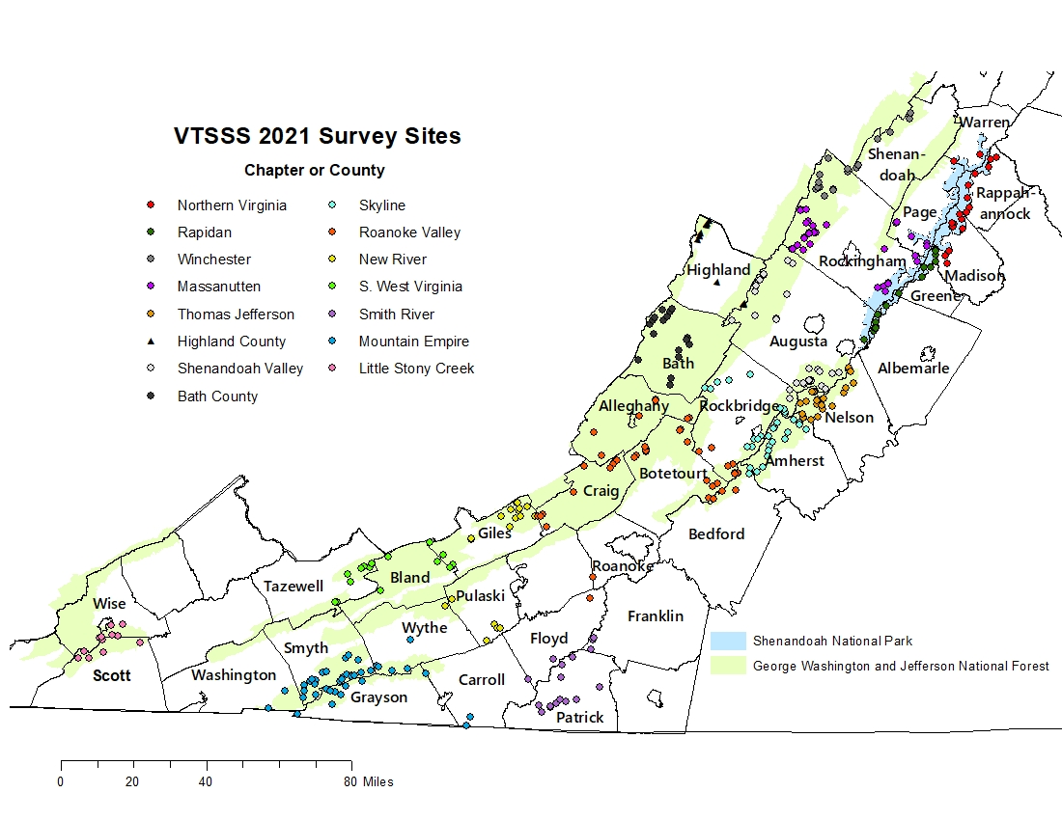
Volunteer Sample Site Map
Sample Window: Last week of April 2021

Slide 8

VTSSS 2021 sample collection summary
1 state TU coordinator: Tom Benzing
Northern VA regional coordinator: Marcia Woolman
13 TU Chapters and Coordinators (+ Bath and Highland County)
Each Chapter sampled 12-45 sites
155 volunteers, 383 sites (+ 71 additional quarterly) = 454 sites sampled
Volunteer hours reported: 1150 hrs
  Northern VA – Rob Cain/Chris Rich
  Rapidan- Amy Orr
  Winchester- Stan Ikonen
  Massanutten – Rodney Miner
  Shenandoah Valley – Tom Benzing
  Roanoke – Mark Taylor
  Thomas Jefferson – Chubby Damron
  Skyline – Steve Romine
  Smith River – Wayne Kirkpatrick /Eric Tichay
  Little Stony – Justin Bently
  Mountain Empire – Heather Davidson
  New River – Arnold Graboyes
  Southern WVA – Chris Mullins/Steve Pugh
  Highland/Bath County – Rick Webb/ Ryan Hodges

Slide 9
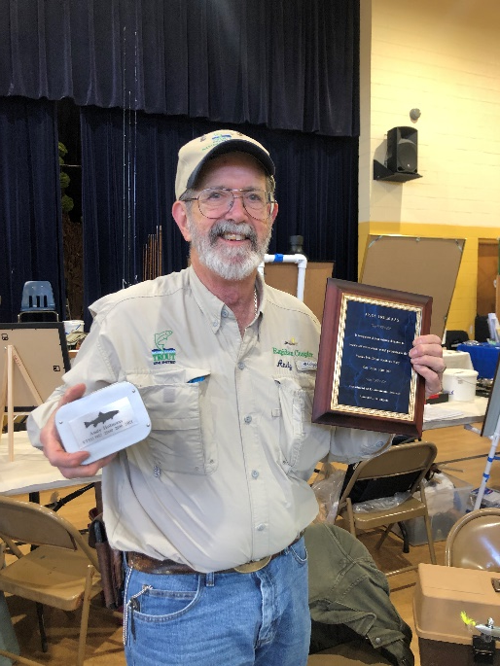
Notable Repeat Volunteer Samplers (based on field forms)
2021 TU Chapter
Name
Years sampled (1987, 2000, 2010, 2021)
Rapidan Andy Holmaas 1987, 2000, 2010, 2021
Roanoke Valley Jeff Cutright 1987, 2000, 2021
Shenandoah Valley Doug Stegura 2000, 2010, 2021
Rapidan Marcia Woolman 2000, 2010, 2021
Smith River Rusty Lacy 1987, 2021
Most Sites Sampled by an individual/family in 2021
Mountain Empire Lisa Benish 15 sites!
Thomas Jefferson Chubby Damron & Jaydon Damron 12 & 2 sites
Mountain Empire Heather, Kevin, Kaydee Davidson 10 & 9 & 8 sites

Slide 10
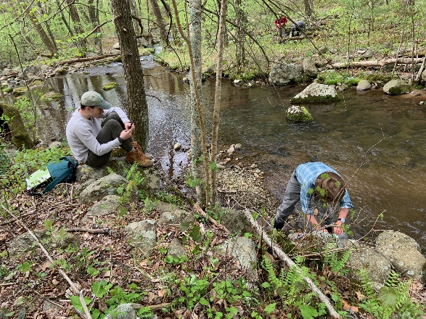
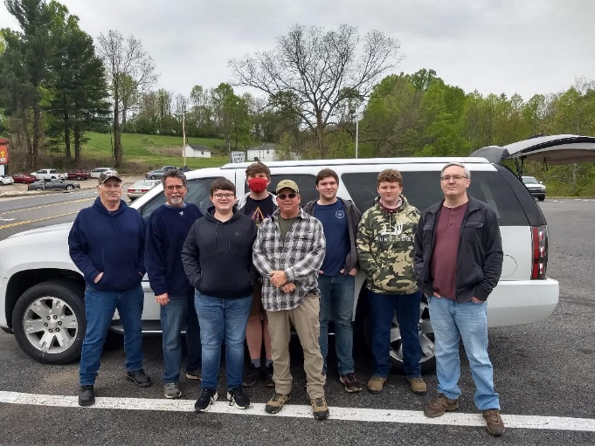
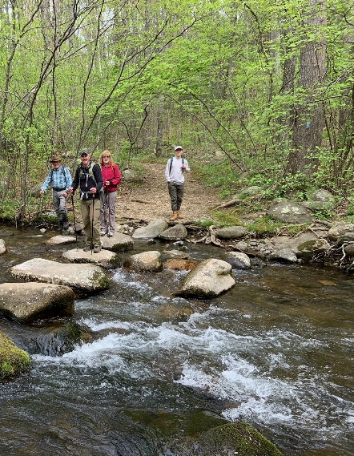
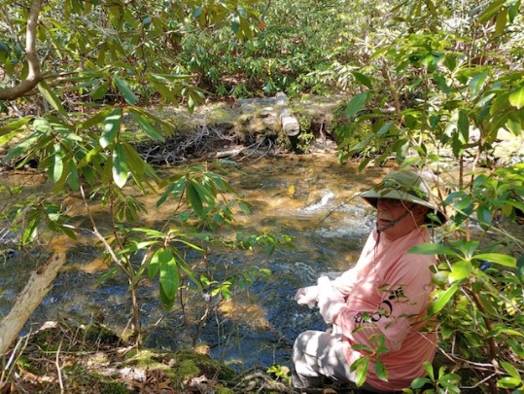
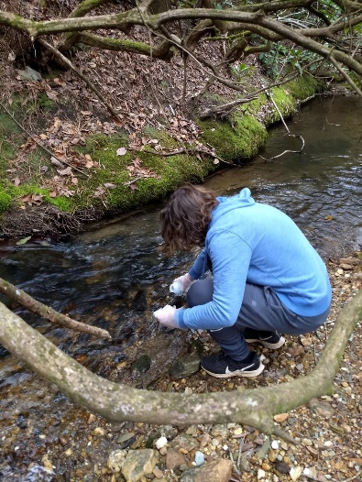
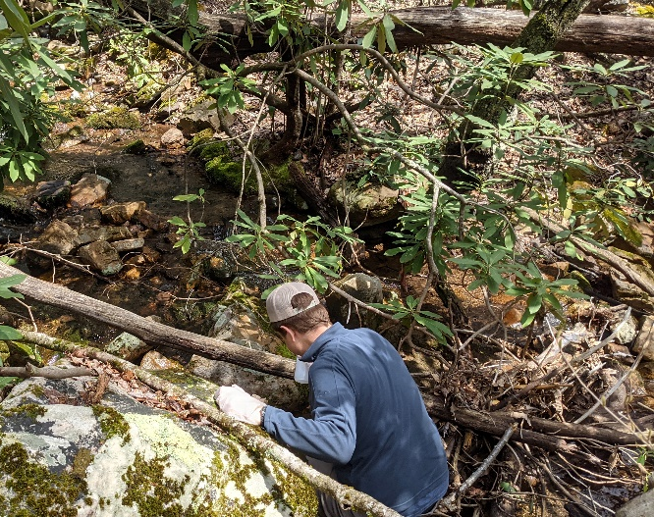
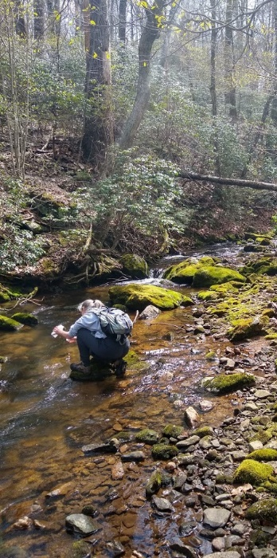
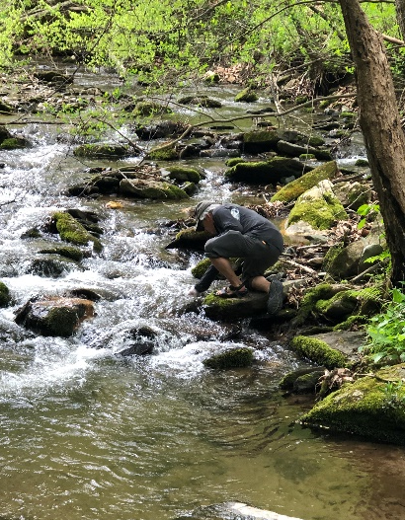
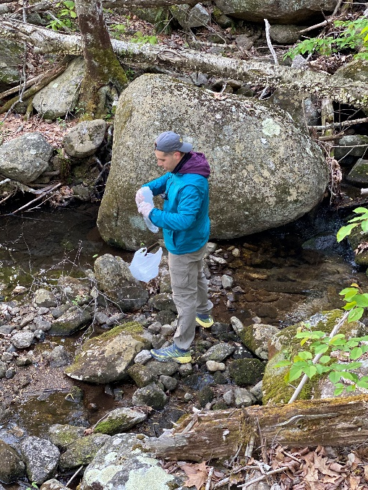
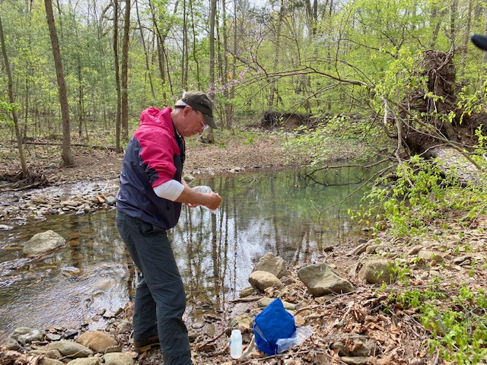
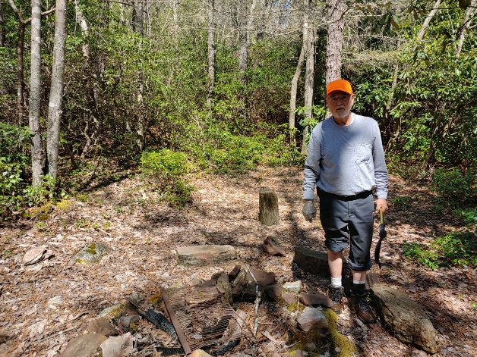
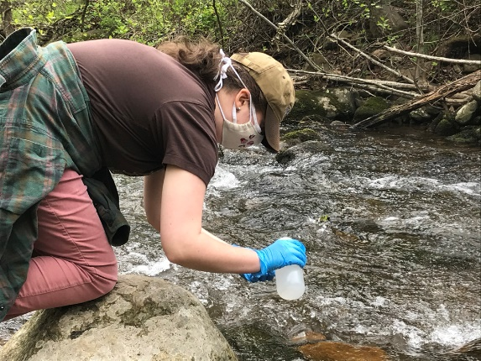
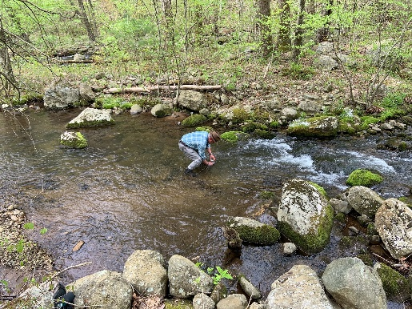
VTSSS 2021
Thanks to all those who sampled!

Slide 11
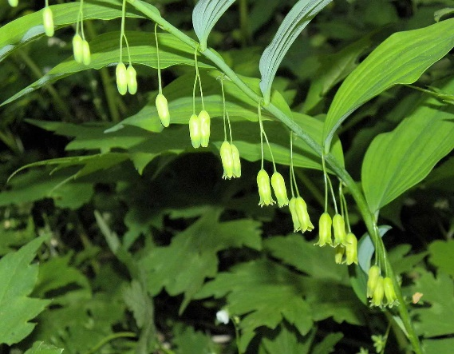


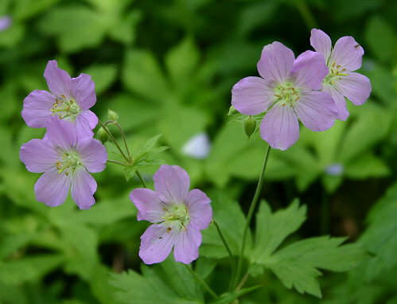
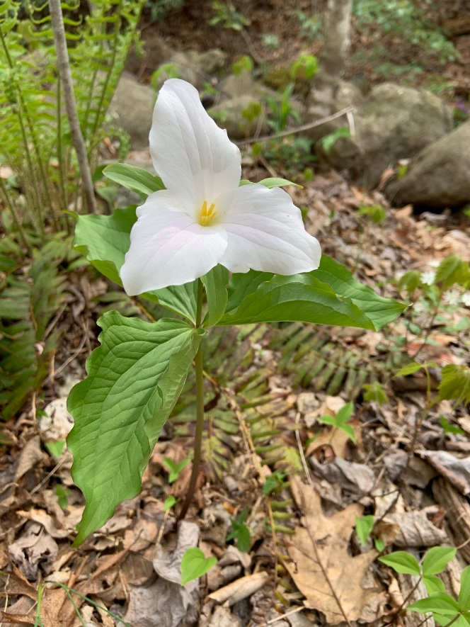
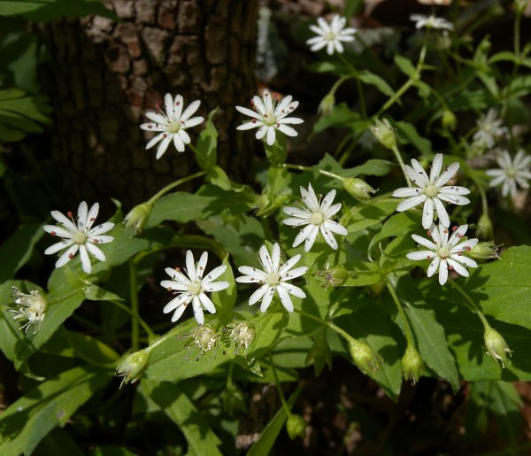
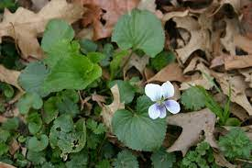
Rob Cain photograph/flower ID
Solomon’s seal
bluets
Pink trillium grandiflorum
Wild geranium
Trillium grandiflorum
chickweed
violet

Slide 12
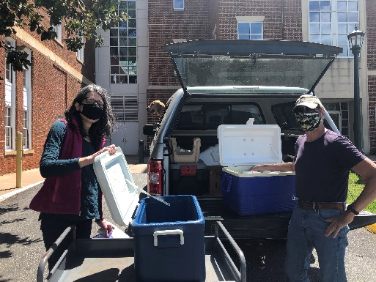
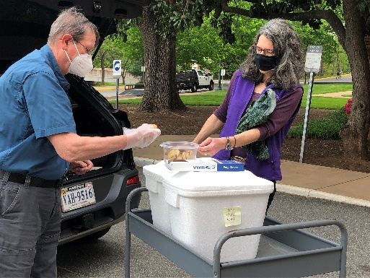
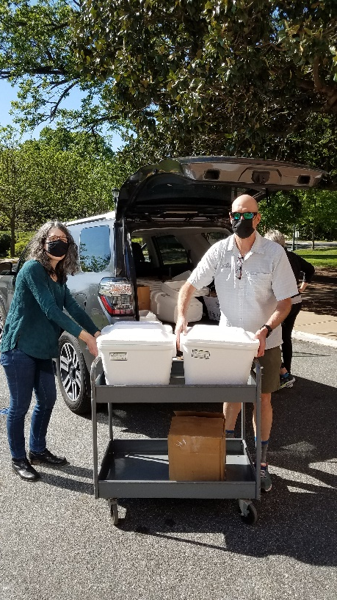
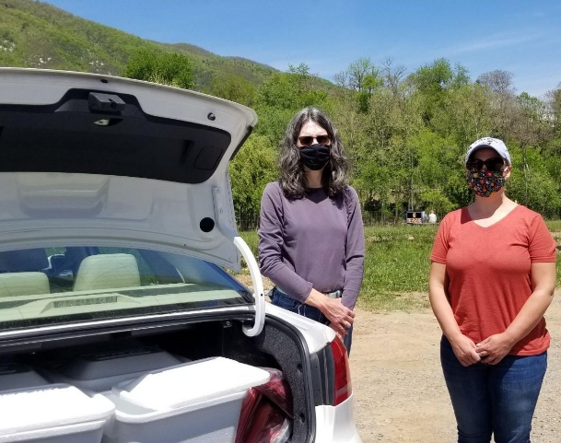
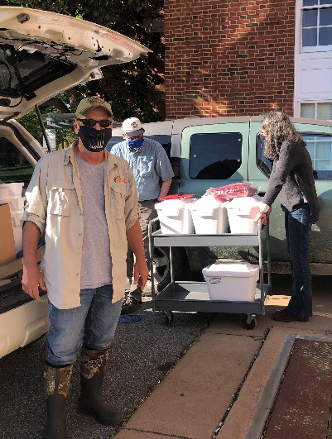
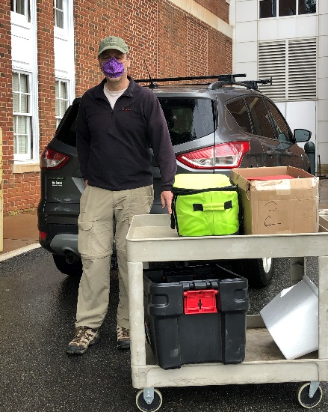
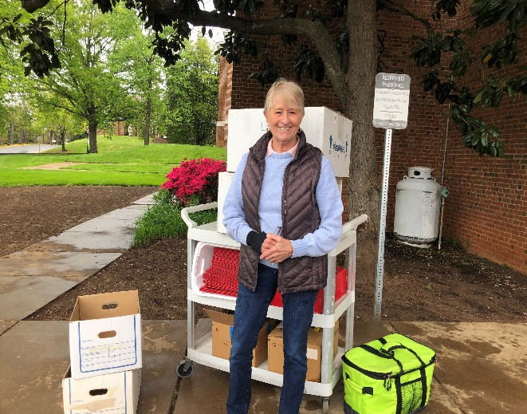
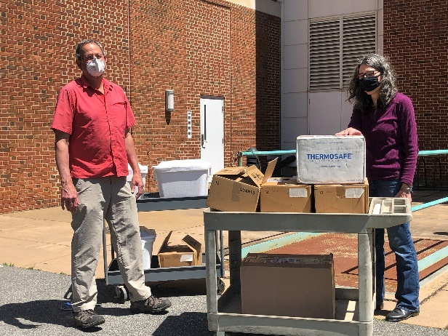
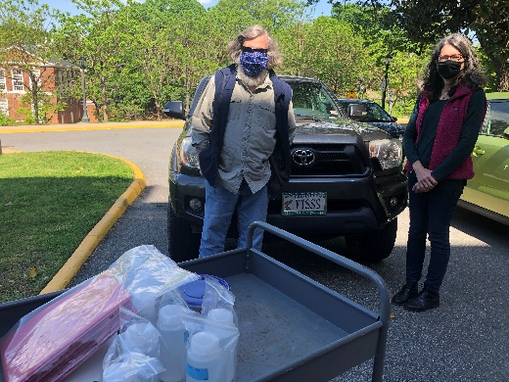
VTSSS 2021
Thanks to all those who coordinated and delivered samples!
Arnold Graboyes, New River
Eric Tichay, Smith River
Rodney Minor, Massanutten
Mark Taylor,
Roanoke Valley
Heather Davidson, Mountain Empire & Little Stony, S. West Va
Chubby Damron, TJ
Tom Benzing, Shenandoah Valley
Rick Webb, Highland & Bath County
Marcia Woolman,
Northern Chapters
Steve Romine, Skyline

Slide 13


Stream chemistry data in this presentation include:
Acid-neutralizing capacity (ANC)
ANC is a general measure of stream sensitivity to acid and is used to classify streams as suitable or unsuitable for Brook Trout
pH
pH is a more direct measure of current stream conditions and has biological implications
UVa VTSSS Laboratory
SO₄ ²⁻
Sulfate is the main acidifier from acid deposition
NO₃ ⁻
Nitrate, also acidifies but typically very low in VA mountain forest streams
Sum of Base Cations (SBC)
SBC (Calcium + Magnesium+ Sodium+ Potassium)
Weathering products from bedrock that neutralize acid inputs.

Slide 14

ANC thresholds and Brook Trout response
ANC concentrations will be presented by their associated brook trout response category, as listed in the table

Slide 15

2021 Acid Neutralizing Capacity (ANC) by ‘response category’

Slide 16

Brook Trout Response Category for each of the VTSSS decadal surveys
1987
2000
2010
2021
Median
ANC
62 69 94 85
We have observed increases in the percentage of sites with suitable habitat, between 1987 and 2021.
The percent of sites with unsuitable habitat has decreased between 1987 and 2021.

Slide 17

Bedrock class for VTSSS 2021 sites
Some bedrock types can more easily neutralize acids
  Mafic high ANC, not sensitive to acidification (29 sites)
  Felsic (104 sites)
  Argillaceous (105 sites)
  Siliciclastic low ANC, very sensitive to acidification (215 sites)
least sensitive
most sensitive
Notes:
USFS – 305 sites, NPS 65 sites, 87 sites other designation

Slide 18
ANC, for each survey year, grouped by bedrock
1987 2021
1987 2021
1987 2021
1987 2021
50
Suitable
least sensitive most sensitive
For sites on each bedrock class, we observe improvements in median ANC from 1987-2010, but not between 2010 and 2021.

Slide 19
Sulfate, for each survey year, grouped by bedrock
SHEN Precip
For sites on each bedrock class, we observe improvements (decreases) in median sulfate from 1987 to 2021.
Sulfate decreases in streamwater are more moderate than rainwater (~38 to 3 µeq/L), due to years of accumulation in soils.

Slide 20
Nitrate, for each survey year, grouped by bedrock
SHEN Precip
In 2021, increases in nitrate in 2021 (~15 µeq/L) observed. Potential reasons for increase in nitrate include watershed disturbance (e.g., defoliations/pests).
Nitrate concentrations in precipitation in SHEN have decreased between 1987 and 2020, from 16 to 5 µeq/L.

Slide 21
Sum of Base Cations, for each survey year, grouped by bedrock
For sites on each bedrock class, we observe increases in median SBC from 1987-2010, but not from 2010 to 2021 (except Mafic), like ANC trends.

Slide 22
ANC trends, 1987-2021
Faster Recovery
The trend in ANC from 1987-2021 indicates a range in recovery rates for individual sites within a bedrock class.
Mafic sites have a greater median increasing rate of ANC.
Slower Recovery
Median ANC, µeq/L/yr
1.6 0.7 0.7 0.4

Slide 23
Do stream chemical trends relate to watershed characteristics?
There is variability in chemical trends over time.
Is there a relationship to watershed characteristics?
Watershed Characteristics
Mean/Max watershed elevation is the most consistent predictor variable for trends for all sites and individual bedrock groupings.
Latitude
Longitude
Area
Mean Leaf Area Index
Mean Annual Precipitation
Min elevation
Max elevation
Mean elevation
Mean Slope
Mean Aspect (east/west and north/south)
% Forest Cover
Faster Recovery
Slower Recovery
Lower elevation sites are recovering faster

Slide 24


Nitrate trends – relationship to watershed characteristics
There is a strong significant relationship between nitrate trends and watershed Latitude. Northern sites had greater increases in nitrate.
We do not know the reason for this trend yet.
Potential for forest pests, concentrated regionally, to be impacting health and nutrient uptake of forest.

Slide 25
Summary
Chemical conditions (ANC) in Appalachian mountain streams that support native brook trout have improved for the majority of sites (~86%) between 1987 and 2021.
Declines in stream water sulfate concentrations, driven by emission regulations initiated with the 1990 Clean Air Act Amendments, contribute to improvements in stream chemistry.
Sites with mafic bedrock and those at lower elevations are recovering at a faster rate.
Despite improvements, only 69% of streams have ANC levels that are consistently ‘suitable’ for brook trout.

Slide 26





Data dissemination
Environmental Protection Agency – Clean Air Markets Division, assesses response to acid rain in US
Virginia Department of Environmental Quality
National Park Service –Evan Childress, supervisory fisheries biologist
U.S. Forest Service – Dawn Kirk, fisheries biologist for GW and Jefferson NF
Virginia Department of Wildlife Resources – Steve Reeser, fisheries biologist
Public, via the SWAS-VTSSS website and federal database (Water Quality Portal)
Resource Managers and Scientists
Public
Regulators
Teachers
Students
Citizen scientists
Fisherman
…

Slide 27



SWAS-VTSSS Mountain Stream Database
https://swas.evsc.virginia.edu/POST/scripts/overview.php

Slide 28
Looking towards the future environment…

Slide 29



Emerging threat: Microplastics
Microplastic under blue light
Biological effects on fish:
Accumulates in digestive track and liver
Obstructs gills
Increase mercury bioaccumulation
Prevent nutrient assimilation
Carriers for organic pollutants, heavy metals, pesticides, and harmful pathogens
Matthew Zaragoza, 4th-year UVA student

Slide 30

Emerging threat: Microplastics
Sampling added to VTSSS in 2021.
Results
194 samples collected
122 stream samples analyzed
23% have microplastics in a 1L sample
~0.26 microplastic pieces per L in VA mountain streams
BASELINE DATA important to understanding future changes

Slide 31


Multiple Environmental Stressors: a changing climate combined with slow recovery from acid emission/deposition
The brook trout’s very name reflects its vulnerability. “Fontinalis” means “of the springs,” revealing the species’ reliance on cool, clear water to survive.
Increasing stream temperature
- caused by increasing air temperature
- caused by a decrease in stream shading

Slide 32




Projections for a changing climate
Downstream warming and headwater acidity may diminish cold water habitat (McDonnell et al. 2015)
  2 -4°C air temperature increase = 6%- 10% reduction in cold water habitat in SE US forests
upstream
Habitat
downstream
ANC < 50 µeq/L
Temperature > 20ºC
Changes in streamflow may have mixed effects (Blum et al. 2019)
  Increased fall and summer baseflows are beneficial
  Higher intensity storms may harm eggs and juveniles in winter and spring

Slide 33



Thank you for participating and listening!
And thank you to our funders (47.1K raised)
Individual donations!

