Slide 1
Sharing and Caring:
Development of Self-Disclosure Between Teens and Best Friends in Adolescence
Meghan Costello, Corey Pettit, Gabrielle Hunt, Alison Nagel, Ariana Rivens, Olivia Hazelwood, & Joseph Allen
University of Virginia

Slide 2
Self-Disclosure
A communication in which an individual shares personal, private information (such as personal thoughts and feelings) with a conversation partner in order to make themselves known to that other person. (Pearce & Sharp, 1973)
Notes:
Inherently social, dyadic

Slide 7
Self-Disclosure…
Increases in adolescence (Buhrmester & Paige, 1995)
Indicates a balance of individuality and engagement in friendships (Bauminger et al., 2008)
Elicits responsiveness and is key for intimacy in close relationships (Reis & Shaver, 1988; Roberts & Greenberg, 2002)
Links to short- and long-term physical, mental, and relational health outcomes (Allen et al., 2018; Holt-Lunsted et al., 2010)

Slide 8
How do teens naturally learn about self-disclosure in their friendships?

Slide 9
Kliff-Vida Sample
98
86
$40,000
Race Representation

Slide 10
Supportive Behavior Task
“Tell me about some problem in your life that you would be willing to discuss with [friend] for six minutes. It doesn’t have to be the most challenging thing you’re dealing with, just something you’d like help, advice, or input on.”
Goal to understand vulnerability: Would the average teen feel embarrassed or uncomfortable if they shared this with a close friend?
Depth of Self-Disclosure
Two trained graduate student coders
Reliability every seven interactions
Single most disclosing statement
ICC’s = .69-.75
Notes:
Order of the taskss

Slide 11
Depth of Self-Disclosure
0 | Brief, non-controversial statements about likes and dislikes or wants and needs. ”I like playing videogames before dinner.”
1 | Personal opinions or facts about self, with some potential to be embarrassing. “My grade will be fine, but I think I might fail this Spanish quiz.”
2 | Expressing thoughts, opinions, or facts about self that are not always readily expressed and have more potential to feel embarrassing. “I don’t know my way around the school. How are we supposed to know where the classrooms are?”
*Scores greater than a 2 are getting into areas that are not commonly shared with others.
3 | Feelings that are less socially acceptable or facts that are a little more unusual, a little more emotional, and/or seem to be important to the speaker. “I’m worried that we’re going to have a hard time staying in touch this summer.”
4 | Statements that are not commonly shared even among close friends, strong feelings, or information that may be very strange or embarrassing to tell a stranger. “Ever since my parents’ divorce, they keep fighting in front of me and they drag me into it.”

Slide 12
Depth of Self-Disclosure
0 | Brief, non-controversial statements about likes and dislikes or wants and needs. ”I like playing videogames before dinner.”
1 | Personal opinions or facts about self, with some potential to be embarrassing. “My grade will be fine, but I think I might fail this Spanish quiz.”
2 | Expressing thoughts, opinions, or facts about self that are not always readily expressed and have more potential to feel embarrassing. “I don’t know my way around the school. How are we supposed to know where the classrooms are?”
*Scores greater than a 2 are getting into areas that are not commonly shared with others.
3 | Feelings that are less socially acceptable or facts that are a little more unusual, a little more emotional, and/or seem to be important to the speaker. “I’m worried that we’re going to have a hard time staying in touch this summer.”
4 | Statements that are not commonly shared even among close friends, strong feelings, or information that may be very strange or embarrassing to tell a stranger. “Ever since my parents’ divorce, they keep fighting in front of me and they drag me into it.”

Slide 13
Depth of Self-Disclosure
0 | Brief, non-controversial statements about likes and dislikes or wants and needs. ”I like playing videogames before dinner.”
1 | Personal opinions or facts about self, with some potential to be embarrassing. “My grade will be fine, but I think I might fail this Spanish quiz.”
2 | Expressing thoughts, opinions, or facts about self that are not always readily expressed and have more potential to feel embarrassing. “I don’t know my way around the school. How are we supposed to know where the classrooms are?”
*Scores greater than a 2 are getting into areas that are not commonly shared with others.
3 | Feelings that are less socially acceptable or facts that are a little more unusual, a little more emotional, and/or seem to be important to the speaker. “I’m worried that we’re going to have a hard time staying in touch this summer.”
4 | Statements that are not commonly shared even among close friends, strong feelings, or information that may be very strange or embarrassing to tell a stranger. “Ever since my parents’ divorce, they keep fighting in front of me and they drag me into it.”

Slide 14
Hypothesis: Best friends co-develop self-disclosure from age 13 to 18

Slide 15
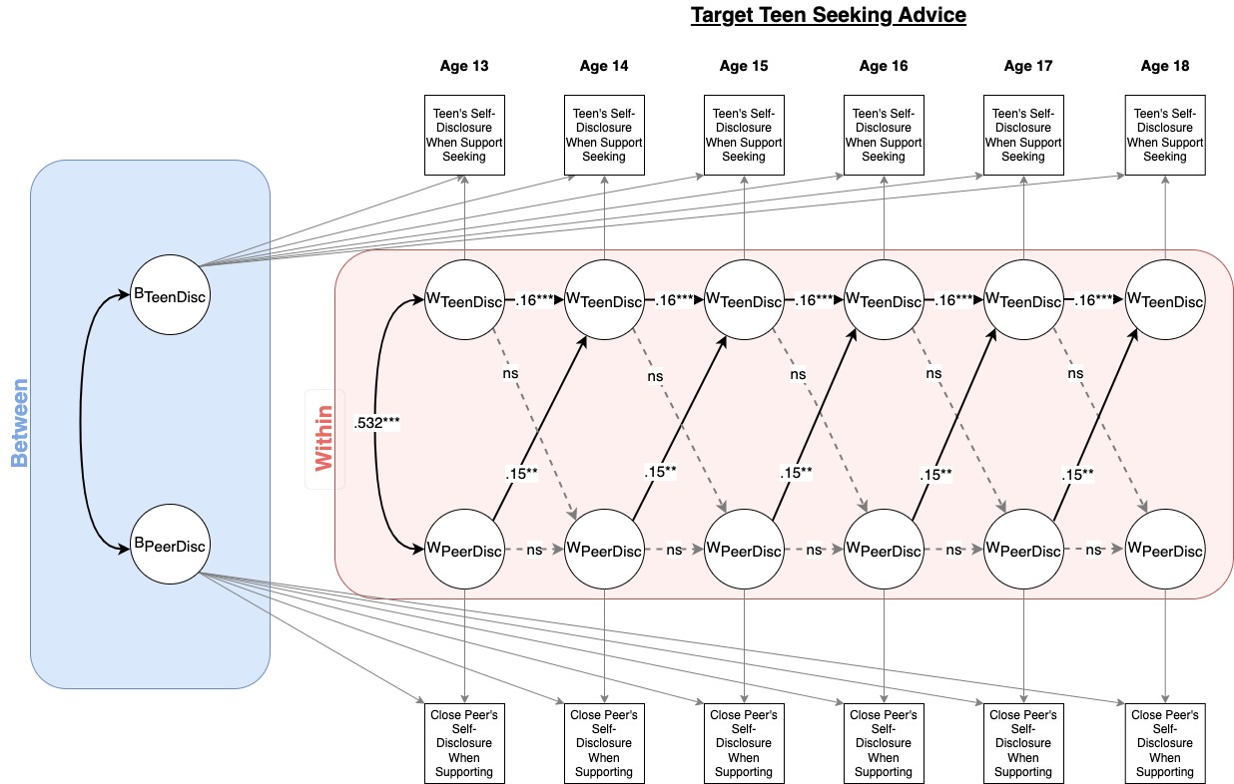
Notes:
Co-development of disclosure

Slide 16
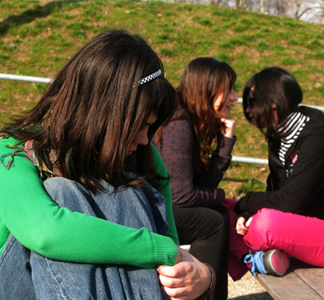
Discussion
Peers “mirror” each other’s self-disclosure within a given conversation
Adolescents adjust the amount they disclose each year based on their experience of others’ self-disclosure, in addition to their own
Developmental trajectories persist even though adolescents brought in different friends on subsequent waves about 50% of the time

Slide 17
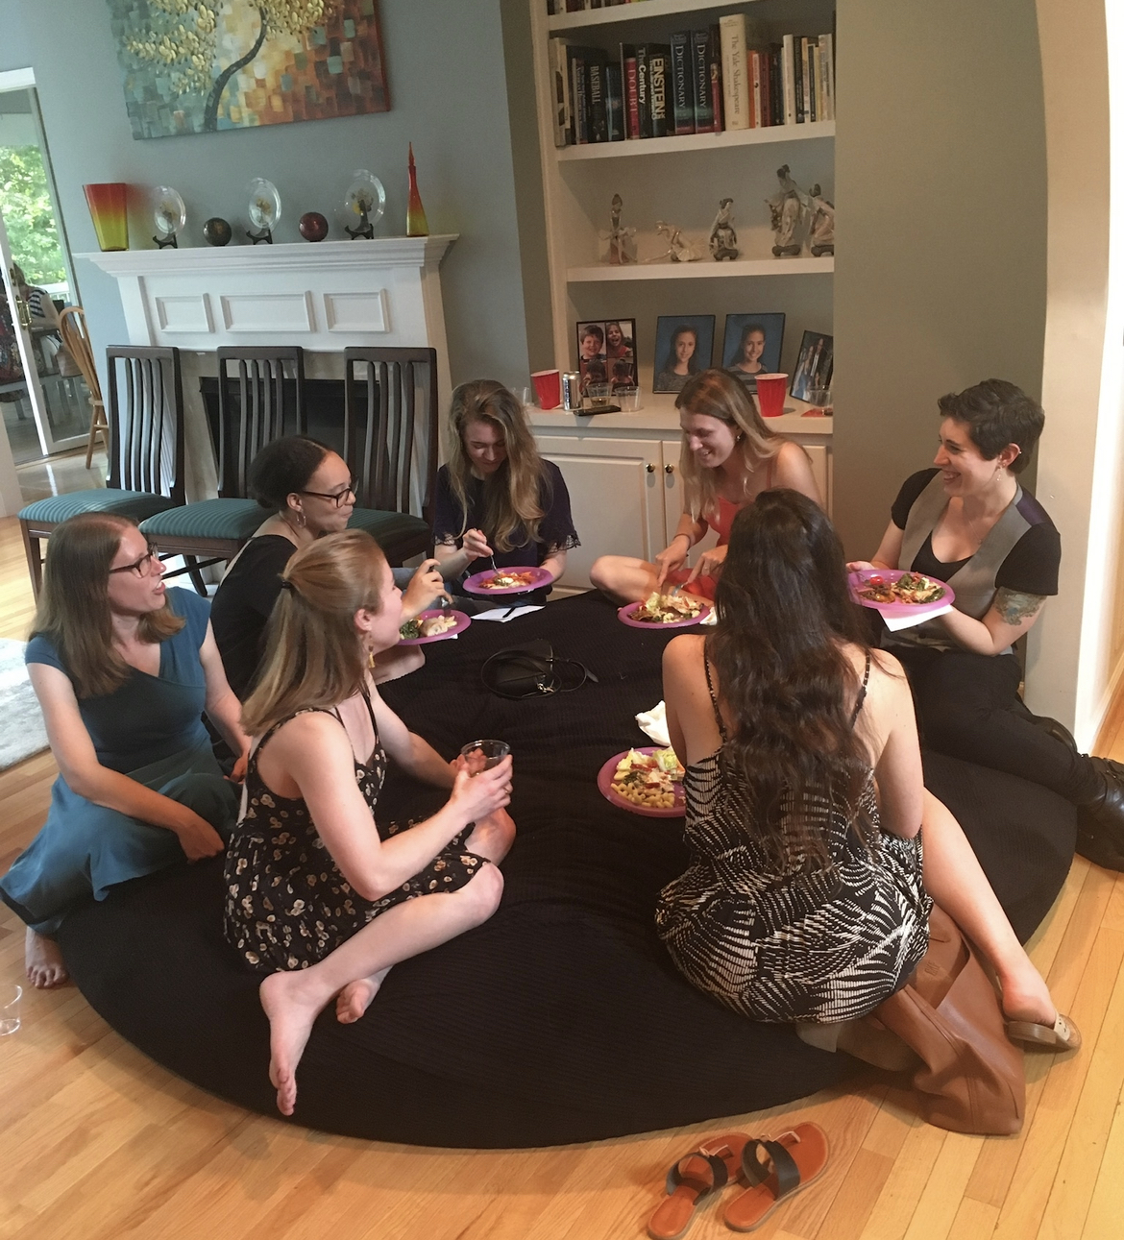
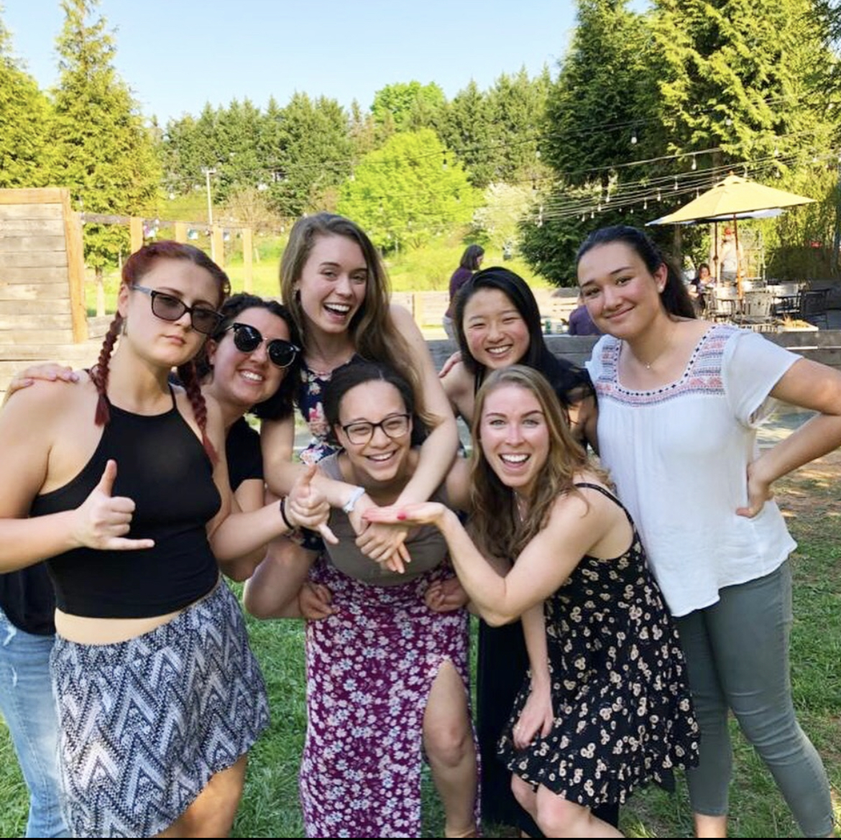
Dissertation Committee:
Joseph Allen
Noelle Hurd
Jessica Connelly
Jospia Roska
Co-Authors:
Corey Pettit
Gabrielle Hunt
Alison Nagel
Ariana Rivens
Olivia Hazelwood
Kliff-Vida Lab:
Alison Nagel
Jessica Stern
Audrey Alexander
Alida Davis
Jennifer Mitchell
Olivia Hazelwood
Margaret Brehm
Lauren Breeden
Amanda Hellwig
Gabby Hunt
Corey Pettit
Ariana Rivens
Natasha Bailey
This study was supported by grants from the National Institute of Child Health and Human Development and the National Institute of Mental Health (R37HD058305, R01-MH58066, & F32HD102119) to Joseph Allen.
mac4qe@virginia.edu
@MeghanACostello

