Slide 1
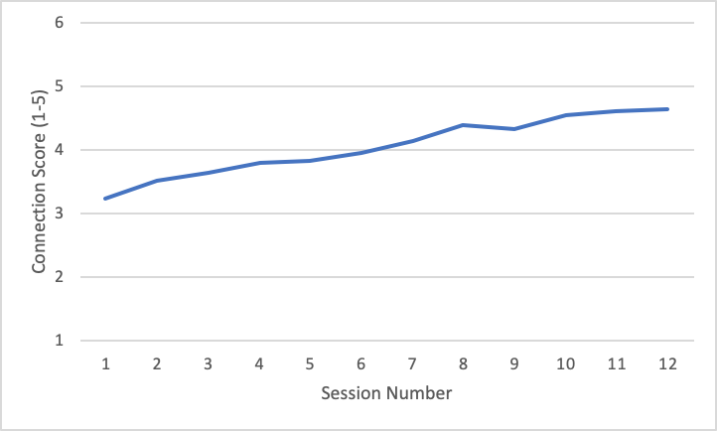
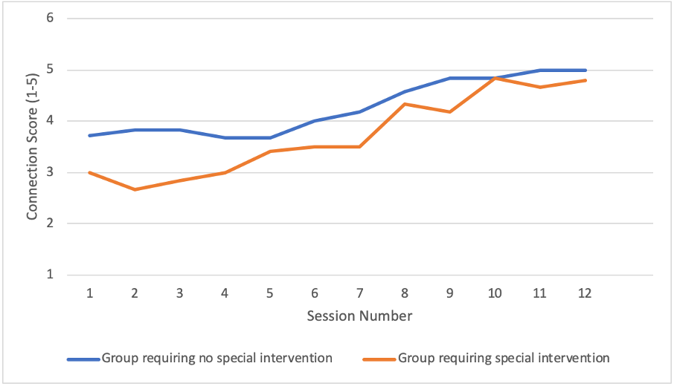
“How Connected Do You Feel to Your Group?”: An Incremental Improvement Approach to a Group-Based Social-Belongingness Intervention for College Students
Alison G. Nagel*, Olivia Hazelwood*, Meghan Costello, Gabriel Hunt, Corey Pettit, Ariana Rivens, Joseph Allen
Introduction
Continuously assessing patients' progress helps clinicians modify treatment and increase effectiveness, particularly for clients predicted to have poor outcomes (Lambert et al., 2018).
In education-based interventions, researchers have called for a similar incremental improvement approach to improve student outcomes (Bryk, 2015).
Practical measurements provide quick and sensitive data to adjust intervention programming in real-time (Yeager et al., 2013).
Triangulation with other types of data can better contextualize these findings (Oliver-Hoyo & Allen, 2006).
This paper examines the incremental improvement process of a group-based, social belongingness intervention for college students – The Connection Project (TCP) – shown to reduce loneliness and depression and increase belongingness (Costello et al., 2022).
Program and Measures
TCP takes groups of 6-10 students through a 12-session curriculum led by 2 undergraduate facilitators.
Each week, participants complete a short survey asking, “How connected do you feel to your group members after tonight’s session?” from 1 (not at all connected) to 5 (extremely connected).
A clinical supervisor uses a triangulation approach to interpret these scores alongside similar facilitator ratings of group-level connection and their own observations.
The average ‘Connection Score’ both within and across all groups is then used to make continuous improvements at the (1) individual group level and (2) the overall program level.
Discussion
1. Connection Scores can be used to inform group-level, real-time improvements to.:
Evaluate the level of agreement between facilitators’ and participants’ Connection Scores.
Normalize difficulties during the “storming” stage of group development (Tuckman & Jenson, 1977; see Figure 1).
Provide specific modifications to groups less likely to connect; TCP groups with lower initial levels of openness are less likely to bond than groups with higher initial openness (Nagel, 2019), and Connection Scores helped identify groups with below-average starting scores to adapt the intervention (see Figure 2).
2. Connection Scores can be used to iteratively improve the overall program.
A decrease, plateau, or inconsistency across groups’ Connection Scores for a given session flagged a weak point in the curriculum, leading to program improvements (curriculum changes, improvements in facilitator and supervisor training).
Connection Scores were then compared across semesters to evaluate the effectiveness of modifications.
Figure 1. Average Connection Scores across all groups all sessions.
Note. Includes Connection Scores from the Fall 2021, Spring 2022 and Fall 2022 semesters (n groups = 109; n participants = 958).
Sample Characteristics
Participants in TCP were undergraduate students from a mid-sized public university in the Southern US. | ‘Connection Score’ data were anonymously collected from all participants weekly across 3 semesters.
Semester | N Students | N Surveys | N Sessions
Fall 2021 | 284 | 2,456 | 12
Spring 2022 | 290 | 2,760 | 12
Fall 2022 | 384 | 3,015 | 10
The distribution of gender, racial, and ethnic identities was similar to the university community (59% female, 39% male, 2% other; 55% White, 21% Asian/Pacific Islander, 10% Black, 3% Latinx/Hispanic, 10% multiracial or other).
Figure 2. Comparison of Connection Scores Between a Below Average Initial Connection Score Group Requiring Special Intervention Versus a Group That Did Not Require Special Intervention.
Note. The group represented by the orange line started with a below-average Connection Score and modified intervention strategies in real-time to improve Connection Scores in future sessions; a significant curriculum modification was made at Session 5. The blue line represents a group that followed standard group development and did not need to implement any additional strategies. Modifying the curriculum for the orange group resulted in improved connection scores that rose to match the overall average.
Contact Information: Alison G. Nagel, agn3f@virginia.edu, Olivia Hazelwood, oah4tx@virginia.edu
This study was supported by grants from The William T. Grant foundation and The President and Provost's Fund at the University of Virginia.

