Slide 1
“It is OK to talk my partner into having sex”: Links between adolescent sexually coercive attitudes, attachment insecurity, and adult relationship functioning
Corey Pettit, Jessica Stern, Joseph Allen
Society for Research on Adolescence

Slide 2
Sexually coercive attitudes in adolescence
General research on sexual coercive attitudes has been promising
Hope to identify:
Why these attitudes develop
2. How they impact romantic relationship functioning

Slide 3
KLIFF study
20+ year longitudinal study tracking 184 kids from age 13 and measuring information about relationships with parents, peers, and romantic partners
Sexually Coercive Attitudes (SCA) Measure:
“It is OK to try to talk someone into having sex, even if they've said they didn't want to.”
“If my boy/girlfriend wanted to have sex and I didn't, it would be OK to say no.”
Attachment with parents
SCA measured each year
Romantic relationship qualities
Age 13
Age 17
Age 22
Age 23
Age 32
Notes:
Measures general attitudes about how acceptable it is to express sexual autonomy
Rather than trying to measure

Slide 4
KLIFF study
20+ year longitudinal study tracking 184 kids from age 13 and measuring information about relationships with parents, peers, and romantic partners
Sexually Coercive Attitudes (SCA) Measure:
“It is OK to try to talk someone into having sex, even if they've said they didn't want to.”
“If my boy/girlfriend wanted to have sex and I didn't, it would be OK to say no.”
Attachment with parents
SCA measured each year
Romantic relationship qualities
Age 13
Age 17
Age 22
Age 23
Age 32
Notes:
Measures general attitudes about how acceptable it is to express sexual autonomy
Rather than trying to measure

Slide 5
Attachment and sexual motivations
Anxious:
Desire to feel close to partner
Avoidant:
Desire to maintain personal control and keep distance in relationships
Reluctance to discuss sex
Linked to manipulation and subverting sexual desires
Secure:
Desire to have sex as part of committed relationships
Notes:
Sex is an attachment process in many ways – intimacy, reassurance
WHY LOOK AT WITH SCA SPECIFICALLY?

Slide 6
Attachment and sexual motivations
Anxious:
Desire to feel close to partner
Linked to manipulation and subverting sexual desires
Secure:
Desire to have sex as part of committed relationships
Avoidant:
Reluctance to discuss sex
Desire to maintain personal control and keep distance in relationships
Notes:
Sex is an attachment process in many ways – intimacy, reassurance
WHY LOOK AT WITH SCA SPECIFICALLY?

Slide 7
Attachment and sexual motivations
Anxious:
Desire to feel close to partner
Linked to manipulation and subverting sexual desires
Secure:
Desire to have sex as part of committed relationships
Avoidant:
Reluctance to discuss sex
Desire to maintain personal control and keep distance in relationships
Notes:
Sex is an attachment process in many ways – intimacy, reassurance
WHY LOOK AT WITH SCA SPECIFICALLY?

Slide 8
 | Sexually Coercive Attitudes (age 17-22)
Variable | B | SE (B) | β | 95% CI | R | R² | $∆$R²
Step 1 |  |  |  |  | .40 | .16 | .16
Gender | .38 | .07 | .40 | [-1.51, 1.40]
Family Income | .03 | .02 | .11 | [-.82, .63]
Step 2 |  |  |  |  | .44 | .19 | .03
Secure Attachment (age 13) | -.08 | .09 | -.10 | [.09, .26]
F | 12.83*
*p < .05. **p < .01.

Slide 9
KLIFF study
Relationship with parents
SCA measured each year
Romantic relationship qualities
Age 13
Age 17
Age 22
Age 23
Age 32

Slide 10
SCA and adult relationship functioning
Sexual aggression
Validates measure as a predictor of sexual coercion
Psychological aggression
Broader attempts of control
Autonomy and relatedness undermining
Applied measure of attachment in relationships
Notes:
-reports from both partners

Slide 11
SCA and adult relationship functioning
Sexual aggression
Validates measure as a predictor of sexual coercion
Psychological aggression
Identifies SCA as indicative of broader attempts of control
Autonomy and relatedness undermining
Applied measure of attachment in relationships
Notes:
Reports from both parnters

Slide 12
SCA and adult relationship functioning
Sexual aggression
Validates measure as a predictor of sexual coercion
Psychological aggression
Identifies SCA as indicative of broader attempts of control
Hostility during conflict
Links SCA to an observed measure of negative relationship behaviors
Notes:
Reports from both parnters

Slide 13
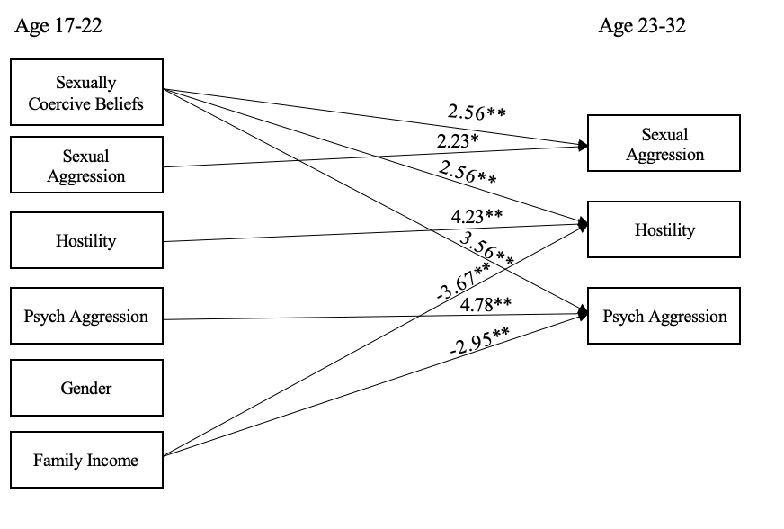

Slide 14
Key Takeaways
Sexually coercive attitudes related to attachment orientation.
Sexually coercive attitudes linked to a variety of negative relationship behaviors.
Notes:
A relationship orientation characterized by trust and intimacy may be protective against sexually coercive attitudes
Targeting adolescent attitudes about sexual coercion could have reverberating implications in reducing relationship aggression.

Slide 15
References
Mikulincer, M. (2006). Attachment, caregiving, and sex within romantic relationships. Dynamics of romantic love: Attachment, caregiving, and sex, 23-44.
Tracy, J. L., Shaver, P. R., Albino, A. W., & Cooper, M. L. (2003). Attachment styles and adolescent sexuality. Adolescent romance and sexual behavior: Theory, research, and practical implications, 137-159.
Karantzas, G. C., McCabe, M. P., Karantzas, K. M., Pizzirani, B., Campbell, H., & Mullins, E. R. (2016). Attachment style and less severe forms of sexual coercion: a systematic review. Archives of sexual behavior, 45, 1053-1068.
Cadely, H. S. E., Finnegan, V., Spears, E. C., & Kerpelman, J. L. (2020). Adolescents and sexual risk-taking: The interplay of constraining relationship beliefs, healthy sex attitudes, and romantic attachment insecurity. Journal of adolescence, 84, 136-148.
Gentzler, A. L., & Kerns, K. A. (2004). Associations between insecure attachment and sexual experiences. Personal relationships, 11(2), 249-265.
Davis, D., Shaver, P. R., & Vernon, M. L. (2004). Attachment style and subjective motivations for sex. Personality and social psychology bulletin, 30(8), 1076-1090.

Slide 16
Thank you!
Kliff lab
Kliff participants
National Institute of Child Health and Human Development and National Institute of Mental Health (R37HD058305, R01-MH58066, & F32HD102119)

