Slide 1
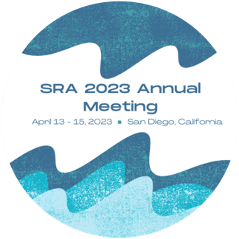
Empathy Across 3 Generations
Jessica Stern, University of Virginia
Notes:
thx Yuhang
intro/ name
today presenting findings from 25-yr long study of teens, parents, & peers to examine how the capacity to show empathy for others is transmitted from 1 gen to the next.

Slide 2
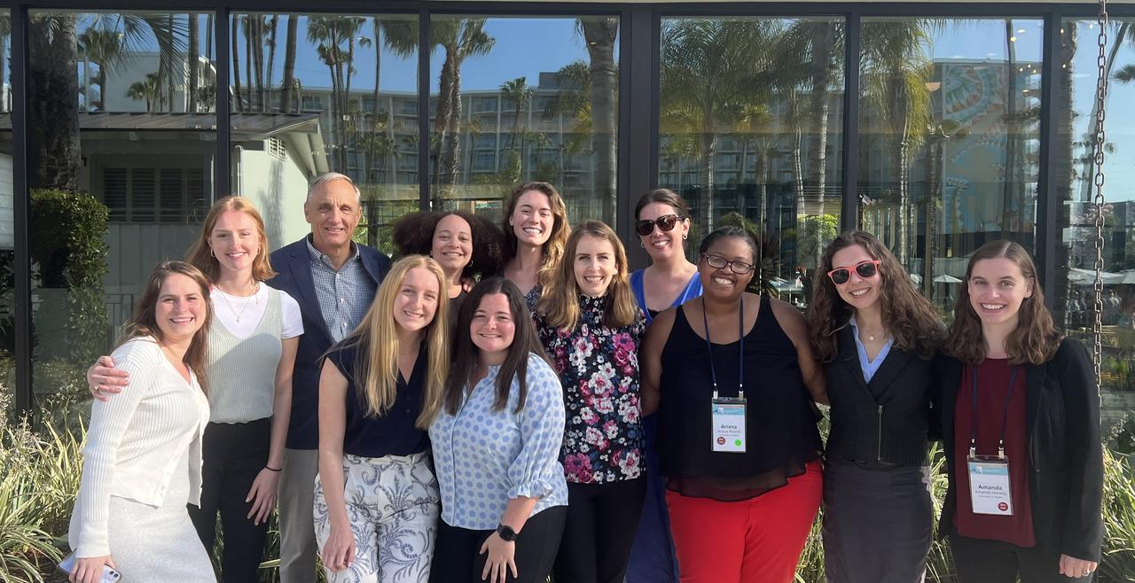
Thank you!
Co-authors:
Amanda F. Hellwig
Meghan A. Costello
Jennifer Mitchell
Joseph P. Allen
Special thanks to RAs and Project Coordinators
past and present!
Notes:
FIRST: Everything you’re about to see is the result of a huge collaborative effort,
led by Joe Allen and supported by incredible grad students, research assistants, & project coordinators.
I esp. want to thank our coauthors & funders, who make this type of intensive longitudinal work possible.

Slide 3
Empathy
Cognitive Empathy
Understanding others’ experience
Identifying others’ emotions
Perspective-taking
‘I know how you feel’
Emotional Empathy
Feeling concern for others’ welfare
Resonating with others’ emotions
Affect mirroring
‘I feel what you feel’
Supportive Behavior
Taking action for others’ welfare
Prosocial behavior (help, comfort)
Presence/ showing up
‘I do something to help you feel better’
Batson, 2009; Decety, 2015; Eisenberg, 2000, 2017
Notes:
wanna start w/ Q of what emp is & why it matters for healthy dev
bc emp is NOT JUST ONE THING— multidimensional construct, involving:
COG capacities
a second dim. is EMO emp… well-regulated, other-focused emo emp. is often a key driver of…
SUPP BX…
Across each of these dims, huge INDIV DIFFS & these diffs are consequential: - Parents’ emp for child shapes quality of p-c rel’n
- teens’ emp facilitates pos peer interactions
- and LACK of emp in teens & adults has been linked to aggression and abuse.
SO it’s important to understand dev roots of these diffs.

Slide 4
Intergenerational transmission of empathy
Genetics (Knafo et al., 2008, 2009)
Socialization (Eisenberg et al., 1993, 2000)
Modelling (Zahn-Waxler et al., 1984)
First-hand experience → secure attachment (Stern et al., 2015, 2021; Stern & Cassidy, 2018)
Learning and practice (Gordon, 2009)
Notes:
more specifically, we were interested in how emp is transmitted across gens.
prev work has shown modest assoc. btwn parents’ & teens’ emp,
but typically studies have relied on self report at a single time pt, examining at most 2 gen (parent & ch).
this prev research suggests that emp is transmitted via multiple mechanisms:
Genetic contribution, particularly from the dopamine D4 receptor gene... which interact w/ env influences like:
Socialization, like parents encouraging their teen to be more empathetic to younger sib
one type of soc is Modelling, where parents set example by demo. empathy toward other ppl
But beyond modeling emp toward others generally, we have proposed that teens’ first hand exp of parents’ emp. may contribute to teens’ secure attachment, which in turn predicts teens’ own care for others.
Importantly, emp is a skill that can be learned & honed with practice, such that initial skills acquired in home may be further developed in mutually supp interactions w/ peers
In present study, we focus on factors in the SOC env, but note that genes certainly are playing a role as well.

Slide 5
Developmental processes in adolescence
Sensitive period of brain development (Blakemore, 2008)
heightened neural responsiveness to peers
advances in empathy forecast adult social competence (Allemand et al., 2015)
Normative shift from parents to peers
experiences with parents shape peer relationships
peer relationships begin to surpass parents as sources of long-term influence (Allen et al., 2021)
Notes:
So why look at these processes in adol? I probs don’t have to convince this grp about importance of dev timing, but briefly:
[go quickly thru]
But we don’t know much about whether experiences w/ peers in adol influence parenting bx in adult.

Slide 6
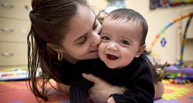
Theoretical Model
Supportive Responses to Child Distress
Parent Empathic Support for Teen 13y (G1)
Teen Empathic Support for Friends 13-16y (G2)
Teen Empathic Support for Friends 17-19y
Child Empathy (G3)
–
–
Non-supportive Responses to Child Distress
Early adolescence:
parent-teen empathy
Later adolescence:
teen-peer empathy
Adulthood:
parent-child empathy
Notes:
Based on this work, the present study tested a theoretical model,
beginning in early adol & spanning into adulthood.
We hypothesized that parents’ emp for teens… cd call this a "pay it forward" pathway -- the emp I receive is the emp I give to friends
Because teens have honed their emp & caregiving skills by practicing w/ peers in adol, perhaps this will influence the way they parent as adults.
Specifically, because they provided supp in response to their friends' emo distress, they may be better equipped to engage in more supp & less non-supp responses to their child's emo distress, which in turn might support emp in the next gen.
In the present study, we test this model in 2 parts, which I’ll explain next.

Slide 7
Method: Participants
N = 184 (98 females), mid-Atlantic U.S.
assessed annually from age 13-32
58% White, 29% Black, 8% multiracial, 5% other groups
mothers, fathers, nominated closest friend
Subsample of n = 60 participants who had data on at least one child (ages 3-8) by Wave 21 (age 32)
Notes:
ppts drawn from ongoing long study of teens
assessed annually…
sample was diverse & broadly rep of comm. from which it was drawn
teens participated alongside their M, F, & nominated same-sex best friend at each wave PAUSE
As ppts entered adulthood, we tracked who became parents. By age 32, approx. 74 ppts. had children.
CLICK: In the present analyses, we focus on the 60 participants who consented to provide data for at least 1 child ages 3-8.
we focus on participants’ first child in analyses.
However, results w/ this subsample are preliminary, as we're continuing to collect these data.

Slide 8
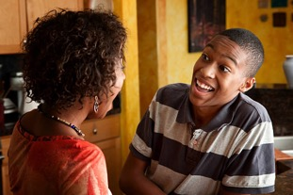
Method: Observed Empathy (G1-G2)
Supportive Behavior Task – parent & peer versions (Allen et al., 2001)
emotional empathy
emotional engagement
cognitive empathy
accurate identification of the support-seeker’s problem
supportive behavior
instrumental support
emotional support
Notes:
Interested in assessing emp observationally, moving beyond traditional self-report measures.
Team of coders coded video-recorded interactions in the supportive behavior task, in which one person talks to a partner about “problem they were having that they could use some advice or support about” for 6min.
Did this 2 WAYS:
First, we observed teens SEEKING support from parents. In present analyses, we focus on mothers, but we are actively coding interactions w/ fathers as well.
Second, we observed teens PROVIDING support to their best friend. So we get a picture of BOTH the supp teens RECEIVE from parents + qual of supp they can GIVE to peers.
To code the core dimensions of emp, we focused on the bx of supp PROVIDER— mothers in the parent task, and teens in the peer task.
to capture EMO emp, coded extent to which the supporter appears to be connected to and emotionally engaged with the person seeking help.
to cap COG emp, coded whether supporter accurately ID'd the other's problem
we used TWO indicators of supp beh: instrumental supp (such as offering help to address the prob) & emo supp (such as validating the other’s feelings)
each type of bx was coded on a scale from 0 to 4, and showed good interrater reli.
bc 4 scores were correlated, we averaged them to create an emp composite, with higher scores indicating greater emp, following prev work.
In sum, we combined 4 observed indicators to derive scores for mothers’ emp toward their teen, and teen’s emp toward their best friends at each wave, spanning age 13-19.

Slide 9
Method: Reported Empathy (G2-G3)
Parents’ Responses to Child Distress (CCNES; Fabes & Eisenberg, 1998)
supportive responses: problem-focused, emotion-focused, expressive encouragement
non-supportive responses: minimizing, punitive, distressed
Child Empathy Scale (SSIS; Gresham & Elliot, 2008)
parent-report of child’s empathy toward others
Notes:
IF ppts had children, they were invited to complete a set of Qs including:
The coping with ch’s neg emo scale, which includes factor tapping parents' supportive resp. to children's negative emotions–resp that address the ch's problem or sooth the emotion, or encourage their emo expression
also includes factor capturing NON-SUPP resp. -- where parent minimizes or punishes ch's distress, or becomes distressed themselves
Ppts. also reported on child’s soc beh using Social Skills Improvement System //subscale for child empathy

Slide 10
Results: Model 1 (G1-G2; N = 184)
Mom Empathic Support for Teen 13y
.12**
Teen Empathic Support for Friends 13-16y
.50**
Teen Empathic Support for Friends 17-19y
Indirect effect = .06, 95% CI [.02, .12], p= .014
*p < .05, **p < .01, ***p < .001. covariates: gender, income
Notes:
In Model 1, we examined pathways from parents’ to teens’ emp. using the full sample, controlling for teen gender and family income.
As predicted…

Slide 11
Results: Model 2 (G2-G3; N = 60)
Indirect effect = 1.24, 95% CI [0.13, 2.93], p= .076
Supportive Responses to Child Distress
10.22*
.12**
Teen Empathic Support for Friends 17-19y
Child Empathy
ns
Non-supportive Responses to Child Distress
ns
*p < .05, **p < .001. covariates: gender, income
Notes:
In model 2, we examined pathways from teens’ emp for peers to parenting & child outcomes,
focusing only on the subsample of ppts who had children.
We found that...
suggesting that there's something specific about the transmission of pos, supp processes

Slide 12
Conclusions
Teens who experienced empathic support from mothers at age 13 showed greater empathy for close friends across adolescence – “pay it forward”
Teen empathy for close friends showed moderate stability over time – developmental continuity
Empathy for friends at age 17-19 predicted supportive (but not non-supportive) parental responses to children’s distress, scaffolding children’s own empathy – specificity of support
Notes:
...providing supp for a "pay it fwd" pathway

Slide 13
Future Directions
Role of fathers’ empathy
Partners/ coparents & siblings
Beyond parochial empathy: out-group members
Variation by gender, SES, racial identity, cultural context
Moderators and protective factors
What interrupts intergenerational patterns of low empathy?
Notes:
...importantly these pathways may vary by gender...
a particularly exciting next step is to examine moderators of these pathways to address the Q:

Slide 14
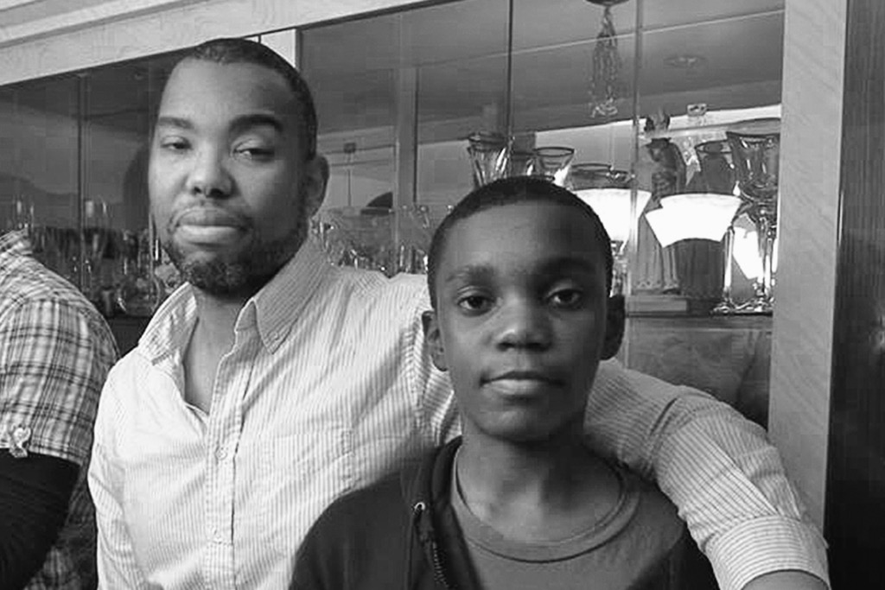
“I didn’t always have things, but I had people—I always had people.
I had a mother and father who I would match against any other… I had friends who would leap in front of a bus for me.
You need to know that I was loved, [that] I have always loved my people and that broad love is directly related to the specific love I feel for you.”
– Ta-Nehisi Coates (2015), Between the World and Me
Notes:
end w/ quote from Ta-Neh-AH-si Coates, writing to his teenage son.

