Slide 1
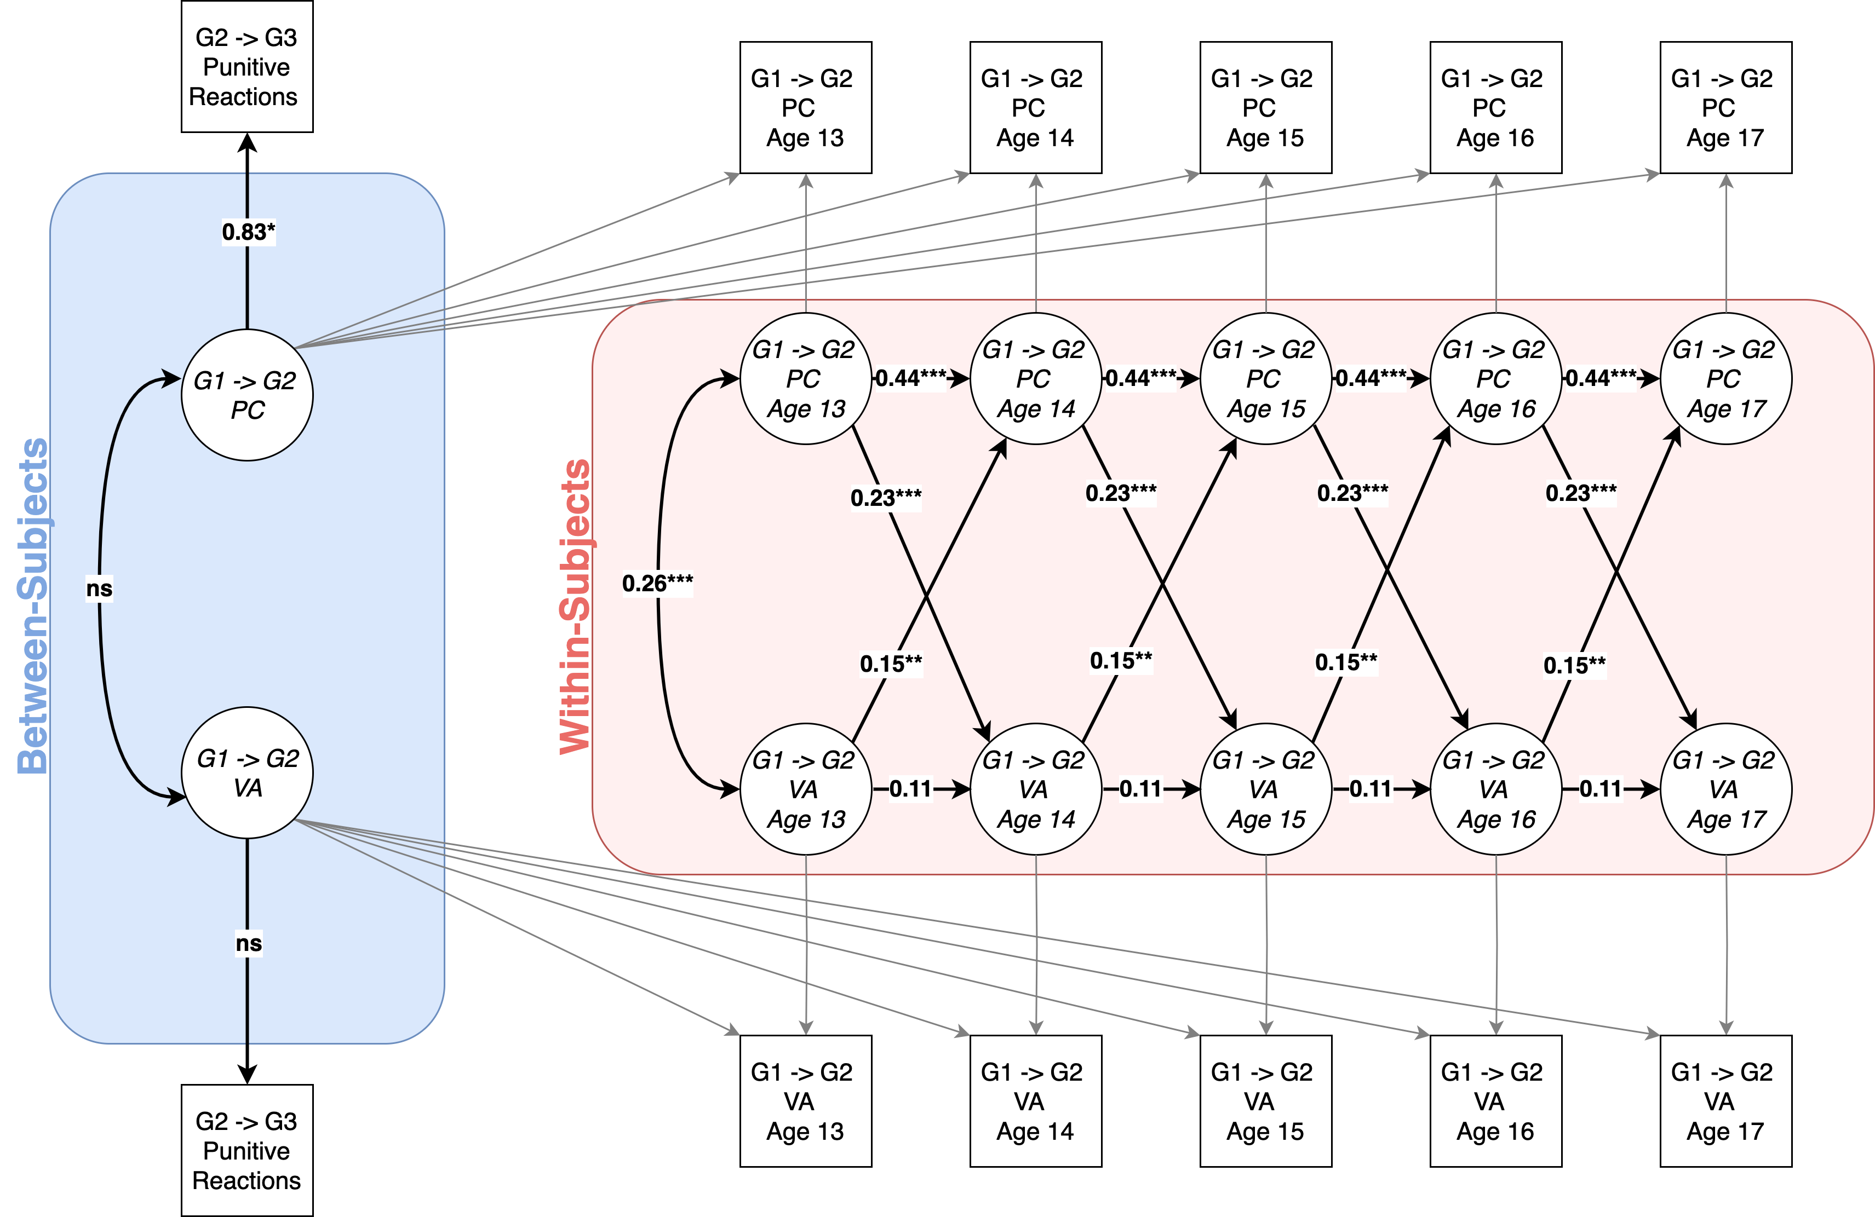
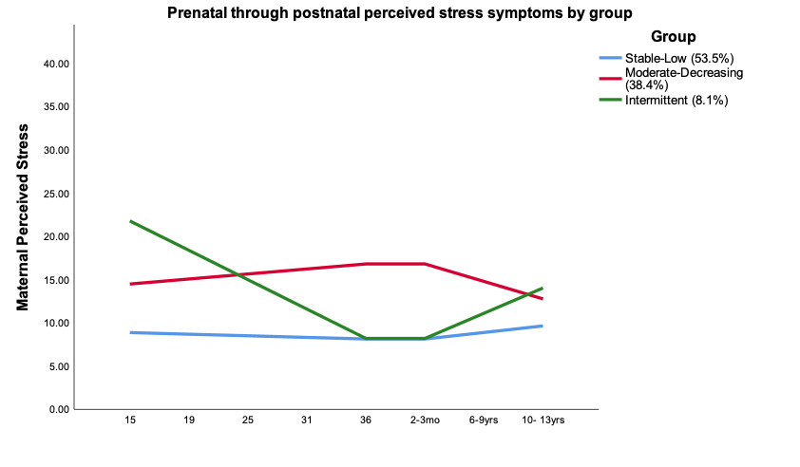
The Dynamic Nature of Parental Psychological Control and Parental Verbal Aggression During Adolescence and Beyond: An Intergenerational Investigation
Natasha Bailey, B.A., Meghan Costello, M.A., Corey Petit, M.A., Jessica Stern, Ph.D., & Joseph Allen, Ph.D.
University of Virginia
Background
Results
Parental psychological control (PC) and parental verbal aggression (VA) exert negative effects on the development of emotion regulation in adolescents.
There may be a recursive developmental process between parental PC and VA across adolescence.
This process may predict harsh parenting behavior in the next generation.
Aims:
1) examine within-person associations between parental PC and VA across adolescence
2) investigate the intergenerational effects of these behaviors
Figure 1. Random intercept cross-lagged panel model of the associations between parental psychological control and parental verbal aggression across adolescence and predictions to participants’ future parental behavior. G1 = Generation 1 (participants’ parents); G2 = Generation 2 (participants); G3 = Generation 3 (participants’ children); PC = Psychological Control; VA = Verbal Aggression.
Methods
Participants were from a multigenerational, longitudinal study of social development.
N=184
85 male, 99 female
58% White, 29% Black, 13% other racial identities
From ages 13-17, participants (Generation 2) reported on their parents’ PC and VA (Generation 1).
In adulthood, participants with children (n=70) provided information on their punitive responses to their own children’s emotions (Generation 3).
Greater parental PC than expected predicted greater parental VA than expected the following year.
Greater parental VA than expected predicted greater parental PC than expected the following year.
Participants who experienced more PC from parents during adolescence were more likely to exhibit punitive responses toward their own future offspring’s emotions.
Discussion
Parental psychological control and verbal aggression have a transactional relationship across adolescence.
Experiencing parental psychological control may shape the development of adolescents’ emotion regulation abilities, thereby increasing the likelihood that they will respond harshly to their future children’s displays of emotion.
Acknowledgements: Preparation of this manuscript was supported by the Eunice Kennedy Shriver National Institute of Child Health & Human Development and the National Institute of Mental Health (R37HD058305, R01-MH58066, & F32HD102119).

