Slide 1
How Teens Balance Conflict with Fathers and Peers: A Within-Person Examination Using RI-CLPM
Natasha A. Bailey, Meghan A. Costello, Jessica A. Stern, Alida A. Davis, & Joseph P. Allen
University of Virginia
Notes:
Hi everyone, my name is Natasha Bailey and I’m currently a first-year doctoral student in the Clinical Psychology PhD program at the University of Virginia working with Dr. Joe Allen. Today I am excited to tell you “How Teens Balance Conflict with Fathers and Peers: A Within-Person Examination Using RI-CLPM”

Slide 2
Introduction
Parent and peer contexts are mutually reinforcing in adolescence
Compensation: high aggression in one relationship → less aggression in another relationship
Hamaker et al., 2015; Sheeber et al., 2007; Shek & Ma, 2001; Steinberg & Silverberg, 1986
Notes:
Parent and peer relationships are distinct, yet mutually reinforcing contexts during adolescence. [click] If an adolescent has an aggressive, conflictual relationship in one of these contexts, it’s possible that they’ll have an aggressive, conflictual relationship in the other context. However, multiple highly aggressive relationships are aversive, especially during adolescence. Therefore, [click] it’s also possible that teens may behave in a compensatory way, whereby they react to high levels of aggression in one relationship by behaving in a way that’s less aggressive or more harmonious in another relationship. Compensatory behaviors seem especially important to examine within the context of father-adolescent relationships, as aggression between adolescents and fathers is a stronger predictor of poor mental health in teens than aggressive mother-adolescent relationships.

Slide 3
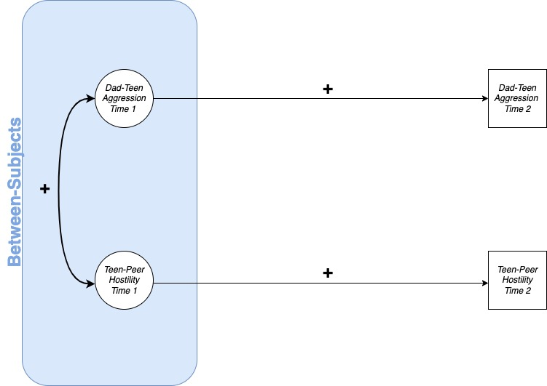
Notes:
However, the challenge to examining this compensation hypothesis across father and peer contexts is that compensatory behaviors can be difficult to detect statistically given that, in general, past aggression in relationships is positively associated with future aggression. Therefore, a statistical approach that distinguishes between-subjects effects (such as greater aggression overall) [click] from within-subjects effects (such as reactions to specific instances of aggression) is needed to examine this question. Random intercept cross-lagged panel modeling or RICLPM is a statistical technique that separates between and within-person variance and allows us to examine the extent to which deviations from expected levels of a construct in one context (such as psychological aggression in father relationships) forecast future change in another context (such as hostility in peer relationships). Therefore, the current study used RI-CLPM to examine associations between father-adolescent psychological aggression and adolescent-peer hostility over a 5-year period.

Slide 4
Methods
Participants (N = 184)
Assessed annually from ages 13-17
86 male, 98 female
Median family income: $40,000-$59,999
Race/ethnicity
58% White
29% Black or African American
8% Mixed race/ethnicity
5% ther minority groups
Psychological aggression measured via the Conflict Tactics Scale
Father-on-adolescent psychological aggression (experiencing aggression from father)
Adolescent-on-father psychological aggression (perpetrating aggression toward father)
Hostility toward peer measured via conflict discussion task
Notes:
Participants were a community sample of 184 adolescents participating in a larger longitudinal study of adolescent social development. Participants were assessed annually from ages 13-17. [click] Each year, they completed the Conflict Tactics Scale, which assessed the extent to which they experienced psychological aggression from their father and the extent to which they perpetrated psychological aggression toward their father. [click] Each year they also participated in a videotaped conflict discussion task with a close peer that was coded for hostile behavior, such as interrupting or making rude statements toward their peer.

Slide 5
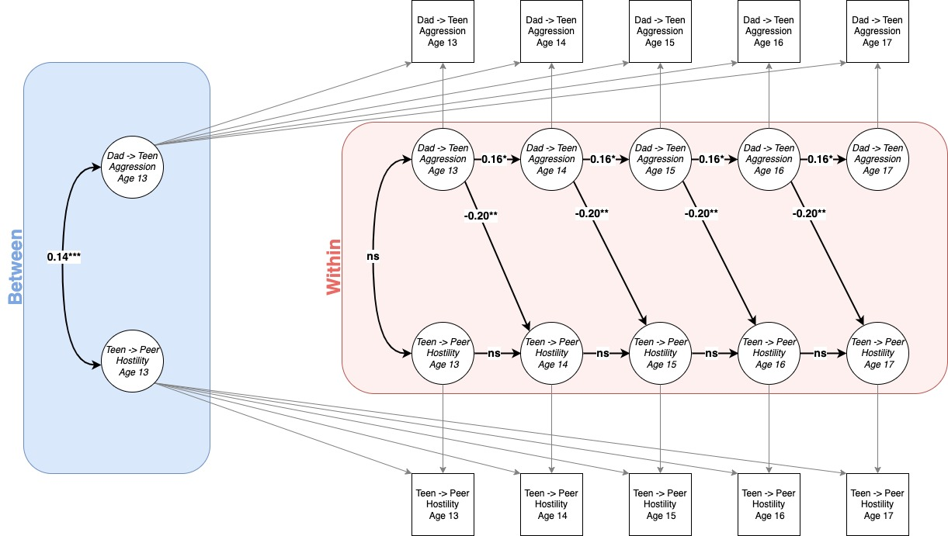
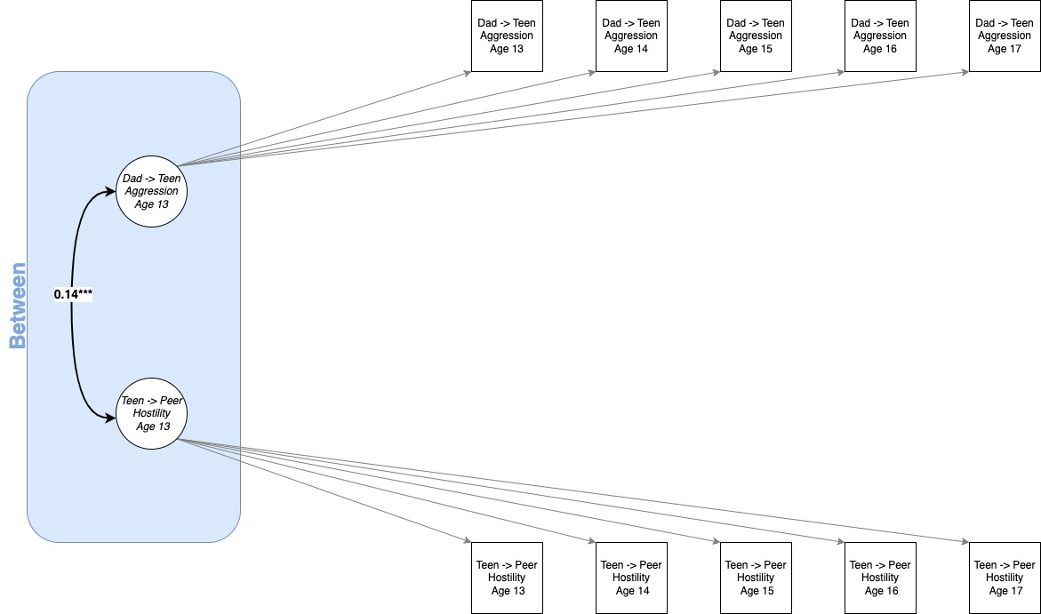
Results
*adjusted for participant gender & family income
Notes:
For the sake of time, I’m going to focus on the results for father-on adolescent psychological aggression, but findings for adolescent-on-father psychological aggression were highly similar. At the between-subjects level, there is a positive association between father-on-adolescent aggression and adolescent-peer hostility. However, [click] when looking at the cross-lag pathways, we see that adolescents who experienced more psychological aggression from their father were less likely to display hostility toward their peer the following year. This means that when teens perceived their fathers to be more aggressive than expected based on their longer-term pattern of behavior, these adolescents were subsequently less hostile with their peers than would otherwise be expected. Additionally [click], adolescents who displayed more hostility toward their peer than expected based on their overall pattern of hostility at a particular assessment were less likely to report experiencing psychological aggression from their father the following year

Slide 6
Conclusions
Findings provide evidence for compensation across father and peer relationships
Compensatory behaviors were only visible because of the use of RI-CLPM
Short-term behavior change is more actionable for intervention
Notes:
Our findings provide evidence for compensatory behavior across father and peer relationships. These patterns of behavior would not have been observed without the use of RI-CLPM. At a between-subjects level, greater father-on-adolescent aggression was associated with greater adolescent-peer hostility. However, when we separated these between-subjects effects from within-subjects effects, we observed short-term deviations from this overall positive association between aggression across father and peer contexts. These short-term behavior changes are exactly what is of interest to both clinicians and parents focused on intervening to change behavior from a given state. Thus, the current study provides support for the existence of compensatory dynamics between father and peer contexts that are otherwise obscured by cross-sectional designs or between-subjects analytic approaches, thereby highlighting the utility of RI-CLPM as a statistical technique for examining longitudinal within-person effects.

Slide 7
Acknowledgements
KLIFF/VIDA Lab
Joseph Allen
Jessie Stern
Alison Nagel
Meghan Costello
Alida Davis
Amanda Hellwig
Corey Petit
Gabby Hunt
Ariana Rivens
Margaret Brehm
Olivia Hazelwood
Lauren Breeden
Jen Mitchell
Questions?
ufy2fb@virginia.edu
Twitter: @NatashaBailey88
R37HD058305, R01-MH58066, & F32HD102119
Notes:
I’d like to thank my co-authors and the rest of my lab for their collaboration and support of this project, the participants of the KLIFF/VIDA study, and our funding sources. Thank you all for listening.

Slide 8
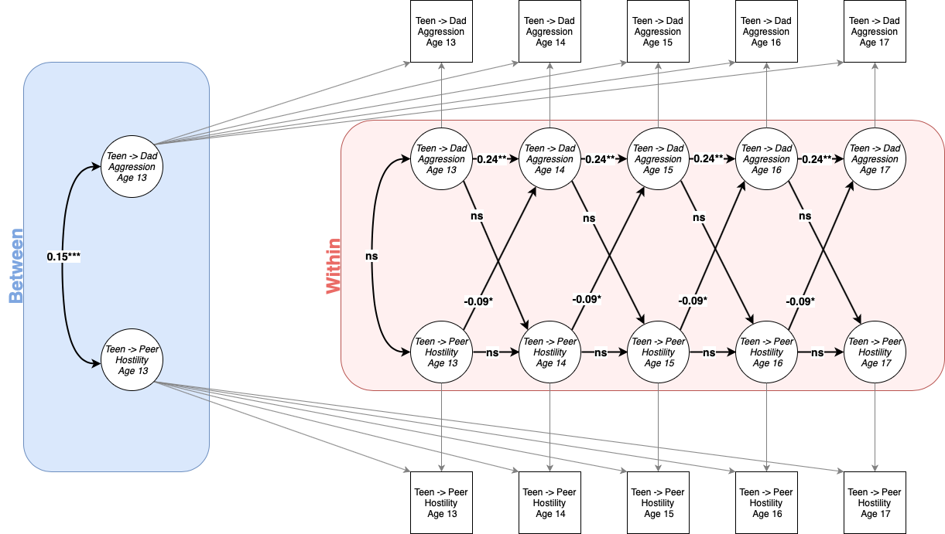
Results
*adjusted for participant gender & family income
Notes:
A similar pattern of results was observed for the adolescent-on-father aggression model. Again, there’s a positive association between adolescent-on-father aggression and adolescent-peer hostility. [click] Although the cross-lag path between adolescent-on-father psychological aggression and adolescent hostility toward their peer failed to reach statistical significance, [click] teens who displayed more hostility toward their peer than expected at a particular assessment were less likely to engage in psychological aggression towards their father the following year.

