Slide 1
Support-Seeking Topics, Self-Disclosure, and Emotional Support from Best Friends in Adolescence: Emergent Themes and Associations
Meghan Costello, M.A., Margaret Brehm, B.A., Ariana Rivens, M.A., Alison Nagel, Ph.D., Joseph Allen, Ph.D.
University of Virginia

Slide 2
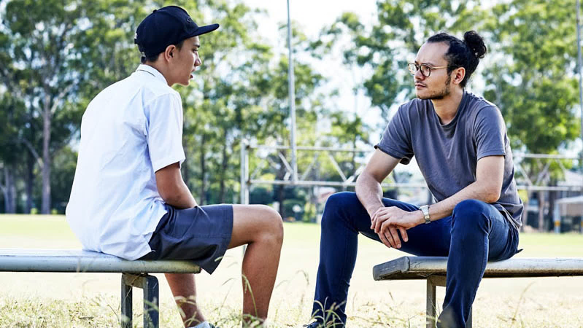
The ability to seek and provide supportive care is necessary for establishing and maintaining intimate relationships. (Cassidy, 2001)
Asking for social support is inherently vulnerable, and incurs social risk that adolescents are particularly sensitive to. (Somerville, 2013)
Developing the ability to express a need for support requires repeated opportunities to practice and learn. (Costello et al., 2022; Mikulincer & Shaver, 2020)
There is known variation in adolescents’ ability to seek support. (Allen et al., 2023)
Adolescents are active participants in their own development. (Bauminger et al., 2008)

Slide 3
What do adolescents discuss with their best friends when prompted to seek support about anything for which they want help, support, or advice?
How is topic choice related to supportive processes?

Slide 4
Kliff-Vida Sample
99
85
$40,000
Race Representation

Slide 5
Close Friends
We’d like to get an idea of who your friends are and who you ‘hang around’ with. You may include boys, girls, or both when thinking about these friends. We’d like you to think of people around your age who you know. For example, you might think of:
People at school who are in your classes or lunch
Kids from your neighborhood or who live near you
Kids who you know from activities like band, sports, or club

Slide 6
Supportive Behavior Task
Support-seeking topics
Self-disclosure by adolescent
Emotional support given by best friend
1998-2004
Age 13-18
13
14
15
16
17
18
1998
2004

Slide 7
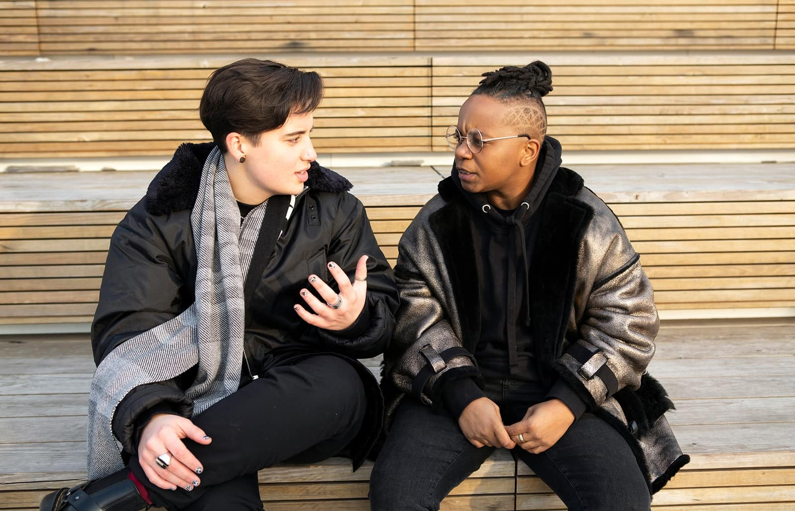
Supportive Behavior Task
“Discuss some problem in your life for six minutes. It doesn’t have to be the most challenging thing you’re dealing with, just something you’d like help, advice, or input on.”
Topics - transcription of first 30 seconds, applied consensual coding process: (Spangler et al., 2012)
Reviewed all transcriptions, devised a list of codes, and came to consensus on a final list of 10
Applied codes (ICC = .96), reached consensus about all disagreements
Behavioral coding by 2 graduate student coders:
Self-disclosure
Emotional support provided

Slide 8
What do adolescents discuss with their best friends when prompted to seek support about anything for which they want help, support, or advice?
How is topic choice related to supportive processes?

Slide 9
10 Support Topics
Academic Concern/ Teacher Conflict | Age 18: “My question is what can I do to stay more focused while in school man? As far as school work, how to really crack down, like, just focus and get good grades like you.”
Extracurriculars/Sports | Age 13: “My topic is about basketball. Could you give me some advice about how to do better?”
Future Planning | Age 18: “Ok, my topic is what kind of advice can you give me about college? Like what schools should I go to, what should I look for in a school, and umm…that’s about it.”
Money/Jobs | Age 13: “I need some money to get a CD, but I have no money. What do you think I could do to raise some money?”
Other | Age 18: “I want to know your opinion about whether or not I should pierce the other side of my lip.”
Parent/Parent Conflict | Age 13: “Don’t you think I am old enough to go outside by myself? Mom don’t let me do nothing, she don’t even let me stay in the house by myself for long. What do you think I should do about that?”
Peers/Peer Conflict | Age 18: “My question was what’s up with [Friend] and is there any hope of anything ever happening again? I don’t know what’s going on, it’s so weird still, ‘cause I’ve been getting weird emails from her.”
Romantic Partners/Dating | Age 13: “Given the fact that I know I can trust you and expect you not to tell anybody…there’s this guy at school and I don’t know if I like him or not.”
Siblings/Sibling Conflict | Age 17: “Wondering whether I should be worried about it…he doesn’t tell me shit about what goes on and that’s probably mostly because I’m his older brother but uh, recently you know I know he goes downtown and gets drunk and stoned and is that enough of a reason for me to worry about him?”
Trips/Travel/Logistics | Age 13: “You know how they are going on that ski trip? …Do you think I should go?”

Slide 10
Academic Concern/ Teacher Conflict | Age 18: “My question is what can I do to stay more focused while in school man? As far as school work, how to really crack down, like, just focus and get good grades like you.”
Extracurriculars/Sports | Age 13: “My topic is about basketball. Could you give me some advice about how to do better?”
Future Planning | Age 18: “Ok, my topic is what kind of advice can you give me about college? Like what schools should I go to, what should I look for in a school, and umm…that’s about it.”
Money/Jobs | Age 13: “I need some money to get a CD, but I have no money. What do you think I could do to raise some money?”
Other | Age 18: “I want to know your opinion about whether or not I should pierce the other side of my lip.”
Parent/Parent Conflict | Age 13: “Don’t you think I am old enough to go outside by myself? Mom don’t let me do nothing, she don’t even let me stay in the house by myself for long. What do you think I should do about that?”
Peers/Peer Conflict | Age 18: “My question was what’s up with [Friend] and is there any hope of anything ever happening again? I don’t know what’s going on, it’s so weird still, ‘cause I’ve been getting weird emails from her.”
Romantic Partners/Dating | Age 13: “Given the fact that I know I can trust you and expect you not to tell anybody…there’s this guy at school and I don’t know if I like him or not.”
Siblings/Sibling Conflict | Age 17: “Wondering whether I should be worried about it…he doesn’t tell me shit about what goes on and that’s probably mostly because I’m his older brother but uh, recently you know I know he goes downtown and gets drunk and stoned and is that enough of a reason for me to worry about him?”
Trips/Travel/Logistics | Age 13: “You know how they are going on that ski trip? …Do you think I should go?”

Slide 11
1
1
No discussion
Siblings
Peers
Extracurriculars/Sports
Other
Travel/Logistics
Romantic/Dating
Academic/Teacher
Money/Jobs
Parents
Future Planning
Participant
Participant
184
184
13
14
15
16
17
13
14
17
18
15
16
18
Age (years)
Age (years)

Slide 12
Adolescent-Generated Support Topics from Age 13 to Age 18
Topic | Age 13 | Age 14 | Age 15 | Age 16 | Age 17 | Age 18 | Total
Academic Concern/ Teacher Conflict | 25 15.7% | 23 14.7% | 16 12.5% | 13 9.5% | 12 8.5% | 6 4.7% | 95 11.1%
Extracurriculars/ Sports | 28 17.6% | 16 10.3% | 17 13.3% | 25 18.3% | 10 7.1% | 9 7.0% | 105 12.2%
Future Planning | 5 3.1% | 4 2.6% | 4 3.1% | 15 11.0% | 33 23.4% | 32 25.0% | 93 10.8%
Money/Jobs | 14 8.8% | 21 13.5% | 12 9.4% | 12 8.8% | 19 13.5% | 17 13.3% | 95 11.1%
Other | 13 8.2% | 4 2.6% | 6 4.7% | 7 5.1% | 12 8.5% | 7 5.5% | 49 5.7%
Parent/Parent Conflict | 6 3.8% | 7 4.5% | 5 3.9% | 6 4.4% | 4 2.8% | 3 2.3% | 31 3.6%
Peer/Peer Conflict | 37 23.3% | 33 21.2% | 30 23.4% | 20 14.6% | 22 15.6% | 19 14.8% | 161 18.7%
Romantic Partners/Dating | 27 17.0% | 36 23.1% | 28 21.9% | 31 22.6% | 25 17.7% | 30 23.4% | 177 20.6%
Siblings/Sibling Conflict | 10 6.3% | 4 2.6% | 5 3.9% | 4 2.9% | 2 1.4% | 0 0.0% | 25 2.9%
Trips/Travel/ Logistics | 4 2.5% | 8 5.1% | 5 3.9% | 4 2.9% | 2 1.4% | 5 3.9% | 28 3.3%
Total N | 169 | 156 | 128 | 137 | 141 | 128 | 859
Note: Percentages reflect percent of total for column and may not add to 100 due to rounding.

Slide 13
Adolescent-Generated Support Topics from Age 13 to Age 18
Topic | Age 13 | Age 14 | Age 15 | Age 16 | Age 17 | Age 18 | Total
Academic Concern/ Teacher Conflict | 25 15.7% | 23 14.7% | 16 12.5% | 13 9.5% | 12 8.5% | 6 4.7% | 95 11.1%
Extracurriculars/ Sports | 28 17.6% | 16 10.3% | 17 13.3% | 25 18.3% | 10 7.1% | 9 7.0% | 105 12.2%
Future Planning | 5 3.1% | 4 2.6% | 4 3.1% | 15 11.0% | 33 23.4% | 32 25.0% | 93 10.8%
Money/Jobs | 14 8.8% | 21 13.5% | 12 9.4% | 12 8.8% | 19 13.5% | 17 13.3% | 95 11.1%
Other | 13 8.2% | 4 2.6% | 6 4.7% | 7 5.1% | 12 8.5% | 7 5.5% | 49 5.7%
Parent/Parent Conflict | 6 3.8% | 7 4.5% | 5 3.9% | 6 4.4% | 4 2.8% | 3 2.3% | 31 3.6%
Peer/Peer Conflict | 37 23.3% | 33 21.2% | 30 23.4% | 20 14.6% | 22 15.6% | 19 14.8% | 161 18.7%
Romantic Partners/Dating | 27 17.0% | 36 23.1% | 28 21.9% | 31 22.6% | 25 17.7% | 30 23.4% | 177 20.6%
Siblings/Sibling Conflict | 10 6.3% | 4 2.6% | 5 3.9% | 4 2.9% | 2 1.4% | 0 0.0% | 25 2.9%
Trips/Travel/ Logistics | 4 2.5% | 8 5.1% | 5 3.9% | 4 2.9% | 2 1.4% | 5 3.9% | 28 3.3%
Total N | 169 | 156 | 128 | 137 | 141 | 128 | 859
Note: Percentages reflect percent of total for column and may not add to 100 due to rounding.

Slide 14
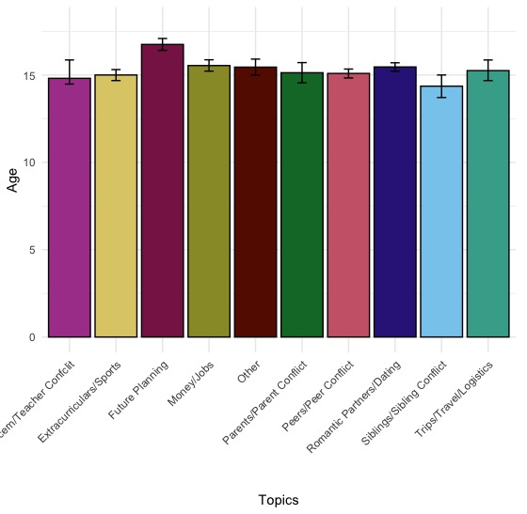
**
F = 10.92, p < .001
M_{age} Future Planning = 16.75
p < .01 for all pairwise comparisons after
Bonferroni correction

Slide 15
What do adolescents discuss with their best friends when prompted to seek support about anything for which they want help, support, or advice?
How is topic choice related to supportive processes?

Slide 16
What do adolescents discuss with their best friends when prompted to seek support about anything for which they want help, support, or advice?
How is topic choice related to supportive processes?

Slide 17
Supportive Behavior Task
Behavioral coding by two trained graduate student coders:
Self-Disclosure: single most-disclosing statement (ICC’s = .69-.75)
0 = brief, non-controversial (likes/dislikes)
2+ = wouldn’t tell a stranger
4 = not commonly shared, feelings may be less socially acceptable
Emotional support provided by supporting best friend via expressions of warmth, empathy, concern, “drawing out” (ICCs = .61-.78):
0 = no attempt to support
4 = clear recognition of emotional distress

Slide 18
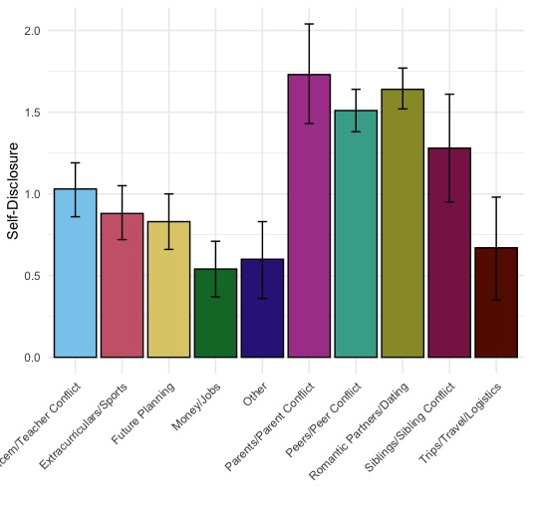
Vulnerable Self-Disclosure
***
1.73
1.64
1.51
Omnibus test:
F = 23.44, p < .001
Pairwise comparisons after Bonferroni correction ps < .001
Parent = peer = dating > all others
1.28
1.03
.88
.83
.54
.60
.67

Slide 19
Emotional Support Given by Friend
1.45
1.49
Omnibus test:
F = 18.58, p < .001
Pairwise comparisons after Bonferroni correction ps < .02-.001
Peers = parents
Parents = Romantic partners = Siblings = Academic concerns
1.07
.98
1.12
.72
.56
.65
.35
.28

Slide 20
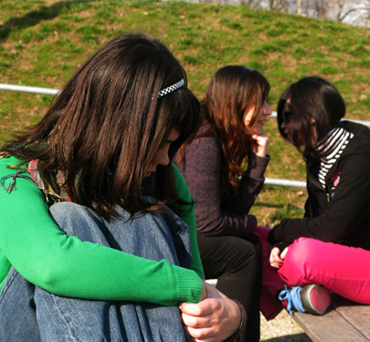
Discussion
Varied topic selection within- and across-participant
Topic associated with responsive emotional support
Not instrumental support
Planning for the future increases across adolescence
The role of discussions with peers about social relationships
Topics discussed shape interpersonal experiences which may shape development

Slide 21
Limitations
Underlying common factors driving friendship dynamics and self-disclosure
Controlling for gender of graduate coders
Observational measures provide a small window into adolescents’ social processes

Slide 22
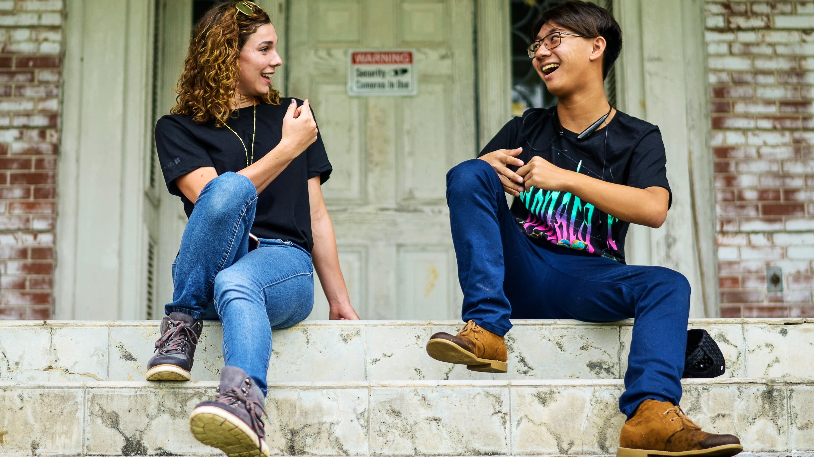
Future Directions
Differences in topic selection by gender
Individual differences in experience of vulnerability
Trajectories of social skills, mental health, relationship quality as related to topics and topic-switching
Consistency of close peer and topic choice

Slide 23
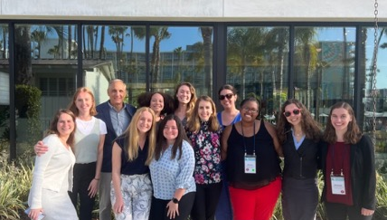
Acknowledgements
Joe Allen
Alison Nagel
Jessie Stern
Ariana Rivens
Alida Davis
Margaret Brehm
Amanda Hellwig
Olivia Hazelwood
Lauren Breeden
Gabby Hunt
Corey Pettit
Natasha Bailey
Research Assistants!

