Slide 1
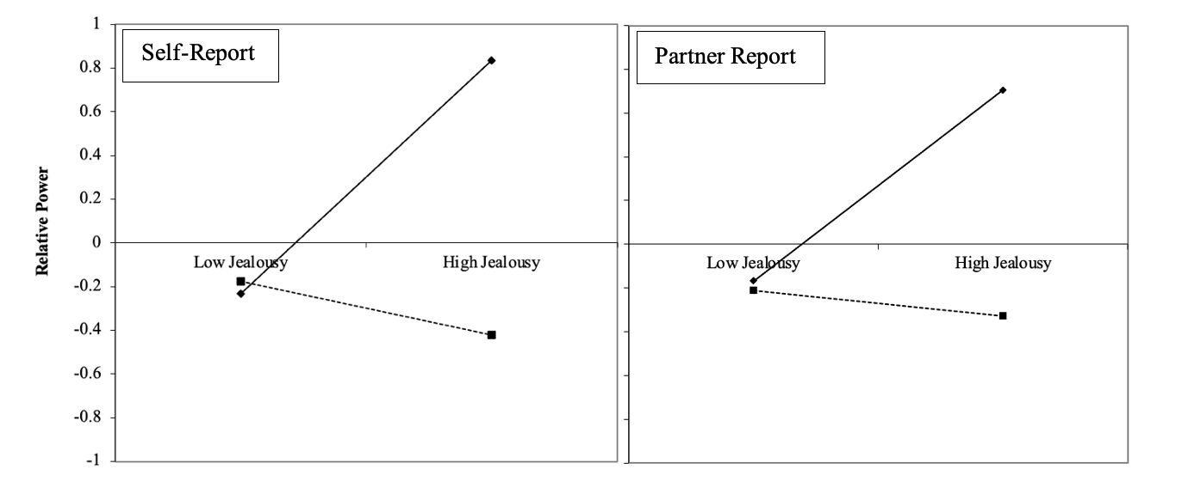
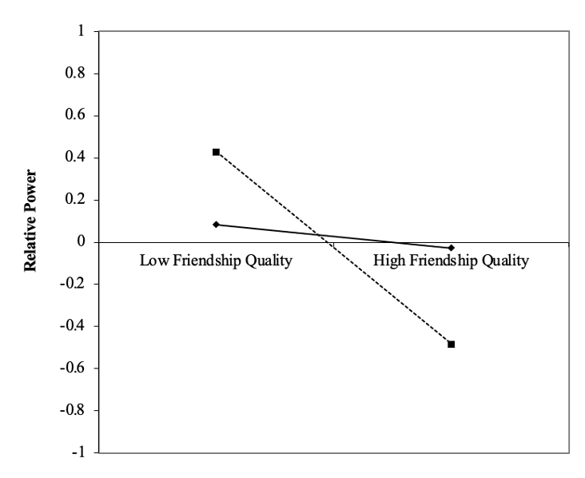
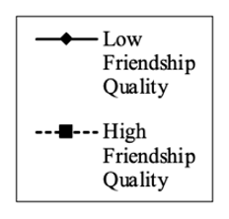
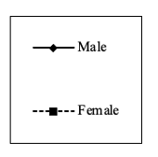
The Power of Friendship: How Adolescent Friendship Quality Predicts Relative Power in Adult Romantic Relationships Margaret V. Brehm, Meghan A. Costello, & Joseph P. Allen University of Virginia
Introduction
Methods
Results
Adolescent friendships are thought to prepare individuals for later romantic relationships (Allen et al., 2020; Boisvert & Poulin, 2016)
In the mid-twenties, couples navigate complex life choices and negotiate power dynamics
Relative Power: the extent to which one partner has more influence over the relationship compared to the other (Halstead et al., 2016)
Perceived unequal power balance linked to psychological symptomology, lower relationship satisfaction, maladaptive communication, dating aggression, jealousy (Simpson et al., 2015)
Perceived equal power balance linked to greater trust, happiness, and security (Hall & Knox, 2019)
Gender has historically influenced how individuals seek power in relationships (Felmlee, 1994)
Participants
184 teens completed questionnaires on friendship quality from ages 13-15 and relationship factors from ages 23-25
Friends and romantic partners provided collateral information
87 male, 97 female
58% White, 29% Black, 8% Mixed race/ethnicity, 5% Other identity groups
Median family income $40,000-$59,000
Measures
Friendship Quality (ages 13-15, self- and friend report)
Subscales: Trust, Communication, Alienation
Suspicious Jealousy (ages 23-25, self- and partner report)
Relative Power (ages 23-25, self-report)
Lower quality friendships from ages 13 to 15 predicted higher (less equal) relative power between ages 23 and 25, across both self- and friend reports of friendship quality (B=-.257, p=.007; B=-.268, p=.01)
Friendship quality moderated the relationship between suspicious jealousy and relative power, such that for individuals with lower quality prior friendships, jealousy in one’s relationship more strongly predicted relative power perceptions (B=-.328, p<.001; B=-.247, p=.008)
Gender moderated the relationship between friendship quality and relative power, such that results were significant for the women in the sample (B=-.201, p=.028)
Post Hoc Analyses:
Within friendship quality, trust was the most significant predictor of relative power (above communication and alienation scores)
How do adolescent friendships relate to adult
power dynamics in romantic relationships?
Hypotheses
Friendship quality from ages 13 to 15 will predict relative power in the mid-twenties, such that individuals with lower quality earlier friendships as reported by teens and their close friends will perceive less equal romantic relationships.
Additionally:
Friendship quality will moderate the relationship between suspicious jealousy and relative power.
Gender will moderate the relationship between friendship quality and relative power.
Figure 1. Friendship quality moderates the relationship between suspicious jealousy and relative power
Figure 2. Gender moderates the relationship between friendship quality and relative power
Discussion
Limitations & Future Directions
Findings suggest
Adolescent friendship quality may be predictive of power dynamics in romantic relationships, especially for females
It may be that adolescents in high-quality friendships learn to establish healthy power dynamics, or they expect stability in their future relationships and feel less compelled to exert dominance
Prior friendship experiences may impact whether jealousy is seen as a relational threat
Trust may be an important friendship characteristic for future relationship functioning
Cannot determine causation within study parameters
Relative power scale was slightly unclear
The sample is largely heterosexual, and power dynamics may operate differently within gay and lesbian relationships (Peplau & Fingerhut, 2007) — future studies could sample from a variety of sexual orientations and gender identities
CONTACT: mvb2kc@virginia.edu
This study was supported by grants from the National Institute of Child Health and Human Development and the National Institute of Mental Health (R37HD058305, R01-MH58066, & F32HD102119) to Joseph Allen.

