Slide 1
Beyond Delinquency and Drug Use: Links of Peer Pressure to Long-term Adolescent Psychosocial Development Joe Allen Jessica A. Stern Corey Pettit Amanda F. Hellwig University of Virginia
Collaborators:
Maryfrances Porter, Ph.D.
Kathleen McElhaney, Ph.D.
Joseph Tan, Ph.D.
Meghan Costello
Lauren Elreda, Ph.D.
Emily Loeb, Ph.D.
Penny Marsh
Corey Pettit
Farah Williams, Ph.D.
Amanda Hellwig
Megan Schad, Ph.D.
Natasha Bailey
Elie Hessel, Ph.D.
Rachel Narr, Ph.D.
Meghan Costello
Alison Nagel, Ph.D.
Christy McFarland, Ph.D.
Emily Marston, Ph.D.
Erin Miga, Ph.D.
Amanda Hare, Ph.D.
Jessica Kansky, Ph.D.
Alida Davis
Gabby Hunt
Bert Uchino, Ph.D.
We gratefully acknowledge grant support from NIMH and NICHD
Copies of related papers are available at: www.Teenresearch.org

Slide 2
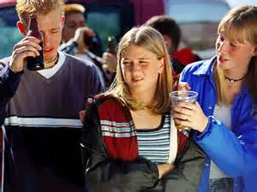
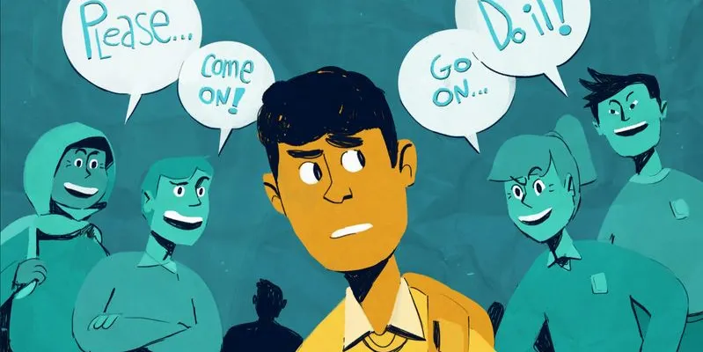
A Brief History of Peer Pressure Research
1980’s and 1990’s
Examining it as a major cause of teen deviance
Assessing pressure to drink, smoke, etc.
Notes:
Peer pressure is a topic that psychologists have been studying for decades, mostly via research examining it as a potential cause of deviant behavior

Slide 3
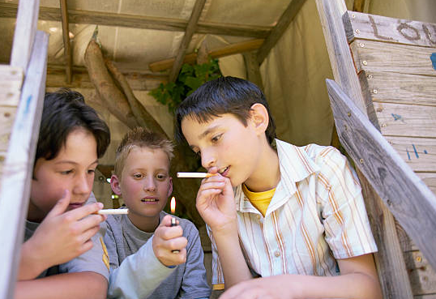
A Brief History of Peer Pressure Research
Then we realized that although peers influence one another, it usually isn’t via pressure
Peers mostly select peers who are similar to them, or engage in behavior of peers because they admire or want to be liked.
Peer pressure won’t explain most deviant behavior.
Notes:
Over time we learned that though peers do INFLUENCE one another to engage in deviant behavior, this mostly isn’t about pressure, but about teens choosing to model behaviors of those they admire or want to be liked by

Slide 4
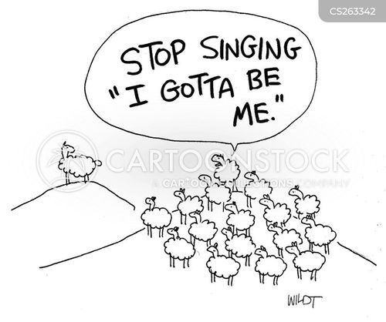
A Brief History of Peer Pressure Research
The field largely moved on.
But peer pressure remained as a major source of adolescent stress.
This makes sense…
Notes:
So the field learned this and moved on, but any teenager will tell you and research has confirmed, that even if it’s not about delinquency, peer pressure is one of the most stressful parts of teen social life.
This shouldn’t be surprising if we think developmentally.

Slide 5
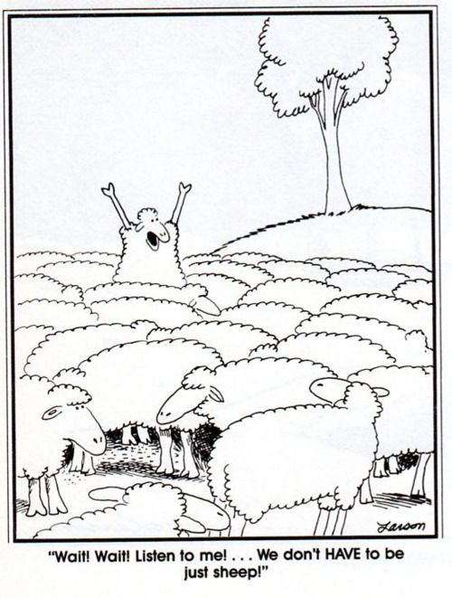
Peer Pressure vs.
Teen Strivings for Autonomy
Need to establish autonomy while maintaining relationships as a fundamental developmental challenge of adolescence
Peer pressure threatens this fundamental drive…
Notes:
For one of the most central challenges of adolescence life is learning to establishing autonomy in key relationships
Larry Steinberg has proposed that as adolescents seek to establish their autonomy from parents, peer relationships become the critical venue where this autonomy and relationship struggle plays out.
*
From this perspective peer pressure is a primary threat, perhaps THE primary threat to adolescents’ developing autonomy, which is no doubt why it's experienced is so stressful.

Slide 6
Peer Pressure vs.
Teen Strivings for Autonomy
When a peer tries to change a teen’s behavior this:
Invalidates the teens’ own desires and intentions
Discourages the teen’s autonomy expression
Whether or not it actually leads to behavior change
And even when it is not about deviant behavior
Notes:
Indeed, pressure around, dress, choice of friends, even pressure to behave well, to get good grades, may be equally challenging to adolescents.
Because it inherently interferes with autonomy development to SLIDE

Slide 7
Three goals
Examine the extent to which experience of pressure is linked to current and future autonomy difficulties,
Examine factors that predict which teens will be most likely to experience peer pressure.
Develop a measure of peer pressure that:
Doesn’t rely on adolescent self-report
Isn’t limited to pressure about deviant behavior
Notes:
First, that teens experiencing high levels of pressure from a close friend, because it directly impinges on autonomy in a key relationship, would then lead to struggles with autonomy issues going forward in new venues and new relationships.
We expected to see this in teens’ behaviors with friends, romantic partners and in the broader world.

Slide 8
Sample
N=184
98
86
Median Family Income: $40,000 - $60,000
(at national average)
Race Representation
Data from Self-reports, parents, close friends, observations, romantic partners
Followed from age 13 to 24 for today’s talk
98% continued participation by age 24

Slide 9
Peer Pressure
I try [A lot, A medium amount, A little bit, Not at all] to influence my friend …
.12
.54***
-.09
Pressure Toward Neutral Behaviors
Whether or not to join clubs and teams
Who my friend decides to ‘’go with’ (date)
Whether or not my friend decides to hang out with a certain crowd or group at school
How much time my friend spends with their friends
To lose weight or be thin
How my friend tries to look (their physical appearance, how smart other people think they are)
Pressure Toward Prosocial Behaviors
To show respect for adults (like teachers, friends’ parents and neighbors
Not to make fun of other kids
Not to pick fights
Not to cut classes or skip school
Not to smoke
Pressure Toward Antisocial Behaviors
To pick fights
To smoke
Not to get good grades
Not to spend time with his/her family
To make fun of other kids
To cut classes or skip school
Cronbach’s alpha’s range from .80 - .85
Cronbach’s alpha’s range from .47 - .74

Slide 10
Stability of Pressure from Best Friend Across Years
(Note: Friend can change from year to year)
General Antisocial
Pressure Pressure
Age 13 to 14 .22** .23**
Age 14 to 15 .50*** .40***
Age 15 to 16 .51*** .26**
Age 16 to 17 .55*** .14

Slide 11
Question 1: What are the primary sequelae of exposure to peer pressure in late adolescence?

Slide 12
Concurrent Relationship of Exposure to Peer Pressure to Displays of Autonomy/Assertiveness with Close Friend
Ages 16-17
Ages 16-17
Hypothetical Dilemma: (e.g., decide which characters would win vs. lose on a reality-show “survivor” contest). s
Statements explaining position and reasoning– a marker of autonomy.
Repeated at each age with scores averaged together.
Interrater reliability in ‘good’ range ICC = .64.
Pressure re: Neutral/Positive Behaviors
-.27***
Assertiveness with Close Friend (Obsvd.)
Pressure re: Antisocial Behaviors
.05
.05
Family Income
.05
Gender

Slide 13
Predictions from Adolescent Exposure to Peer Pressure to Romantic Partner Coercive Behavior (Partner-report)
From Conflict in Relationships Measure (Wolfe et al.,, 1994; 1998)
15-item verbal aggression scale
Threats
Insults
Other coercive behaviors
Partner ratings averaged across the 3 periods (relationships of at least 3-months duration)
Cronbach’s α = .74 -.83
Ages 16-17
Ages 18-24
Pressure re: Neutral/Positive Behaviors
.22*
Romantic Partner Coercive Behavior
(partner report)
Pressure re: Antisocial Behaviors
.04
-.03
Observed Assertiveness with Friend
-.18*
Family Income
-.03
Gender

Slide 14
Predictions from Adolescent Exposure to Peer Pressure to Functional Independence in Adulthood
Ages 16-17
Age 23
From Young Adult Adjustment Scale (Capaldi, King, & Wilson, 1992)
Parent-ratings of Functional Independence ( 5 items) e.g.,
Knows exactly what he/she wants to do in school or work
Is able to take care of himself/herself
Can manage his/her finances competently
Each parent rates separately and scores are then averaged
Cronbach’s α = .83 – .85
Pressure re: Neutral/Positive Behaviors
-.34***
Functional Independence (Parent-report)
Pressure re: Antisocial Behaviors
.01
.22**
Observed Assertiveness with Friend
.22**
Family Income
.22**
Gender

Slide 15
Interim Conclusions
Exposure to pressure from a close friend in late adolescence is linked to:
Difficulty asserting oneself within that friendship
Future exposure to coercive romantic partners
Difficulty functioning autonomously as an early adult in the larger world

Slide 16
Question 2: WHICH teens are most likely to experience high levels of pressure from peers across adolescence?
Hypothesis: Those who are least secure and assertive in key relationships

Slide 17
Inability to Express Autonomy with a Close Friend Predicts Future Exposure to Pressuring Behavior
Age 13
Ages 14-17
Lack of Autonomy with Friend (Obsvd.)
Hypothetical Dilemma (same paradigm as above).
Dilemmas changed each year.
Statements explaining position and reasoning– a marker of autonomy.
Interrater reliability in ‘good’ range ICC = .64.
-.27***
Pressure re: Neutral/Positive Behaviors from
Close Friend
Pressure re: Neutral/Positive Behaviors from
Close Friend
Pressure from Close Friend
.10
-.13
Family Income
.23***
Gender

Slide 18
Poor Quality Mother-Teen Relationship Predicts Exposure to Peer Pressure
Age 13
Ages 14-17
The Inventory of Parent and Peer Attachment (Armsden & Greenberg, 1987).
Maternal ratings
21 items capturing communication, trust, and alienation (reverse-scored).
Cronbach’s α = .94
Mother-Teen Relationship Quality
-.22**
Pressure re: Neutral/Positive Behaviors from
Close Friend
Pressure re: Neutral/Positive Behaviors from
Close Friend
Pressure from Close Friend
.09
-.20**
Family Income
.26***
Gender

Slide 19
Poor Status in Peer Group Predicts Exposure to Peer Pressure
Age 13
Ages 14-17
Sociometrically-assessed
Classmates asked: Name 10 peers with whom you would most like to spend time on a Saturday night.
Relatively stable over time
Previously related to attachment security & positive parental and peer interactions (Allen, et al., 2005; 2007; 2008).
Peer Preference (Sociometric
-.19**
Pressure re: Neutral/Positive Behaviors from
Close Friend
Pressure re: Neutral/Positive Behaviors from
Close Friend
.10
-.13
.27***
Family Income
Gender

Slide 20
Combined Predictors of Future Exposure to Peer Pressure
Age 13
Ages 14-17
Maternal Relationship Quality
-.21**
Peer Sociometric Preference
-.13
Pressure re: Neutral/Positive Behaviors from
Close Friend
Autonomy with Friend (Obsvd.)
-.24***
Pressure from Close Friend
.07
-.11
Family Income
Gender
.26**

Slide 21
Conclusions
Peer pressure has significant implications for concurrent and future autonomy development
Romantic relationships
Independent Functioning
Parallels to Research on Lack of Autonomy within the Family
Experience of peer pressure doesn’t occur randomly
Most likely to occur for teens who:
Hesitate to be assertive
Have weak maternal relationships
Have low status in the broader peer group
The most significant peer pressure may have little or nothing to do with deviant behavior
Notes:
These findings are strikingly consisting with a long line of research on the effects of PARENTAL behaviors that inhibit teens’ autonomy has established almost this exact same set of outcomes.
What we’re seeing is that this autonomy struggle plays out in similar ways in peer relationships.

Slide 22
Limitations
Correlations and Longitudinal Predictions don’t establish causal relations.
We’re observing chains in an ongoing process of autonomy struggle
Pressure from a close friend may differ from pressure from the broader peer group.
Findings based on a new measure
Replication in other samples is now needed.

Slide 23
Overarching Conclusion
Even if peer pressure isn’t a key driver of deviant behavior, this doesn’t make it unimportant.
Teens have always been right to be concerned about peer pressure. Just not for the reasons that researchers and other adults may have initially thought.
Notes:
Although it turns out that peer pressure is not a primary driver of deviant behavior, this does not mean peer pressure is unimportant.
It appears it may both reflect and predict longer-term difficulties in the critical process of establishing autonomy in close relationships.
Said differently, It seems that teenagers were always right to be concerned about peer pressure, just not for the reasons that adults initially thought.

Slide 24
Thank you !
Collaborators:
Maryfrances Porter, Ph.D.
Kathleen McElhaney, Ph.D.
Joseph Tan, Ph.D.
Meghan Costello
Lauren Elreda, Ph.D.
Emily Loeb, Ph.D.
Penny Marsh
Corey Pettit
Farah Williams, Ph.D.
Amanda Hellwig
Megan Schad, Ph.D.
Lauren Everhart
Elie Hessel, Ph.D.
Rachel Narr, Ph.D.
Meghan Costello
Alison Nagel, Ph.D.
Christy McFarland, Ph.D.
Emily Marston, Ph.D.
Erin Miga, Ph.D.
Amanda Hare, Ph.D.
Jessica Kansky, Ph.D.
Alida Davis
Gabby Hunt
Bert Uchino, Ph.D.
We gratefully acknowledge grant support from NIMH, NICHD, the Spencer Foundation, and the William T. Grant Foundation
Copies of related papers are available at: www.Teenresearch.org

