Slide 1
Observed Emotional Engagement in Adolescent Friendships Predicts Neural Correlates of Empathy in Adulthood
Jingrun Lin, Jessica Stern, Joseph Allen, Steven Boker, James Coan
Department of Psychology, University of Virginia
This research was supported by grants from the National Institute of Child Health and Human Development and the National Institute of Mental Health (R01 HD058305-16A1; R01-MH58066; & R01MH080725).
Notes:
My name is Jingrun, my talk looks at emotional engagement in adolescent and neural correlates of empathy in adulthood

Slide 2
Adolescence is a sensitive period for social development
Close peers provide training ground for adult relationships and development of empathy
Emotional support competence among “best friendships” predicted interpersonal relationships in adulthood
Costello et al. (2023), Mikulincer & Shaver (2007), Narr et al. (2019)
Notes:
This goes without saying…adolescence is an important period for social skill development and development of our brain. We know that the kind of skills necessary for friendship development, especially empathic skills are essential for understanding one another, cooperating, and drawing us closer to our peers. Previous research showed that empathy related experience can translate directly to the quality of intimate adult relationships.
We also know that our brain undergoes plastic changes dependent upon the social and emotional experiences with environment during adolescence (Bossong & Niesink, 2010)
It is reasonable to suspect that Friendships in adolescence might shape neural substrates of relationship competencies in adulthood

Slide 3
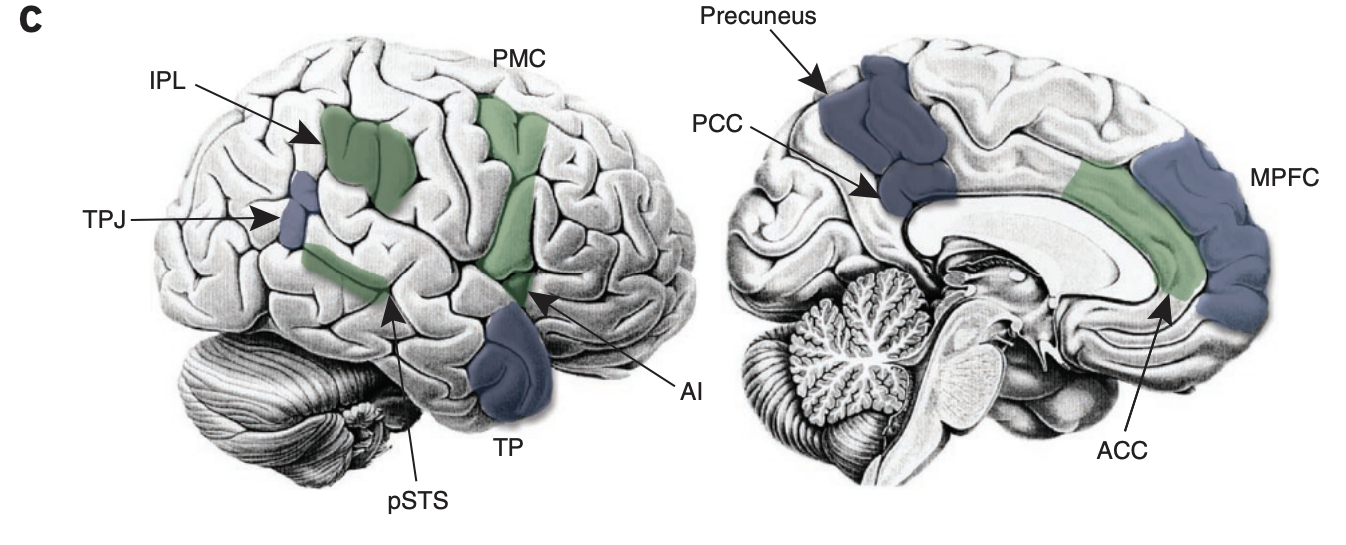
Empathy & The Brain
Zaki & Oschner (2012)
Notes:
By adulthood, empathy related brain regions have been extensively studied. These regions include temporal pole and anterior cingulate cortex, which we will focus on in our study, have been associated with experience sharing and mentalizing-qualities related to empathy. Although our study did not not repeated fMRI to examine the longitudinal neural development of adolescent brain, we still try to take a snapshot to look at--
one of the things that are critical for evoluntionary success -> cooperation and understanding others -> these abilities are supported by a psychological construct -> empathy
Empathy refers to how the perceivers relate to targets; the literature used overlapping terms and in this paper, it is categorized into three disparate processes
The three include (i) experience sharing: vicariously sharing targets’ internal states2, (ii) mentalizing: explicitly considering (and perhaps understanding) targets’ states and their sources3, and (iii) prosocial concern: expressing motivation to improve targets’ experiences (for example, by reducing their suffering)4. Empathy includes many components, including the abilities to take another’s perspective and sharing another’s emotions, which require both affective and cognitive processing (Singer & Lamm, 2009). Previous empirical evidence indicates that empathy may be critical for understanding others and motivating individuals to help (Decety, Michalska, & Kinzler, 2011). Brain regions associated with experience sharing and mentalizing. IPL, inferior parietal lobule; TPJ, temporoparietal junction; pSTS, posterior superior temporal sulcus; TP, temporal pole; AI, anterior insula; PMC, premotor cortex; PCC, posterior cingulate cortex; ACC, anterior cingulate cortex; MPFC, medial prefrontal cortex.

Slide 4
Overarching Goal
We aim to connect formative social experiences in adolescence to neural underpinnings of adult empathy
Notes:
How adolescent empathic related experience corresponded with differential neural activity in response to another’s distress in early adulthood.
How formative social experience in adolescence are connected to neural correlates of empathy in adulthood

Slide 5
Design and Hypothesis
We anticipated that:
1. Higher levels of emotional engagement in adolescence would correspond with greater neural activity in empathy-related regions when anticipating stranger’s distress in adulthood
2. Higher levels of emotional engagement in adolescence would correspond with greater neural activity in empathy-related regions when anticipating partner’s distress in adulthood
Analyses adjusted for gender and family income
Notes:
We hypothesize that higher level of emotional engagement, As a measure of empathy in our study, corresponds with greater neural activation of empathy related regions when anticipating a stranger partner under distress, and this effect is more salient in partner
For empathy related regions, we focused on dACC and temporal pole, as they have been associated with affective and cognitive components of empathy

Slide 6
Final Sample
Total Participants | 88 Subjects Completed Both Tasks
Gender breakdown: | 49 female; 39 male
Race/ethnicity breakdown: | 27 Black/African American; 2 Hispanic/ Latinx; 49 White/European; 7 Mixed Race; 3 Others
Notes:
Power = 0.93
We have 88 participants

Slide 7
Final Sample
Procedure
Total Participants | 88 Subjects Completed Both Tasks
Gender breakdown: | 49 female; 39 male
Race/ethnicity breakdown: | 27 Black/African American; 2 Hispanic/ Latinx; 49 White/European; 7 Mixed Race; 3 Others
Supportive Behavior Task
Handholding Task
Threat-to-Other
Age 13 to Age 21 Annually
(Except Age 20)
= 8 occasions
Age 25
Notes:
Who underwent the supportive behavior task, as Amanda covered, from age 13 to 21. For our study, we focused on emotional engagement measure from the supportive behavior task. At age 25, they came back for the handholding task, which I will talk in more details in a bit
Sample breakdown: 29 friend; 28 dating partner; 27 cohabitating partner; 4 married partner

Slide 8
Age 13 – 21: Supportive Behavior Task – Emotional Engagement
Participants and friends each discussed a problem of their choosing for six minutes.
Emotional engagement, from the participant to the friend, was coded from 0 - 4
Engagement scores reflected the amount and quality of connection demonstrated by the target participant.
eye contact;
body posture;
head movements;
asking questions;
actively listening;
Etc…
Allen et al. (2001)
Notes:
As we talked about, for supportive behavior task, we chose to focus on the emotional engagement measure only – and it reflects verbal and bodily cues such as eye contact, body posture, active listening, etc. that participants demonstrate to recognize, understand, and share another’s emotional experience
This has already been covered but I just want to mention that in the supportive behavior task, we only focused on the emotional engagement measure – it’s what we are interested in
and what shows the most variance from previous in-lab studies, and when we think about emotional engagement, it requires the ability to
using the Supportive Behavior Task Coding System for Adolescent Peer Dyads (Allen et al., 2001).
and close friend. The more the participant displayed these behaviors, the greater the engagement score. Inter-rater reliability for the participant’s engagement when the friend asked for help (“support given”) were 0.63.
Emotional engagement, as measured in the current study, captures how closely the teen is attending to their friend by demonstrating active listening (i.e., following up on what they said, asking questions about the topic, using positive body postures to increase closeness) when the friend is in need of support. The degree to which one can sustain emotional engagement through verbal and bodily cues when others experience emotional distress requires the ability to recognize, understand, and share another’s emotional experience while remaining self-regulated (Haley et al., 2017). Previous work has shown that adolescents’ emotional engagement is correlated with emotional and instrumental support provision, suggesting its role as a critical component of empathic responding (Stern et al., 2021).

Slide 9
Age 25: Handholding Task: Threat-To-Others
Participants underwent two blocks of threat-of-shock paradigms in counterbalanced order
Each block contained 12 threat cues and 12 safety cues presented in random order.
Partner
Handholding
Stranger
Handholding
THREAT
SAFETY
FIXATION
END
REST
T or S cue
fixation cue
end cue
rest
1 s
4-10 s
1 s
4-10 s
Each “X” indicated a 20% chance of shock
Each “O” indicated no chance of shock
Notes:
For the handholding task, participants are under fMRI scan and they hold the hand of their partner or a stranger when the partner and stranger are undergoing threat of electric shock
Participants in the scanner see either a safety trial with no chance of their partner or stranger getting shocked
Or a threat cue, indicating there’s a 20 percent chance their partner or stranger will get shocked at the end of the trial

Slide 10
Age 25: Handholding Task: Threat-To-Others
Participants underwent two blocks of threat-of-shock paradigms in counterbalanced order
Each block contained 12 threat cues and 12 safety cues presented in random order.
ROIs: dorsal anterior cingulate cortex (dACC) and temporal pole (TP), regions commonly associated with emotion, cognitive-control, and self-regulation
Partner
Handholding
Stranger
Handholding
THREAT
SAFETY
FIXATION
END
REST
T or S cue
fixation cue
end cue
rest
1 s
4-10 s
1 s
4-10 s
Each “X” indicated a 20% chance of shock
Each “O” indicated no chance of shock
Notes:
We did first and second level analyses and on top of that focused on two regions of interests – dACC and TP as they are associated with empathy. We applied these two regions of interests mask to the second level data and extracted brain activity at temporal pole and dACC in the partner and stranger handholding condition
Stranger: Anonymous member of the opposite gender
the presence of a relational partner corresponds with less activation of a participant’s threat-responsive neural circuits compared to when the participant is alone. These effects are observed most consistently in the
Briefly, group-level analyses of the threat minus safety contrast in the partner condition indicated peak activations in the junction between lateral and frontal occipital cortex, occipital pole, right caudate, paracingulate gyrus, and anterior cingulate gyrus, extending broadly into right cerebral white matter, right accumbens, superior frontal gyrus, frontal and temporal pole. When threat was directed at a stranger, activations peaked at middle frontal gyrus, precentral gyrus, left cerebral white matter, right cerebral white matter, and temporal pole, extending broadly into the temporal pole, superior frontal gyrus, juxtapositional lobule cortex, planum polare

Slide 11
Statistical Analyses Plan: Latent Growth Curve Model for Emotional Engagement
0.06**
The model showed acceptable fit (χ² (34) = 48.52, RMSEA = .070, TLI = .721).
I-Teen
Teen1y
Teen2y
Teen3y
Teen4y
Teen5y
Teen6y
Teen7y
Teen9y
0.26
0.17
0.31
0.30
0.20
0.34
0.40
0.77
8 measurement occasions of emotional engagement from age 13 to 21 (except 20)
Notes:
We used latent growth curve model to fit the emotional engagement data across adolescence. We found that an intercept only model fit better than linear, and quadratic model,
The variance of the intercept (estimate = 2.78) was significant (∆χ² (1) = 34.81 p < .001), meaning we can proceed with using the intercept to predict other outcomes
Analyses adjusted for gender and family income

Slide 12
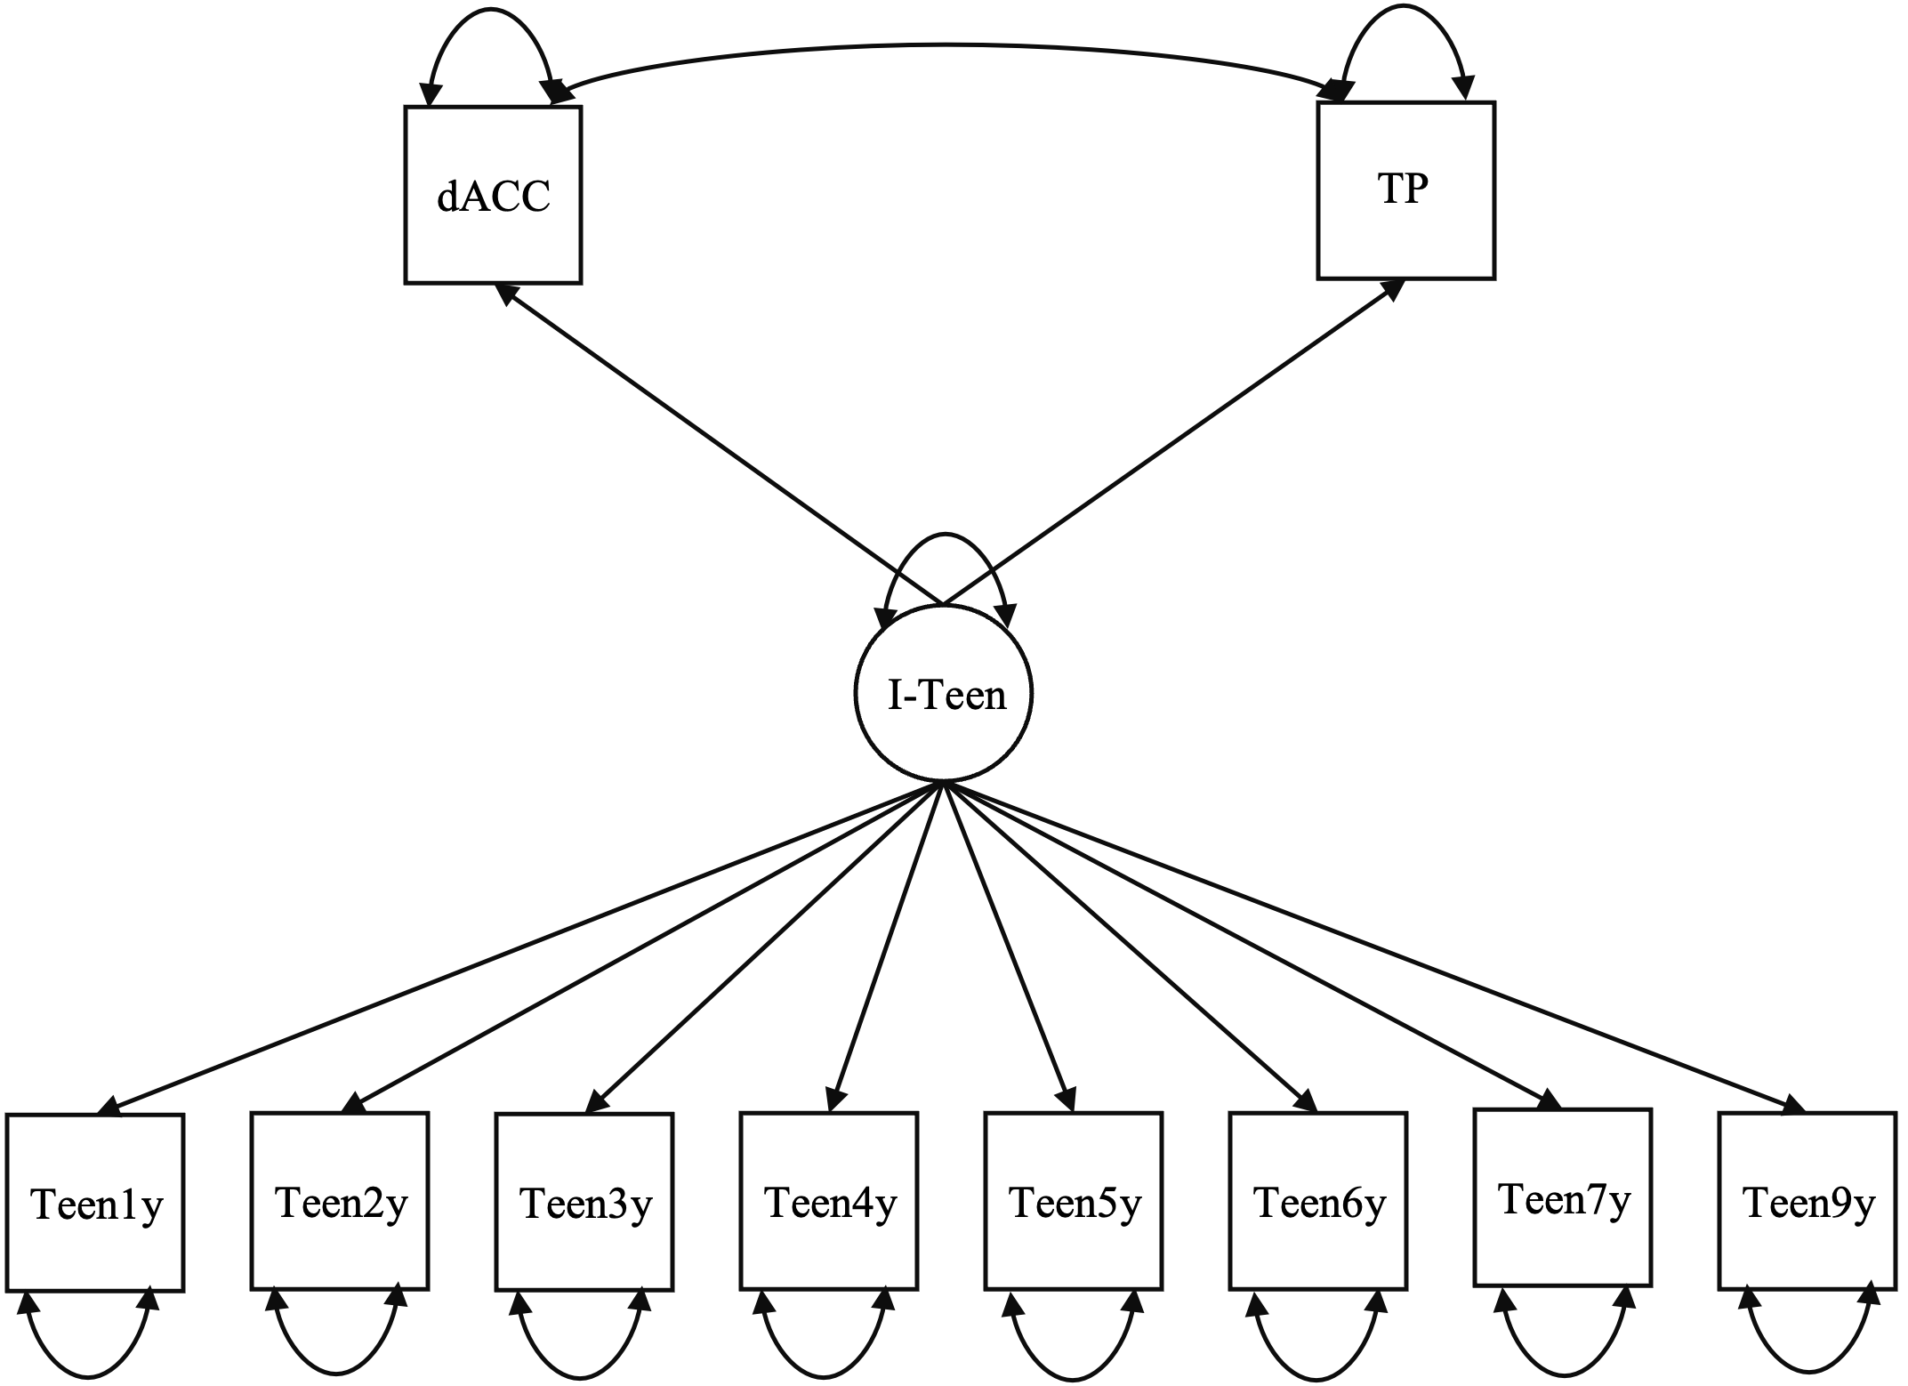
Hypothesis 1: Does Emotional Engagement for Friends Predict Stranger-Directed Empathy Responses?
Area activity when holding stranger’s hand and stranger is facing threat
Notes:
For hypothesis number 1, we want to test if emotional engagement in adolescence predicts stranger directed empathy response
We used dACC and temporal pole activity in the stranger handholding condition

Slide 13
Higher Emotional Engagement in Adolescence Predicted Lower Stranger-Directed Empathy at Temporal Pole
b1 = -0.29
p = 0.463
b2 = -0.61**
p = .002
Notes:
We found that higher emotional engagement across adolescence corresponded with lower temporal pole activity when anticipating a stranger in distress, that is contrary to what we predicted
The model showed acceptable fit (χ² (66) = 111.54, RMSEA = .089, TLI = .641).

Slide 14
Hypothesis 2: Does Emotional Engagement for Friends Predict Partner-Directed Empathy Responses?
Area activity when holding partner’s hand hand and partner is facing threat
Notes:
For hypothesis 2, we want to see if emotional engagement in adolescence predict partner directed empathy response
So we entered daCC and temporal pole activity at the partner handholding condition

Slide 15
No significant Association Between Emotional Engagement and Partner-Directed Empathy
b1 = 0.60
p = 0.148
b2 = 0.13
p = 0.551
Notes:
We found no significant association and in other words, Regardless of emotional engagement demonstrated in adolescence, there’s no difference in how they respond to partner’s distress neurally
The model showed acceptable fit (χ² (66) = 110.33, RMSEA = .087, TLI = .650).

Slide 16
Why is higher emotional engagement linked to reduced temporal pole activation anticipating stranger’s distress?
Maybe handholding added support-giving effect, which reduces neural threat related activity!
-> Higher emotional engagement corresponds to greater benefits from regulatory effect of handholding, so there’s less need for temporal pole involvement
Inagaki et al. (2016), Olson et al. (2007)
Notes:
so none of our findings are consistent with what we hypothesized…one way we thought to interpret our findings is through the handholding design-a major difference in our study compared to other empathy studies
We know that handholding has a support giving effect, which reduces threat related activation in the support giver – the participants; along this line, temporal pole is also important for regulating emotional responses in addition to its role in empathy;
So, maybe higher emotional engagement actually corresponded to greater benefits from the regulatory effect of social others, so there’s less need for temporal pole to be as activated and involved
This is not surprising, as engaging in supportive social behaviors often requires self-regulation of negative emotions or actions in order to maintain attentional focus on the other person and help regulate the other person’s distress.
in line with the self-regulatory account of the current findings, the temporal pole is critical not only for empathic responding but also for integrating complex sensory input to regulate the emotional responses (Olson et al., 2007).

Slide 17
Conclusion
Higher emotional engagement in adolescence
-> Better regulated through external resources
-> More available for others, even strangers!
Notes:
So, we conclude that teens who showed higher level of emotional engagement in adolescence were better at utilizing social resources to regulate threats as adults
If they are better at regulating their own emotions, they might be more available to help others -
This effect we observed is more prominent in the stranger condition, as strangers pose greater challenges for regulation of negatively aroused states compared to that of the partner.
Another way to explain is that adolescents with higher emotional engagement may be more susceptible to the familiarity role in empathy – strangers might be considered an outside group members, resulting in greater gaps in their reaction to stranger vs. partner

Slide 18
Thank you!
Acknowledgements:
We would like to thank the current and past members of the Allen laboratory for their dedicated hard work on the KLIFF/VIDA longitudinal sample. We would also like to thank the current and past members of the VAN lab for their contribution to the imaging data analyses and their invaluable emotional support.
Contact info: jl5xg@virginia.edu
QUESTIONS?

Slide 19
References
Costello, M. A., Allen, J. P., Womack, S. R., Loeb, E. L., Stern, J. A., & Pettit, C. (2023). Characterizing Emotional Support Development: From Adolescent Best Friendships to Young Adult Romantic Relationships. Journal of Research on Adolescence, 33(2), 389–403. https://doi.org/10.1111/jora.12809
Mikulincer, M., & Shaver, P. R. (2007). Boosting attachment security to promote mental health, prosocial values, and Inter-Group Tolerance. Psychological Inquiry, 18(3), 139–156. https://doi.org/10.1080/10478400701512646
Narr, R. K., Allen, J. P., Tan, J. S., & Loeb, E. L. (2019). Close friendship strength and broader peer group desirability as differential predictors of adult mental health. Child Development, 90(1), 298–313. https://doi.org/10.1111/cdev.12905
Zaki, J., & Ochsner, K. N. (2012). The neuroscience of empathy: progress, pitfalls and promise. Nature Neuroscience, 15(5), 675–680 (2012. https://doi.org/10.1038/nn.3085
Allen, J. P., Hall, F. D., Insabella, G. M., Land, D. J., Marsh, P. A., & Porter, M. R. (2001). Supportive behavior coding system. Charlottesville: University of Virginia.
Olson, I. R., Plotzker, A., & Ezzyat, Y. (2007). The Enigmatic temporal pole: a review of findings on social and emotional processing. Brain: a journal of neurology, 130(Pt 7), 1718–1731. https://doi.org/10.1093/brain/awm052
Inagaki, T. K., Bryne Haltom, K. E., Suzuki, S., Jevtic, I., Hornstein, E., Bower, J. E., & Eisenberger, N. I. (2016). The Neurobiology of Giving Versus Receiving Support: The Role of Stress-Related and Social Reward-Related Neural Activity. Psychosomatic Medicine, 78(4), 443–453. https://doi.org/10.1097/PSY.0000000000000302

