Slide 1
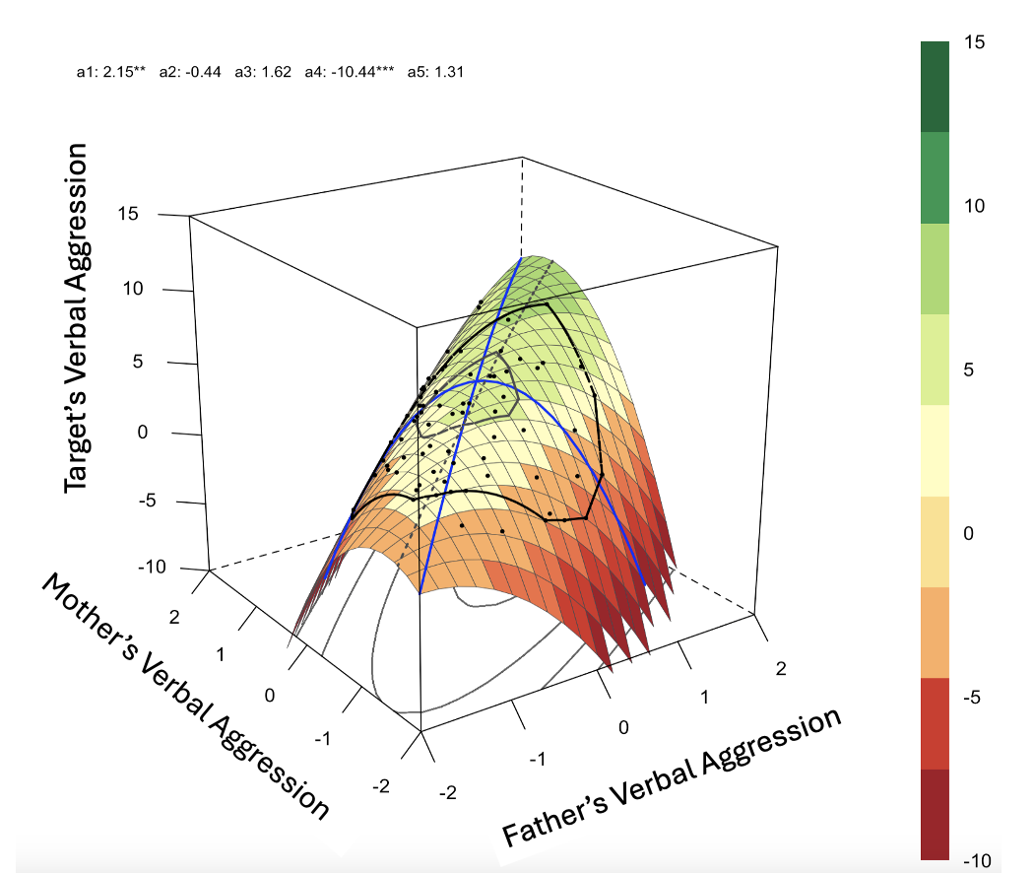
Cross-partner congruence in parent's relationship threat responses and the intergenerational transmission of aggression
Corey Pettit, Joseph Allen, Margaret Brehm, Olivia Hazelwood
University of Virginia
Introduction
Results
Descriptive Statistics
The way parents navigate conflict can have important implications for the romantic relationships of their children.
Modeling maladaptive responses to conflict, like verbal aggression, can create risk for the intergenerational transmission of aggression (Crick & Dodge, 1994).
The interaction between partners’ conflict responses can determine their relational impact, so research is needed exploring the link between dyadic patterns of parents’ conflict responses and the intergenerational transmission of aggression (Gottman, 1999).
Specifically, the congruent use of adverse conflict behaviors may model a method of conflict where partners are attuned to and negatively amplifying each other’s behaviors.
Negative affect reciprocity may be unique risk factor for relationship aggression, but has not been examined intergenerationally (Cordova et al., 1993; Margolin et al., 1988).
Verbal Aggression | Mean | SD
Mother | 8.27 | 2.70
Father | 3.53 | 2.83
Offspring | 4.22 | 5.26
 | Mom greater than dad | Mom and dad equal | Dad greater than mom
Parent aggression during conflict | 19.05% | 50% | 30.95%
Measures
The Conflict Tactics Scale (Straus et al., 1996) was also administered to participants parents at age 17. These items were used to create a subscale measuring Verbal Aggression between parents during conflict. Example excessive distance items include “Your partner insulted or swore at you” and “Your partner stomped out of the room.” α.= 73 for mothers and α.= 77 for fathers.
The Conflict Tactics Scale (CTS; Straus et al, 1996) was also used to measure offspring conflict negativity between age 29-33 (Cronbach’s α =.80).
Conclusions
Hypotheses
Hypothesis 1: Couple level conflict negativity will predict higher levels of negativity in offspring’s romantic relationships
RSA model indicated a significant a₄ parameter. Higher congruence was linked to higher levels of offspring aggression perpetration in later romantic relationships.
A significant a₁ parameter was found. Matching at high levels of aggression is linked to more offspring verbal aggression compared to matching at low levels of parent’s aggression.
Witnessing congruent verbal aggression at age 17 sets expectations and scripts about relationship conflict, this problematic pattern may be especially likely to prompt later relationship negativity.
Findings support theories of negative affect reciprocity and extend implications of theory across generations(Cordova et al., 1993; Margolin et al., 1988).
Findings highlight value of examining dyadic patterns when considering impact of parenting on romantic relationship development.
Selected References
Hypothesis 2: Parents’ conflict negativity congruence will be negatively associated with conflict negativity in offspring’s romantic relationships
Margolin, G., John, R. S., & Gleberman, L. (1988). Affective responses to conflictual discussions in violent and nonviolent couples. Journal of consulting and clinical psychology, 56(1), 24.
Cordova, J. V., Jacobson, N. S., Gottman, J. M., Rushe, R., & Cox, G. (1993). Negative reciprocity and communication in couples with a violent husband. Journal of abnormal psychology, 102(4), 559.
Crick, N. R., & Dodge, K. A. (1994). A review and reformulation of social information-processing mechanisms in children's social adjustment. Psychological bulletin, 115(1), 74.
Gottman, J. M. (1999). Marriage clinic: A scientifically based marital therapy. WW Norton & Company.
Straus, M., Hamby, S., Boney-McCoy, S., Sugarman, D. (1996). The Revised Conflict Tactics Scales (CTS2): Development and preliminary psychometric data. Journal of Family Issues, 17(3), 283-316.
Participants
Drawn from larger longitudinal study of 184 participants assessed since age 13.
107 adolescents (58%) identified themselves as Caucasian, 53 (29%) as African American, 15 (8%) as of mixed race⁄ ethnicity, and 9 (5%) as being from other minority groups.
Median family income: $40,000–$59,999 range.
Each parent reported on conflict behaviors when participants were 17 years old.
Target participants reported on conflict behaviors between age 29 and 33.
Study Funding
This study was supported by grants from the National Institute of Child Health and Human Development and the National Institute of Mental Health (R37HD058305, R01-MH58066, and F32HD102119). The content does not represent the official views of NIH.

