Slide 1
Links of observed adolescent empathy in friendships to activation in self-regulatory brain regions in adulthood
Amanda F. Hellwig, Jingrun Lin, Jessica A. Stern, James. A. Coan, and Joseph P. Allen
This study was supported by grants from the National Institute of Child Health and Human Development and the National Institute of Mental Health to Joseph Allen (R37HD058305, R01-MH58066, & R01HD058305) and James Coan (R01MH080725).
Notes:
This and the following talk from Jingrun come from the same study. My talk will focus on self-regulation and associated brain regions that are activated in response to threat of pain

Slide 2
Neurodevelopment of Empathy
Empathy: key driver of prosocial behavior
Empathic skills develop in stages throughout childhood and adolescence (Decety, 2010)
Focus on self-regulatory development in adolescence
Different brain regions associated with different aspects of empathy (e.g., emotion regulation, perspective-taking)
Notes:
Empathy definition: The ability to put yourself in another person’s shoes – see their perspective and/or feel what they feel
(Emotion understanding aspects of empathy develop very quickly in first years of life, while self-regulatory capacity develops through adolescence)

Slide 3
Emotion Regulation
The ability to appropriately manage and respond to emotional experience and modulate emotional arousal
Important for empathic ability
Develops greatly in adolescence (Silvers, 2022)
dACC (dorsal anterior cingulate cortex) and dlPFC (dorsolateral prefrontal cortex)
How do empathic behaviors in adolescence relate to activation in these two regions associated with self-regulation, when that individual is under threat of pain?
Notes:
Emotion regulation is important for empathy because individuals need to maintain optimal arousal to achieve goals and engage prosocially with others.
Emotion regulation capacities and skills also develop dramatically during adolescence
Studies of the neurodevelopment of emotion regulation have found several sites that are consistently activated when regulating our emotions, including dACC and dlPFC
The dACC may play more of a role in appraisal (perception) of emotions, particularly negative, while the dlPFC may play a more complex role in modulating mood, with a recent cathodal transcranial direct current stimulation study supporting these different roles (Piretti et al., 2022)
And since adolescence is such an important period for the development of self-regulation AND empathic skills within friendships, this led us to our question…
Due to the link between empathy and self-regulatory capacities, we would expect more empathic behaviors to be associated with greater activation of both of these self-regulatory brain regions, but that may not be the case with these emerging findings.
(Interestingly, recent work using cathodal transcranial direct current stimulation found differential processes from stimulating the dACC vs. left dlPFC: only stimulation of the dACC was associated with reduced arousal ratings of emotional stimuli (words and pictures), while left dlPFC had more of a mood regulating role by reducing positive affective state)

Slide 4
Present Study
Larger longitudinal study: 184 adolescents recruited at age 13 from southeast; 99 females (53%)
Present study: 85 participants; 46 female (54%), 39 male
Diverse & representative of the local population (60% White, 26% Black, 14% mixed race or other races/ethnicities)
Ages 13 and 14: Supportive Behavior Task with close friend
Age 24: fMRI task
Notes:
Data come from larger longitudinal study conducted in the Southeast, starting in 1998
184 adolescents at age 13 participated in supportive behavior task with friend
85 of the original 184 participated in the fMRI task at age 24
Close friends could (and did) change across waves, but we are not necessarily looking at relationship quality but rather skills that the participant brings to the friendship, whoever that person is – to understand what their friend is going through and provide attuned support

Slide 5
Supportive Behavior Task
Close friend asked for help with self-selected problem, 6 minutes
Video-recorded and double-coded by graduate students, averaged across coders
Behaviors coded:
Emotional support provision
Instrumental support provision
Emotional engagement
Accurate identification of friend’s problem
Mean behaviors = total empathy score
Averaged across ages 13 and 14
Notes:
Emotional support provision: understands and supports the feelings their friend brings up
Instrumental support provision: gives advice, works together with friend to solve the problem
Emotional engagement: how connected they are to the other person – listening, following-up, showing that they’re interested and understanding
Accurate interpretation: how well they recognize and understand the concern or problem
ICCs for age 13 (W1): emo support = .80, instrum support = .84, engage = .61, interpretation = .55
ICCs for age 13 (W2): emo support = .76, instrum support = .80, engage = .68, interpretation = .25 (restricted range - ICCs for total empathy score were good)
ICCs from .67 to .84 from ages 13 to 17

Slide 6
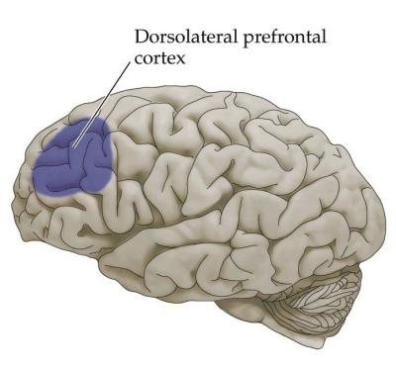
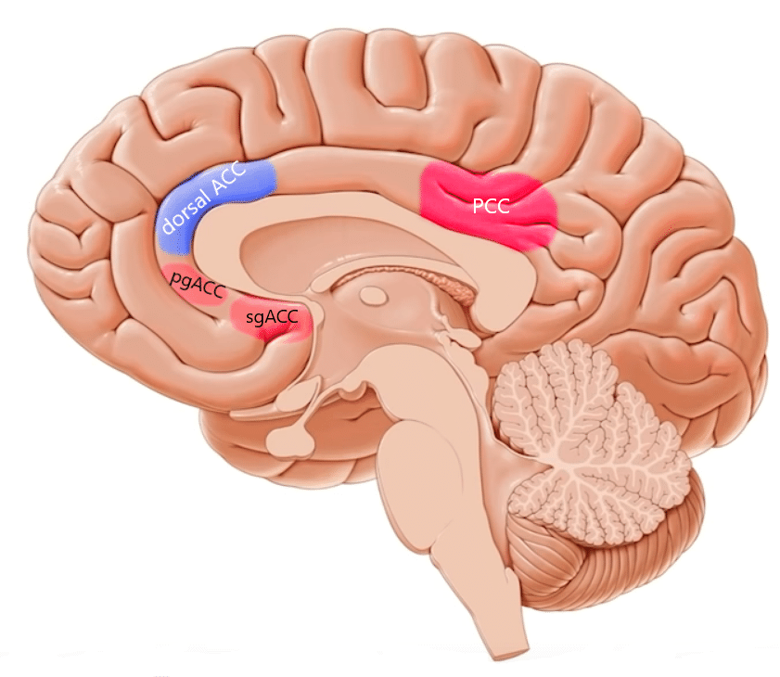
fMRI Task
Participants under threat of electric shock, 3 conditions
Alone
(Holding hands with opposite-sex partner [romantic, friend])
(Holding hands with stranger)
Results are contrast of threat vs. safety trials
Regions of interest:
Dorsal anterior cingulate cortex (dACC)
Dorsolateral prefrontal cortex (dlPFC)
THREAT
SAFETY
FIXATION
END
REST
T or S cue
fixation cue
end cue
rest
1 s
4-10 s
1 s
4-10 s
Notes:
Differential roles of the dACC and dlPFC in emotion regulation (Piretti et al., 2022)
*Finding of greater activation means that that self-regulatory region was more activated when the participant was threatened with pain than when they were “safe”
Each “X” indicated a 20% chance of shock

Slide 7
Results
age 24
dACC
ages 13-14
β = .33, p = .010
Observed Empathy with Close Friend
(emotion appraisal/arousal)
β = .16, p = .219
dlPFC
(mood modulation)
Notes:
Hierarchical regression models were run using full-information maximum likelihood estimation, and we controlled for sex and family income assessed as percent of the poverty level
Consistent with the recent study of the differential roles of these two regions in emotion regulation, we found that adolescents who engaged in more empathic behaviors toward friends in early adolescence later experienced greater activation in the dACC, but not the dlPFC, when awaiting shocks
(Mood modulation as more about valence like pos vs. neg, while arousal more about intensity)

Slide 8
Conclusions & Discussion
Greater activation in dACC – attempts to down-regulate arousal
Consistent with links between empathy and self-regulation (MacDonald & Price, 2019)
Adding to empathy and neural development research with findings regarding observed empathy
Limitations:
Did not investigate the other conditions or other potential regions of interest related to empathy or self-regulation (future directions)
Small sample size
Measured activation of brain regions, but not neural connectivity nor actual emotion regulation capacity
Notes:
This increased activation in the dACC may indicate greater attempts to down-regulate emotional arousal when threatened with physical pain, per previous findings.
The fact that there is a link between empathic behaviors in adolescence and activation in this self-regulatory brain region, the dACC, is consistent with previously found links between empathy and self-regulation
Current work adds to empathy neurodevelopment research by investigating observed empathy in real adolescent friendships
Some limitations, including:
In sum, these findings suggest that the ability to show empathy in an important period of adolescent friendship development may play a role in shaping neural circuits to better support self-regulation of emotional arousal in times of stress.

Slide 9
Thank you!
Acknowledgments:
Our participants
My co-authors, particularly Jingrun Lin for her fMRI expertise and Jessie Stern for her empathy expertise
Joe Allen (faculty advisor)
ARG Lab Members
Adolescence Research Group: teenresearch.org
Virginia Affective Neuroscience Lab: affectiveneuroscience.org

Slide 10
References
Decety, J. (2010). The neurodevelopment of empathy in humans. Developmental Neuroscience, 32(4), 257–267. https://doi.org/10.1159/000317771
MacDonald, H. Z., & Price, J. L. (2019). The role of emotion regulation in the relationship between empathy and internalizing symptoms in college students. Mental Health and Prevention, 13, 43–49. https://doi.org/10.1016/j.mhp.2018.11.004
Piretti, L., Pappaianni, E., Gobbo, S. Rumiati, R. I., Job, R., & Grecucci, A. (2022). Dissociating the role of dACC and dlPFC for emotion appraisal and mood regulation using cathodal tDCS. Cognitive, Affective, & Behavioral Neuroscience, 22, 304–315. https://doi.org/10.3758/s13415-021-00952-3
Silvers J. A. (2022). Adolescence as a pivotal period for emotion regulation development. Current opinion in psychology, 44, 258–263. https://doi.org/10.1016/j.copsyc.2021.09.023

