Slide 2


Slide 13


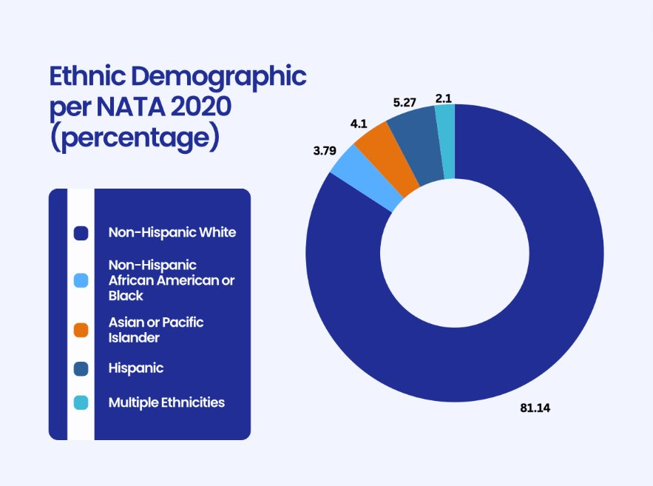
Levels of Discrimination Experienced by African American and Latin X Athletic Trainers and Students in the Workplace
Sydney Nelson, Seungyeon Kim, Jen Xu, Emily Ghaussy, Emily Madrak
University of Virginia
Introduction
Purpose
Results
Discussion
In recent years, there has been an apparent lack of diversity and representation in athletic trainers, specifically in the NCAA, excluding Historically Black Colleges and Universities.¹
Similar is observed within the National Athletic Trainers’ Association (NATA). As depicted in Figure 1, the majority of athletic trainers in the NATA are White/Caucasian, and the second most common group was Black/African American athletic trainers, with less than 4%. Measures of discrimination are also observed in professional master’s athletic training programs.² The amount of microaggressions and the lack of action taken by school administration when reported, has contributed to minority populations reconsidering their careers and pivoting out of athletic training.²
Although there has been more data of the racial and ethnic groups in athletic training, there are still gaps in the research regarding workplace discrimination.
We hypothesized that there would be a relationship with discrimination (all forms)that is more visible in minority groups such as Black/African American and Latin X/Hispanic athletic trainers.
Figure 1: Ethnic demographics of athletic trainers in the NATA
Purpose: This study aims to provide information on how Black/African American and Latin X/Hispanic athletic communities' athletic trainers experience discrimination in the workplace so that interventions can be implemented to reduce discrimination and help communities entering communities.
Research Question: Do Black/African American and Latin X/Hispanic athletic trainers experience greater levels of discrimination in the workplace in comparison to majority groups (White/Caucasian)?
389 participants successfully completing the survey, meeting the appropriate power for a 95% confidence interval. (Table 1)
Kruskal Wallis tests reported significance in multiple groups.
Stigma/devaluation demonstrated statistical significance with race/ethnicity, X²= 18.64 p<0.00. (Table 2)
Black/African American and Latin X/Hispanic participants were more likely to experience racial discrimination in their lifetime compared to White/Caucasian participants. (Table 1)
Latin X/Hispanic participants had a higher likelihood of experiencing exclusion or rejection than White/Caucasian participants. (Table 1)
Black/African Americans were more likely to face stigma or devaluation compared to White/Caucasian, American Indian or Alaska Native, and Native Hawaiian or Pacific Islander participants.
The results demonstrate a high likelihood that Black or African Americans were more likely to face lifetime exposure, exclusion and rejection, stigma, and devaluation compared to their white counterparts.
Latin X/Hispanic athletic trainers and students experienced greater lifetime exposure, and exclusion and rejection compared to their white counterparts.
Creating, implementing, and enforcing policies is a great way to start with anti-discrimination efforts.³
Mentorship programs that will match athletic training students based on their race and similar interests can also help increase the retention rate of students.⁴
Though Commission on Accreditation of Athletic Training Education (CAATE) standards require PMAT programs to discuss items related to diversity, equity, and inclusion, which may help future generations, clearly an issue still exists.⁵ Furthermore, these standards were only added in 2020, still leaving room to grow.
Unless retention strategies are implemented in athletic training graduate programs to mitigate the effects of lifetime exposure and discrimination, there will continue to be lower numbers of minorities in athletic training.⁶
Limitations: Survey bias and uneven size of the ethnicity and race groups.
Future Research Recommendations: Further investigating additional ethnicities and races.
Methods
Study Design: Cross-sectional study consisting of an electronic survey administered through Qualtrics
Participants: Athletic Trainers from 20 to 80 years old and athletic training students in professional programs
Exclusion Criteria: Athletic trainers that were not credentialed, students in pre-professional programs, or students not admitted to professional athletic training programs
Procedures: Participants for the study were recruited via the National Athletic Trainers’ Association, research survey service, snowball sampling, and emails to program directors of CAATE. The initial email stressed that participation was voluntary and anonymous. Data collection occurred from December 2023 to February 2024.
Materials: The survey consisted of 2 sections: a researcher-develop demographics portion, and the Brief Perceived Ethnic Discrimination Questionnaire-Community Version (Brief PEDQ-CV). The Brief PEDQ-CV was used to identify levels of discrimination of athletic trainers and professional athletic training students.
Statistical Analysis: To reach a 95% confidence interval, total of 380 responses were needed, based on the NATA certified and student populations. Kruskal Wallis tests were utilized due to unequal groups
Demographics | N | Percentage
White or Caucasian | 300 | 77.3%
Black or African American | 28 | 7.2%
American Indian or Alaska Native | 3 | 0.8%
Hispanic or Latin X | 26 | 6.7%
Native Hawaiian or Pacific Islander | 2 | 0.5%
Asian | 29 | 7.5%
Total | 389 | 100%
References
Table 1: Demographics of Sample
1. Rizzone KH, Day C, Mackenzie S, Issac L, Sanchez A, Jones CMC. Racial and Ethnic Diversity of Athletic Trainers in National Collegiate Athletic Association Institutions, 2008–2018: A Retrospective Study. Journal of Athletic Training. 2024;59(6):673-679. doi:10.4085/1062-6050-0741.20
2. Greene ZI, Aronson PA, Bradney DA, Canida RL, Bowman TG. Racial Microaggressions During Clinical Education Experiences of Professional Master’s Athletic Training Students. Athletic Training Education Journal. 2022;17(4):329-338. doi:10.4085/1947-380X-21-051
3. AMA guidelines offer path to prevent discrimination in medicine. American Medical Association. Published June 15, 2021. Accessed April 18, 2024. https://www.ama-assn.org/delivering-care/health-equity/ama-guidelines-offer-path-prevent-discrimination-medicine
4. American Psychological Association. Discrimination: What It Is, and How to Cope. Apa.org. Published October 31, 2019. https://www.apa.org/topics/racism-bias-discrimination/types-stress
5. CAATE | Diversity, Equity, Inclusion, and Accessibility. Caate.net. Published 2024. https://caate.net/DEI
6. White KA, Winkelmann ZK, Edler Nye JR, Eberman LE. Recruiting and Retaining Racially Minoritized Students into Professional Postbaccalaureate Athletic Training Programs. Athletic Training Education Journal. 2021;16(2):120-131. doi:10.4085/1947-380X-20-29
 | Lifetime Average | Exclusion/rejection | Stigma | Discrimination | Threat/ Aggression
X² | 28.14 | 20.627 | 18.644 | 27.516 | 5.032
dF | 5 | 5 | 5 | 5 | 5
Significance | <0.001 | <0.001 | 0.002 | <0.001 | 0.412
Table 2: Significant outcomes of Discrimination by Subscale
Acknowledgements
VATA Student Research Grant

Slide 18


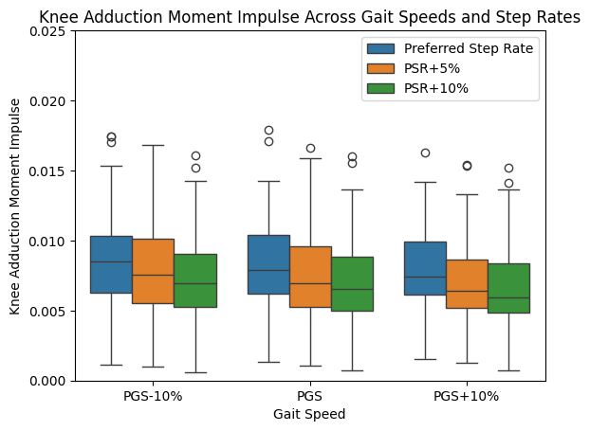


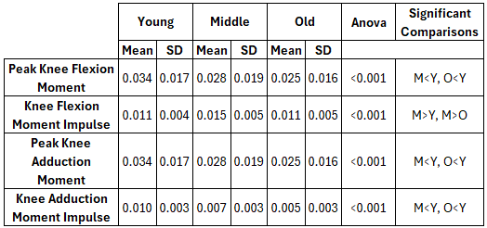
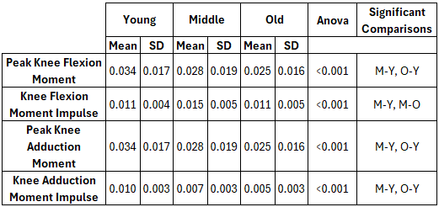


Post hoc test results for age group
Impacts of Step Rate and Gait Speed Changes on Knee Moments Across Age
Dante D. Goss, Jay Hertel
INTRODUCTION
METHODS
Older adults tend to walk with slower gait speeds and reach physical activity targets less often than younger adults [1]
Walking speed and step rate are interrelated but can be changed independently
Increasing gait speed has been shown to increase knee joint loading [2]
Increasing step rate has been shown to decrease knee joint loading [3]
It is currently unknown how these variables collectively influence knee joint loading
Increasing step rate can be effective at increasing gait speed in older adults, but it is currently unknown how this impacts knee joint loading or differs across age
Research Question: How do changes in step rate and gait speed affect knee flexion and knee adduction moments across age groups?
Statistical Analysis:
Analyses of variance were used to assess the influence of gait speed, step rate, and age group on knee flexion moment and knee adduction moment
Tukey’s HSD was used to investigate significant main effects between age groups
DISCUSSION
Neither step rate or gait speed had a significant impact on peak knee flexion moment or knee flexion moment impulse
This is encouraging as increasing either variable may have other health benefits but will not impart additional forces on the knee.
Since knee adduction moment impulse can be modified by step rate but not gait speed, future study should examine if this change can allow for individuals with degenerative knee joint disorders to walk faster while having minimal or potentially positive changes in joint force.
Additionally, it is unknown what the significant effect of age on these variables means, but this may be related to a common shift in force from the ankle up to the hip during walking.
At a set gait speed…
METHODS
Participants (N = 37)
Aged 18-75 (42.95 ± 19.32)
Split between three age groups
Young (18-39)
Middle (40-59)
Old (60-75)
26 Female and 11 Male
Protocol:
Participants were fitted with reflective markers to identify joint positions while walking
A standardized warm up was used to determine “preferred walking speed”
Nine 5-minute walking trials were completed
As step rate
KAM Impulse
Key Takeaways
Age group impacted all measures
Changes in gait speed had no effect on peak knee moments or knee moment impulses
Increasing step rate had no effect on knee flexion moments and peak knee adduction moment, but decreased knee adduction moment impulse
REFERENCES
Troiano, R. P. et al. Physical activity in the United States measured by accelerometer. Med Sci Sports Exerc 40, 181–188 (2008).
Ardestani, M. M., Ferrigno, C., Moazen, M. & Wimmer, M. A. From normal to fast walking: Impact of cadence and stride length on lower extremity joint moments. Gait & Posture 46, 118–125 (2016).
Hart, H. F., Birmingham, T. B., Sritharan, P. & Fischer, L. K. Walk Smarter, Not Harder: Effects of Cadence Manipulation on Gait Biomechanics in Patients with Patellofemoral Osteoarthritis. Medicine & Science in Sports & Exercise 55, 633 (2023).
 | Preferred Step Rate | 5% Above | 10% Above
Preferred Gait Speed | Condition 1 | Condition 4 | Condition 7
10% Below | Condition 2 | Condition 5 | Condition 8
10% Above | Condition 3 | Condition 6 | Condition 9
@UVAEaSIL
@DanteDGoss
linkedin.com/in/gossdante/

Slide 25

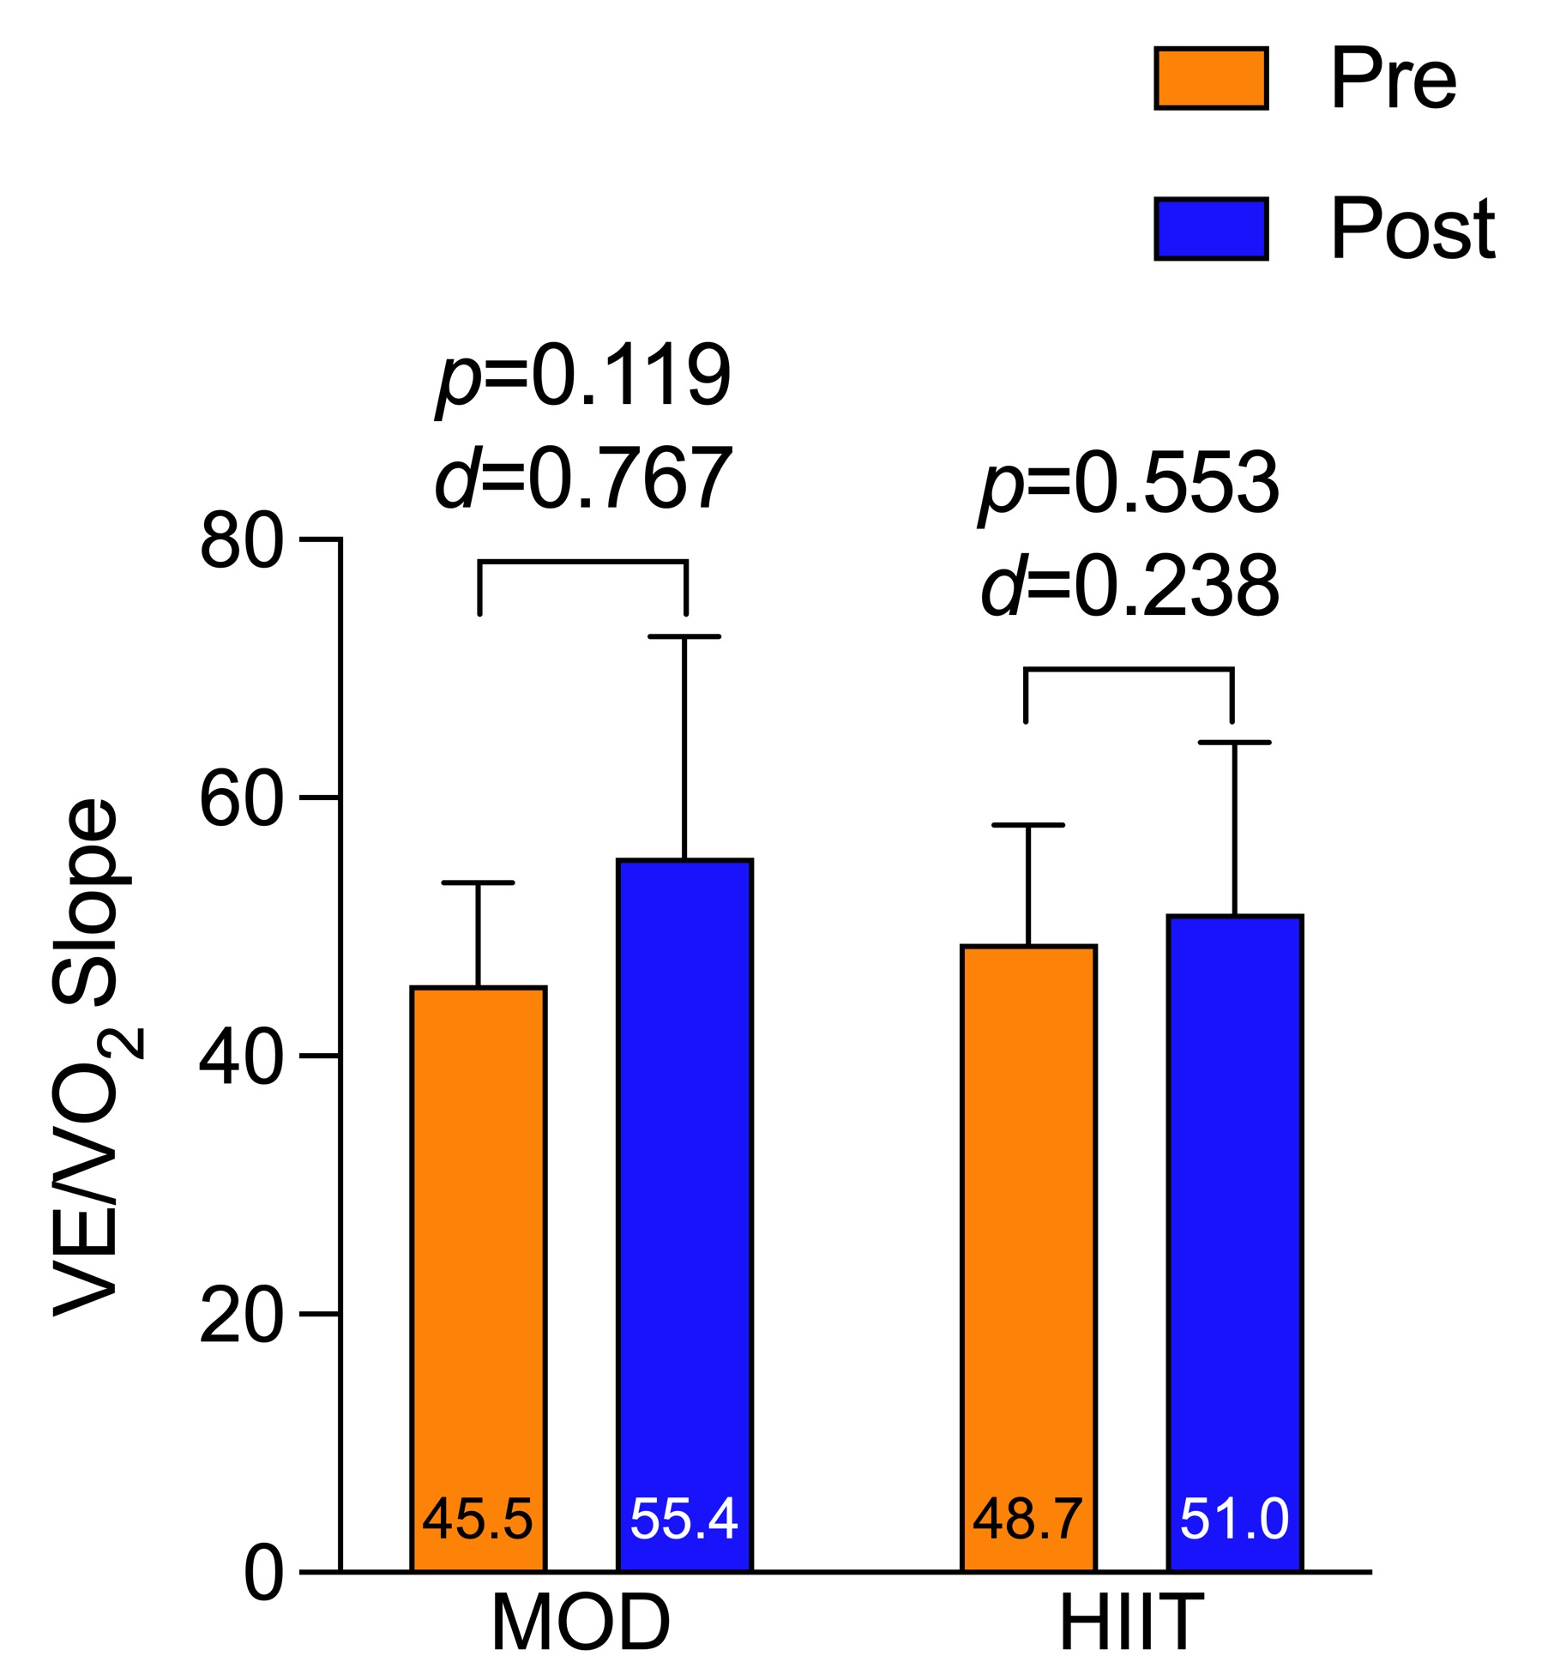
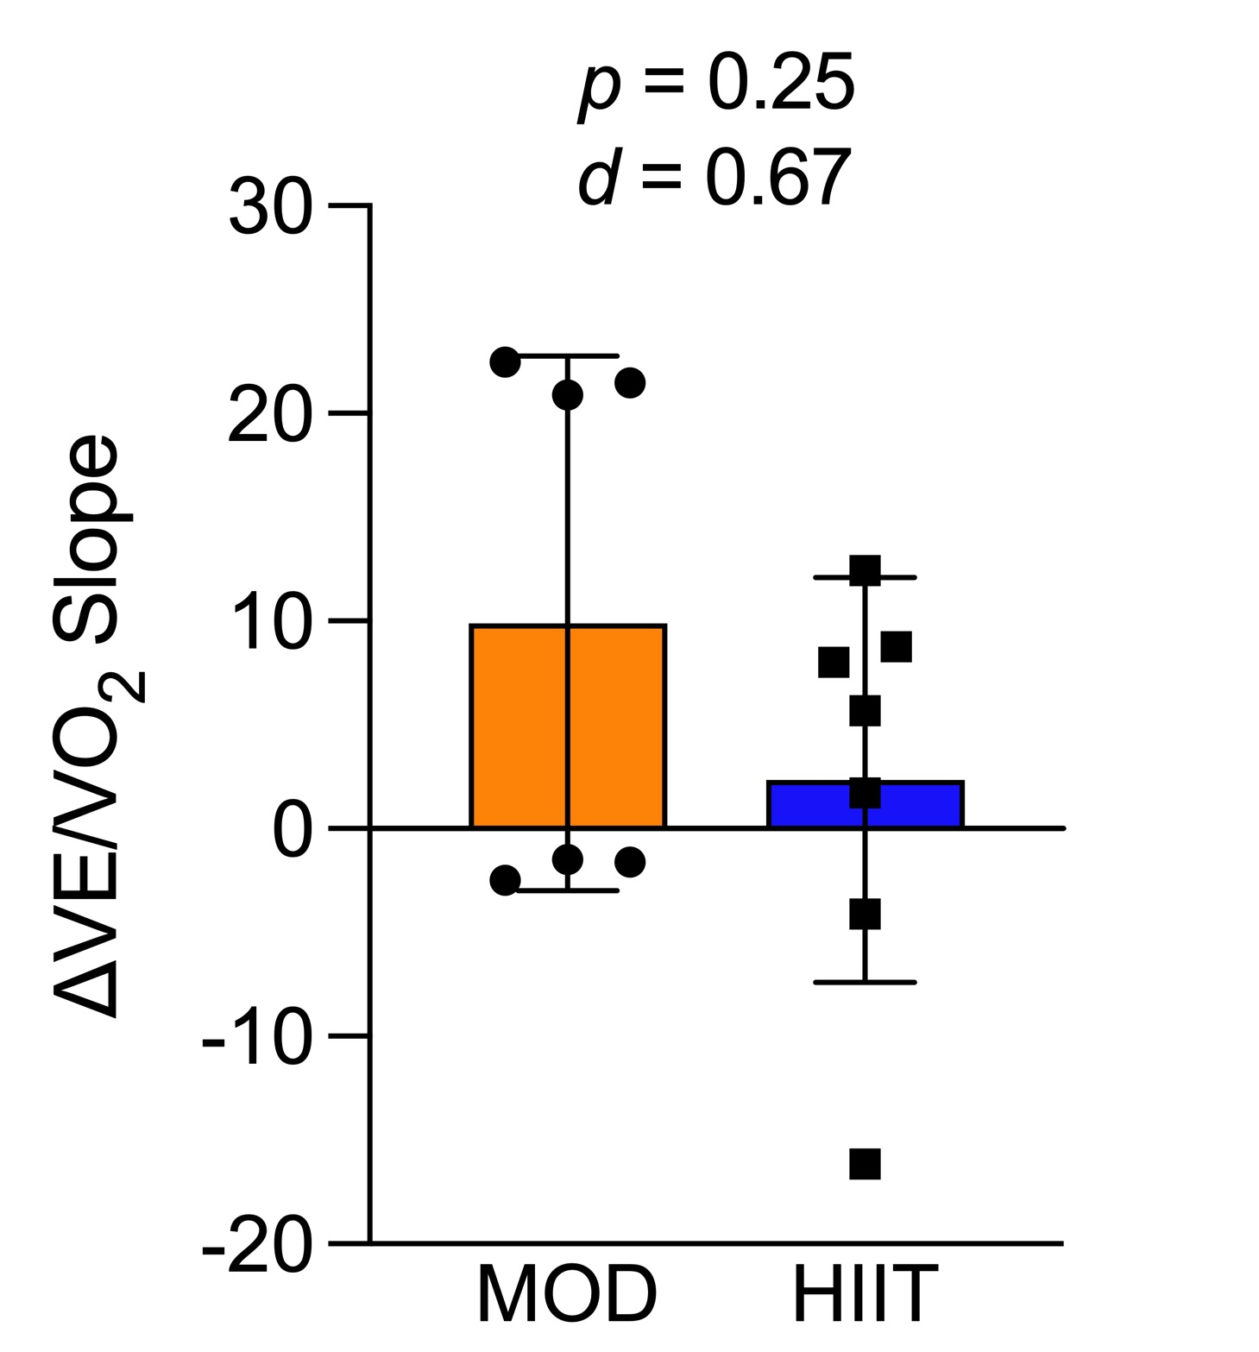
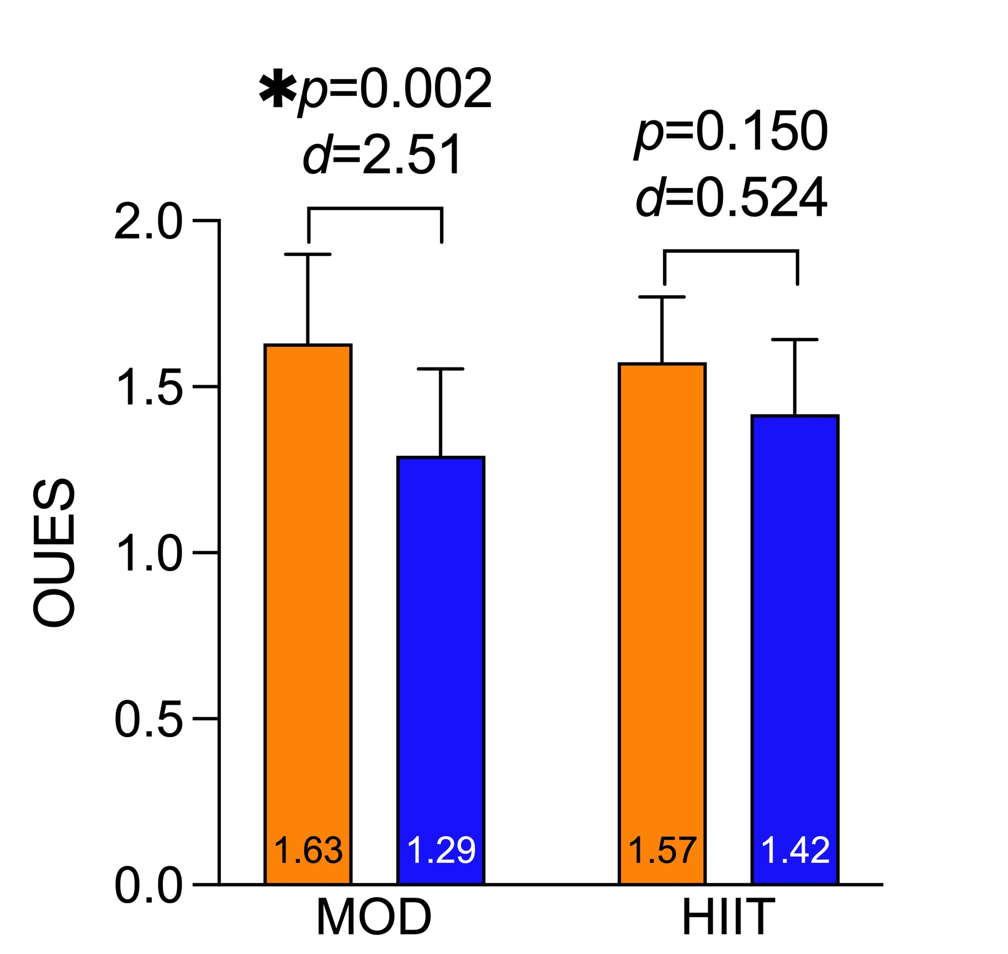
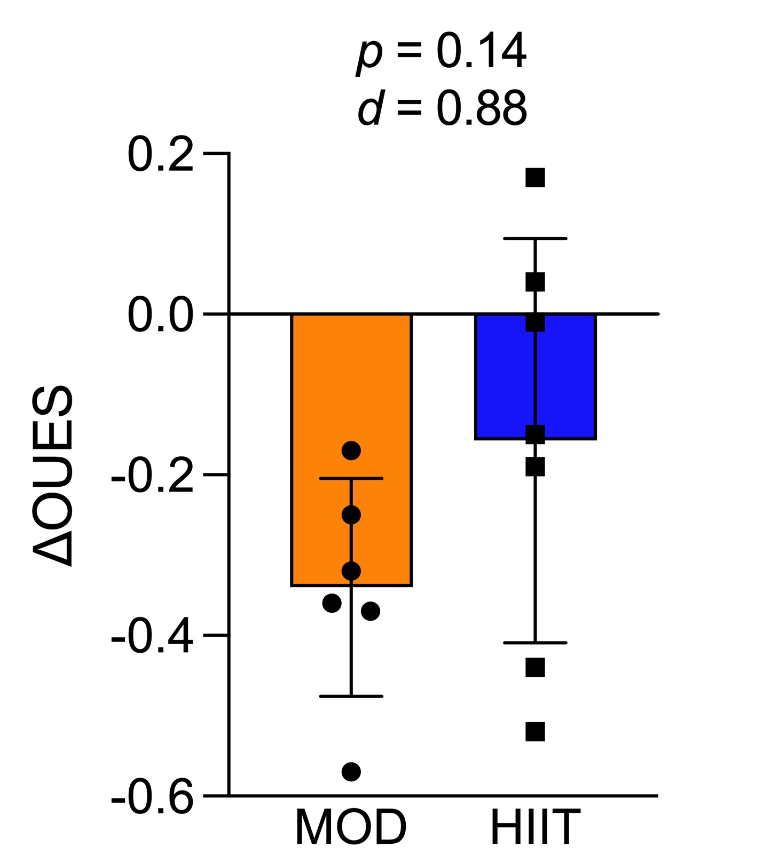
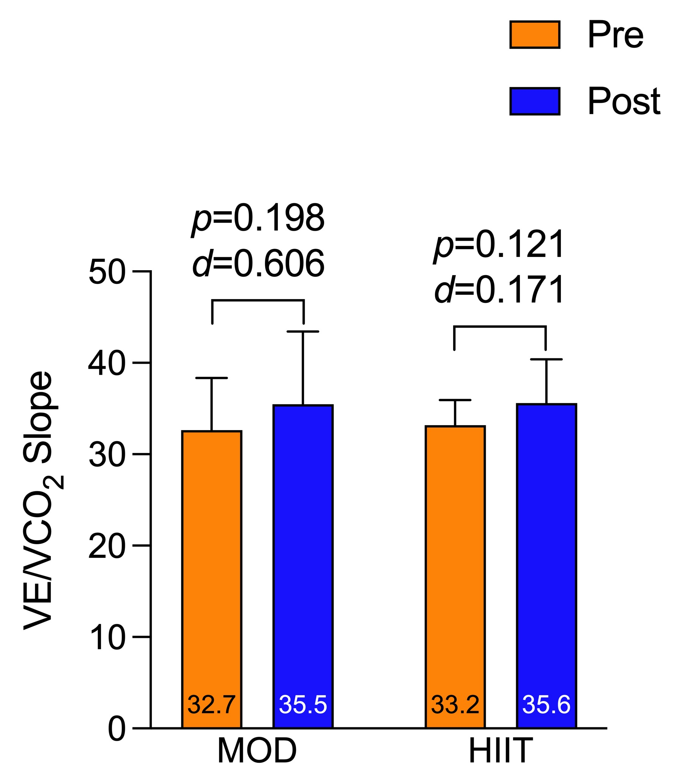
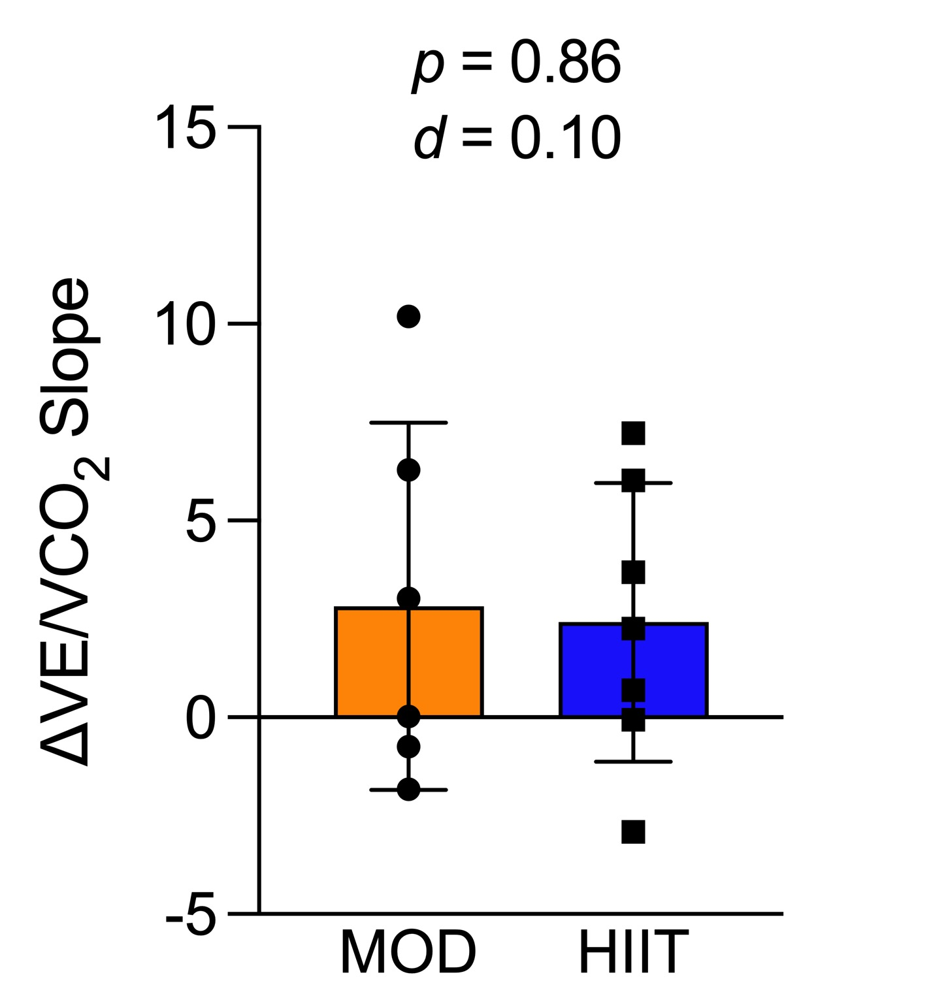
High-intensity vs. Moderate-intensity Exercise and Ventilatory Efficiency and Oxygen Uptake in Patients with Breast Cancer
Mckenzie B. Mabalot, Nathan R. Weeldreyer, Charles C. Ellison, Cheyanne Helms, Zachariah B. Nealy, Antonio Abbate, Christiana M. Brenin, Patrick M. Dillon, Trish Millard, Rebecca A. Krukowski, Jamie M. Zoellner, Siddhartha S. Angadi
Departments of Kinesiology, Public Health Sciences, Cardiovascular Medicine, and Hematology & Oncology at the University of Virginia
ABSTRACT
METHODS
RESULTS
Purpose: This secondary analysis examined if high-intensity interval training (HIIT) was more effective than moderate-intensity exercise training (MOD) for the preservation of ventilatory efficiency and OUES following chemotherapy in patients with breast cancer (BC). Methods: Twenty-four patients with BC scheduled for chemotherapy were randomized to 1 of 2 interventions 1) MOD: 150min/week of walking at 70-75% peak heart rate (PHR) or 2) HIIT: 3 sessions/week of 4x4 intervals at 85-95% PHR on a recumbent bicycle. Subjects underwent V̇O_{2peak} testing on a recumbent bicycle using a 15 watt/min ramp protocol to obtain breath-by-breath data and PHRs for exercise prescription. Post-testing occurred within 3-10 days after the final treatment. Individual deltas for VE/VO₂, VE/VCO₂, and OUES slopes from between-group differences were analyzed via independent samples t-tests after assessing for normality. Alpha was a priori set at 0.05. Results: Thirteen subjects completed all aspects of the study (MOD: n=6, 54.2±10.3yrs, 65.6±7.4kg, 25.1±4.3kg/m²; HIIT: n=7, 55.3±11.9yrs, 78.7±15kg, 28.9±5.5kg/m²). There were no significant differences between MOD or HIIT for changes in overall VE/VO₂ slope (9.88±12.87 vs. 2.32±9.75; p=0.25, d=0.67), overall VE/VCO­₂ slope (2.83±4.66 vs. 2.42±3.54; p=0.86, d=0.10), OUES (-0.34±0.14 vs. -0.16±0.25; p=0.14, d=0.88), VE/VO­₂ slope pre- or post-VT, VE/VCO₂ slope pre- or post-VT from baseline values (p>0.05). Conclusion: VE/VO₂ slopes and OUES were worse in the MOD following BC chemotherapy vs. HIIT. Large effect sizes (d≥0.7) were observed; however, the present study was underpowered and needs to be replicated in a larger sample of patients.
CPET data was used to determine peak heart rate (PHR) for exercise prescriptions and collect breath-by-breath data to determine ventilatory slopes as follows:
VE/VO₂ slope by plotting rate of change of VE (L/min) over rate of change of VO₂ (L/min)
VE/VCO₂ slope by plotting as rate of change of VE (L/min) against rate of change of VCO₂ (L/min)
OUES by plotting rate of change of VO₂ (L/min) against rate of change log₁₀VE
Individual deltas for VE/VO₂, VE/VCO₂, and OUES slopes from between-group differences were calculated as post- minus pre-testing values and were then analyzed via independent samples t-tests after assessing for normality. Alpha was a priori set at 0.05.
INTRODUCTION
Breast cancer chemotherapy-induced cardiotoxicity can lead to the development of cardiovascular disease¹
In patients with cardiovascular disease, ventilatory efficiency (VE/VO₂), VE/VCO₂, and oxygen uptake efficiency slopes (OUES) are worsened, and these measures are strongly predictive of cardiovascular morbidity and mortality independent of VO_{2peak}²⁻⁴
Exercise training improves these measures in patients with heart failure, but it is unknown if exercise has a similar effect or if exercise intensity affects these measures in patients with breast cancer undergoing chemotherapy⁵
RESULTS
Table 1. Subject Baseline Characteristics
Subjects | MOD (N= 6) | HIIT (N= 7) | p
Age (yr) | 54.2 ± 10.3 | 55.3 ± 11.9 | 0.861
BMI (kg/m²) | 25.1 ± 4.3 | 28.9 ± 5.5 | 0.204
Baseline VO₂ (L/min) | 1.52 ± 0.27 | 1.58 ± 0.24 | 0.688
Race:
White | 6 | 4
Black | 0 | 3
Chemotherapy Regimens:
Docetaxel & Cyclophosphamide | 2 | 1
Dose-Dense Doxorubicin & Cyclophosphamide | 2 | 4
Paclitaxel & Trastuzumab | 1 | 2
PURPOSE
These secondary analyses examined if high-intensity interval training (HIIT) was more effective than moderate-intensity exercise training (MOD) for the preservation of VE/VCO₂, VE/VO₂, and OUES in patients with breast cancer undergoing chemotherapy.
CONCLUSIONS
OUES was significantly impaired in the MOD group and maintained in the HIIT group following chemotherapy; also, VE/VCO₂ and VE/VO₂ trended towards greater impairment following BC chemotherapy in MOD vs. HIIT, suggesting higher intensity may be more effective to preserve these measures in patients with breast cancer.
There was a large between-group difference for OUES (d≥0.7), suggesting HIIT improves oxygen uptake efficiency to a greater extent than MOD in patients with breast cancer undergoing chemotherapy, however the present study was underpowered.
It should be noted that the present study was limited by the lack of a control group and small sample size due to patient drop-out.
METHODS
Twenty-four patients with breast cancer scheduled to undergo chemotherapy were randomized to either a MOD or HIIT remote exercise program
MOD: 150 minutes/week of walking at 70-75%PHR
HIIT: 3 sessions/week of 4x4 intervals at 85-95%PHR on a recumbent bicycle
Each subject was given a Polar HR monitor and H10 chest strap to allow remote tracking of exercise intensity via the Polar Flow app.
Each subject performed a cardiopulmonary test (CPET) on a recumbent bicycle using a 15 watts/min ramping protocol until volitional exhaustion.
REFERENCES
1. Lenneman CG, Sawyer DB. Cardio-Oncology. Circulation Research. 2016;118:1008-1020. doi: doi:10.1161/CIRCRESAHA.115.303633
2. Shen, Y., Zhang, X., Ma, W., Song, H., Gong, Z., Wang, Q., Che, L., Xu, W., Jiang, J., Xu, J., Yan, W., Zhou, L., Ni, Y. I., Li, G., Zhang, Q., & Wang, L. (2015). VE/VCO2 slope and its prognostic
value in patients with chronic heart failure. Experimental and therapeutic medicine, 9(4), 1407–1412. https://doi.org/10.3892/etm.2015.2267
3. A D Silveira, G Leopoldino, R C Caceres, H I Garbin, F C Barros, G D Costa, W R Menegazzo, M P Saadi, J G P O Milani, M Milani, OUES and mortality in heart failure: a comparison of absolute
and percent-predicted values across different equations, European Journal of Preventive Cardiology, Volume 31, Issue Supplement_1, June 2024,
zwae175.245, https://doi.org/10.1093/eurjpc/zwae175.245
4. Mejhert, M., Linder-Klingsell, E., Edner, M., Kahan, T., & Persson, H. (2002). Ventilatory variables are strong prognostic markers in elderly patients with heart failure. Heart (British Cardiac
Society), 88(3), 239–243. https://doi.org/10.1136/heart.88.3.239
5. Lin, Y. S., Huang, H. Y., Lin, W. H., Wei, J., Chen, J. C., Kuo, L. Y., Hsu, C. L., Chen, B. Y., & Cheng, F. H. (2016). Oxygen Uptake Efficiency Slope Predicts Major Cardiac Events in Patients With
End-Stage Heart Failure. Transplantation proceedings, 48(3), 956–958. https://doi.org/10.1016/j.transproceed.2015.10.076
Supported by funding within the UVA Comprehensive Cancer Center

