Slide 1
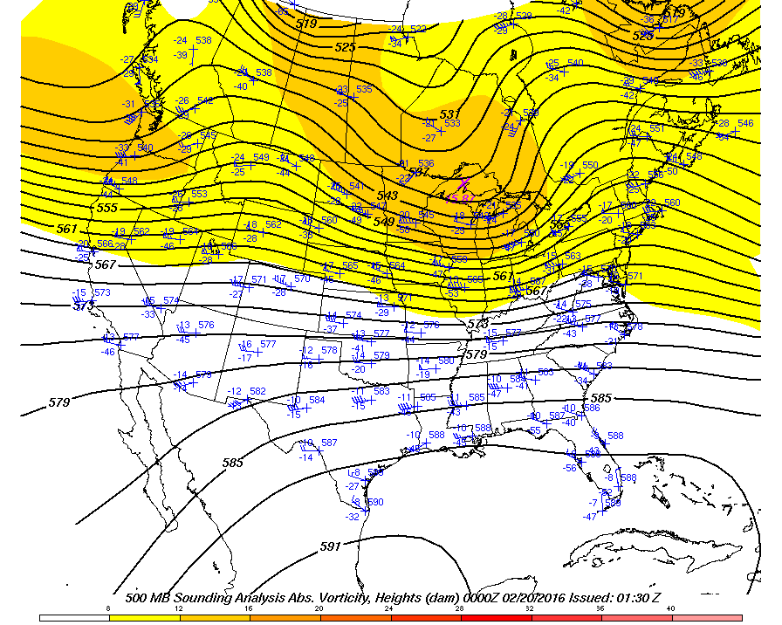
UPPER AIR MAPS

Slide 2
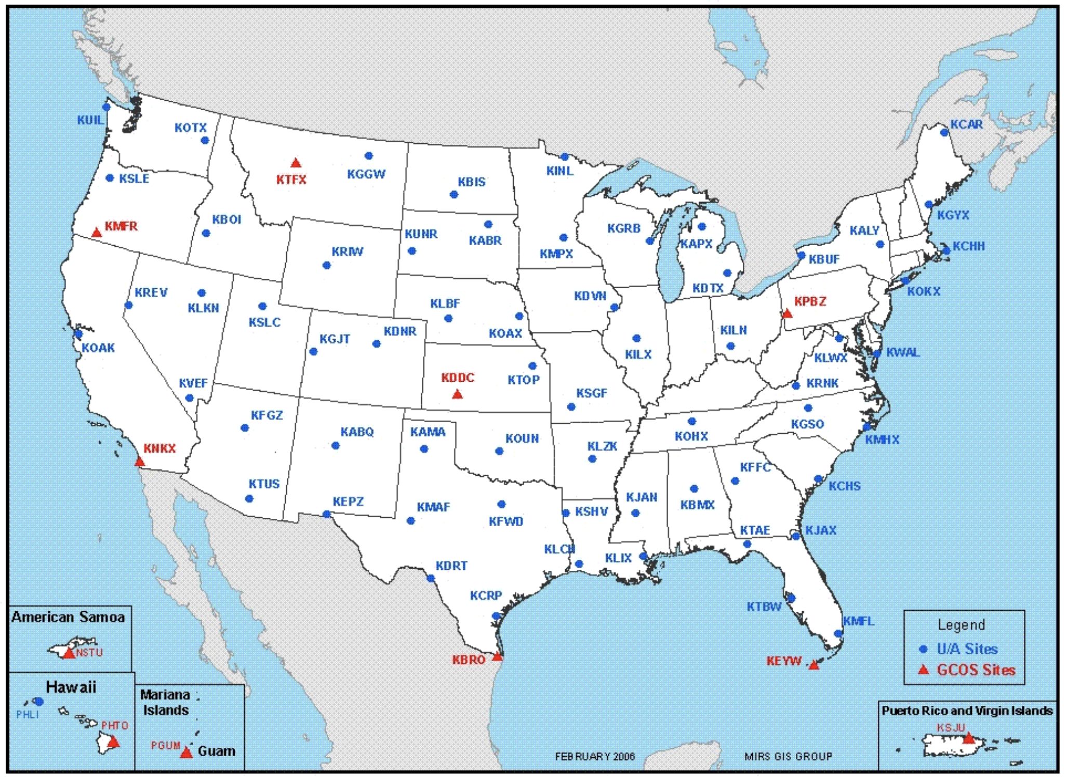
U.S. Rawinsonde Stations

Slide 3
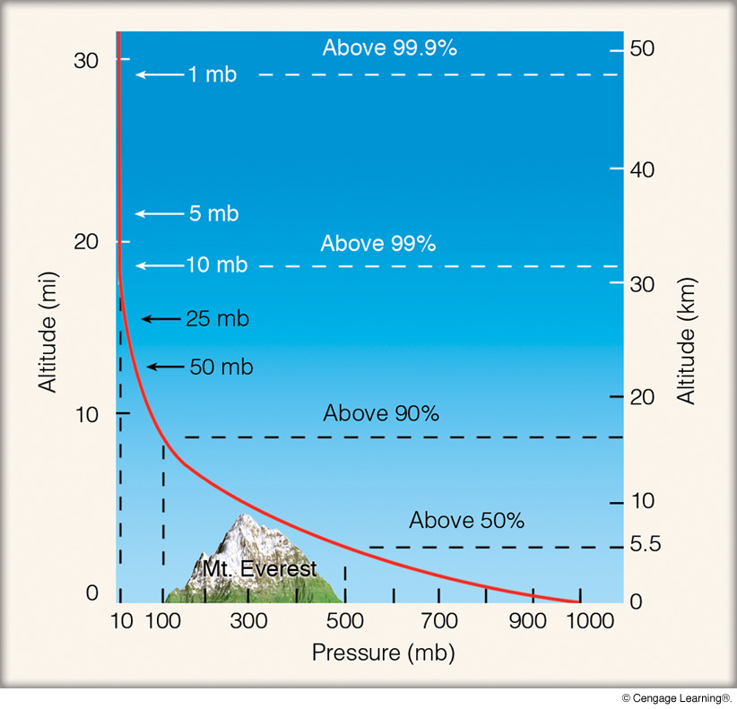
Change of Air Pressure with Height
Notes:
Page: 12
FIGURE 1.10 Atmospheric pressure decreases rapidly with height. Climbing to an altitude of only 5.5 km, where the pressure is 500 mb, would put you above one-half of the atmosphere’s molecules.

Slide 4
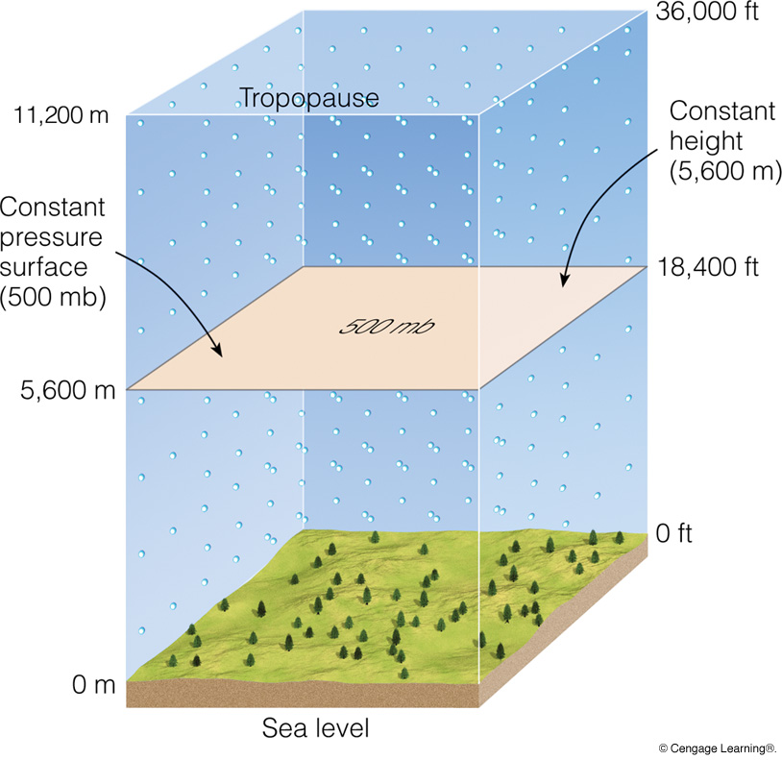
Notes:
Page: 207
FIGURE 8.12 When there are no horizontal variations in pressure, constant pressure surfaces are parallel to constant height surfaces. In the diagram, a measured pressure of 500 millibars is 5600 meters above sea level everywhere. The actual atmosphere extends well above the tropopause level shown here. (Dots in the diagram represent air molecules.)

Slide 5
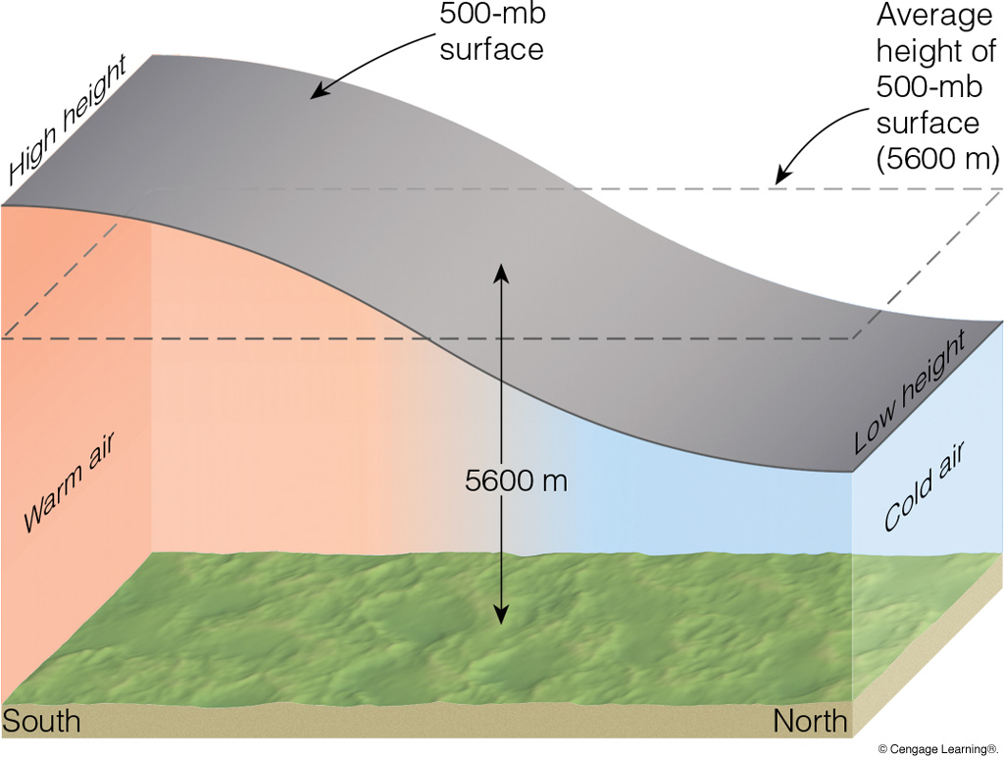
Pressure = 500 mb
Warm air is less dense (“thicker”) than cold air.
Notes:
Page: 207
FIGURE 8.13 The area shaded gray in the above diagram represents a surface of constant pressure, or isobaric surface. Because of the changes in air density, the isobaric surface rises in warm, less-dense air and lowers in cold, more-dense air. Where the horizontal temperature changes most quickly, the isobaric surface changes elevation most rapidly.

Slide 6
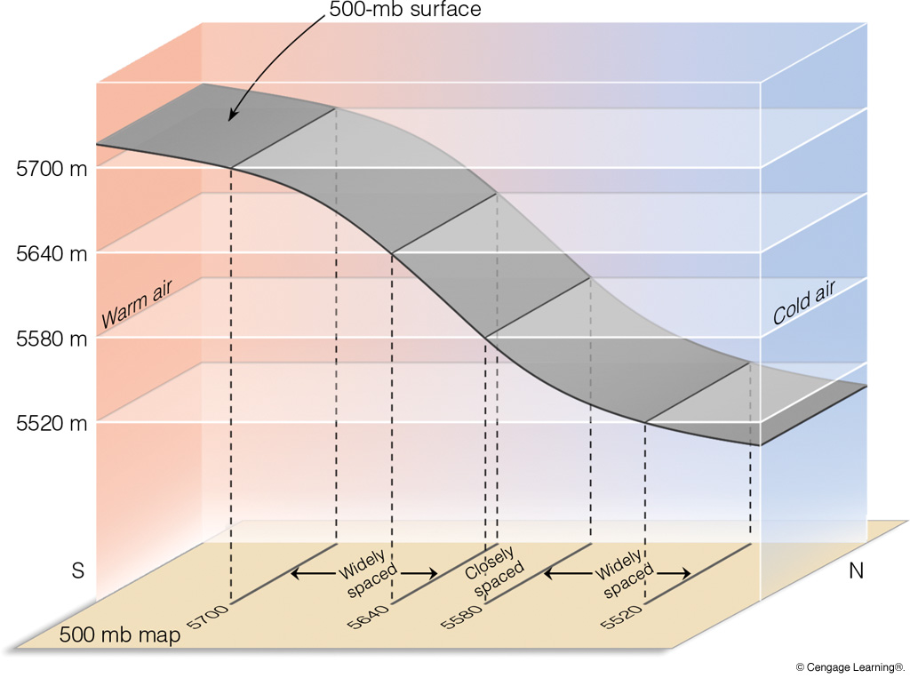
Strongest
Winds
Notes:
Page: 208
FIGURE 8.14 Changes in altitude of an isobaric surface (500 mb) show up as contour lines on an isobaric (500 mb) map. Where the isobaric surface dips most rapidly, the contour lines are closer together on the 500-mb map.

Slide 7
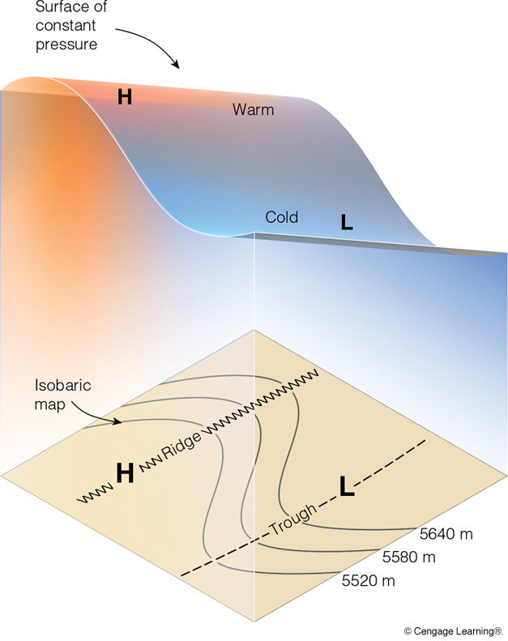
Three-Dimensional Depiction
of an Upper Air Constant
Height Surface
Notes:
Page: 208
FIGURE 8.15 The wavelike patterns of an isobaric surface reflect the changes in air temperature. An elongated region of warm air aloft shows up on an isobaric map as higher heights and a ridge; the colder air shows as lower heights and a trough.

Slide 8
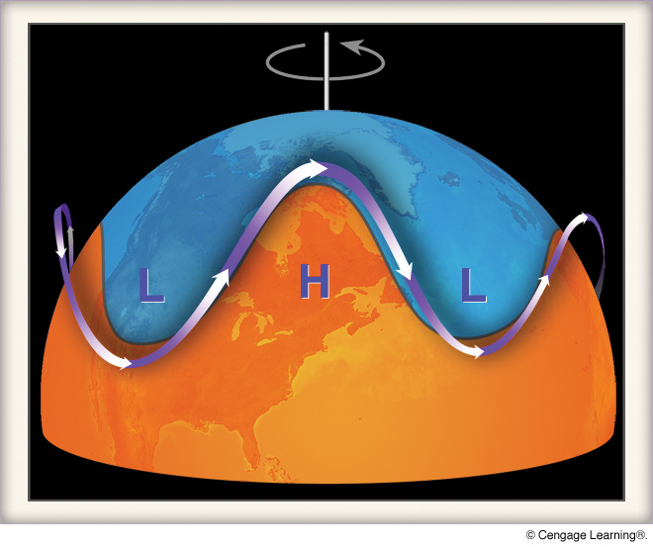
Ridge
Surface
Low
Surface
High
Cold
Cold
L
H
Trough
Warm
Surface lows form downstream of upper air troughs.
Surface highs form downstream of upper air ridges.
Notes:
Page: 274
FIGURE 2 The circulation of the air aloft is in the form of waves—troughs and ridges—that encircle the globe.

Slide 9
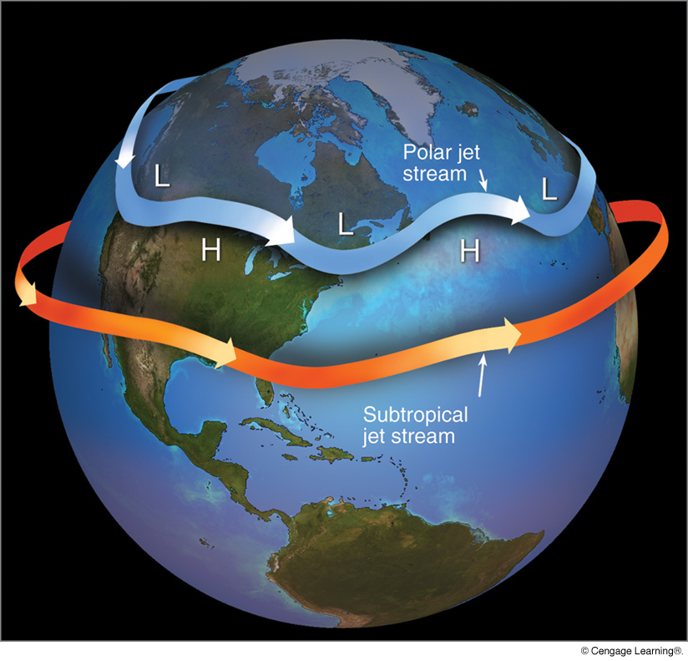
Jet Streams
COLD
WARM
WARM
WARM
(Chap. 8, pp. 203–208)
https://www.weather.gov/
jetstream/constant_intro
Notes:
Page: 275
FIGURE 10.12 A jet stream is a swiftly flowing current of air that moves in a wavy west-to-east direction. The figure shows the position of the polar jet stream and subtropical jet stream in winter. Although jet streams are shown as one continuous river of air, in reality they are discontinuous, with their position varying from one day to the next.

