Slide 1
THERMODYNAMICS
AND
MOISTURE

Slide 2
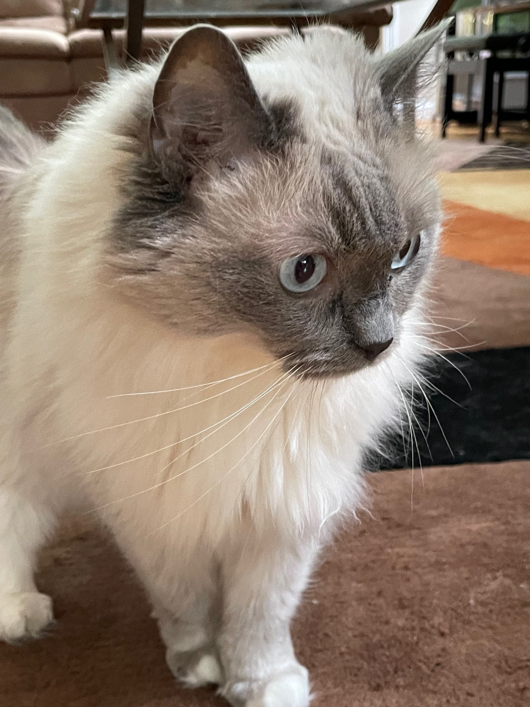
IDEAL GAS LAW (EQUATION OF STATE)
R is called the specific gas constant. Its value depends on the molecular weight of the gas, so it varies from gas to gas.

Slide 3
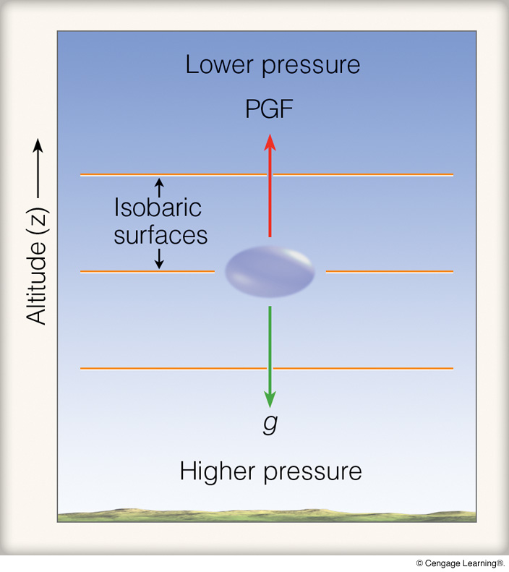
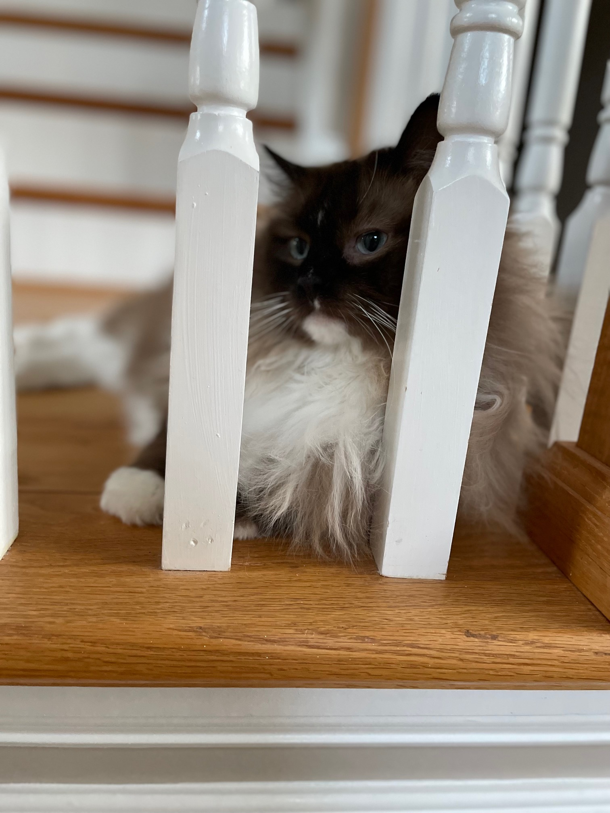
HYDROSTATIC BALANCE
so

Slide 4
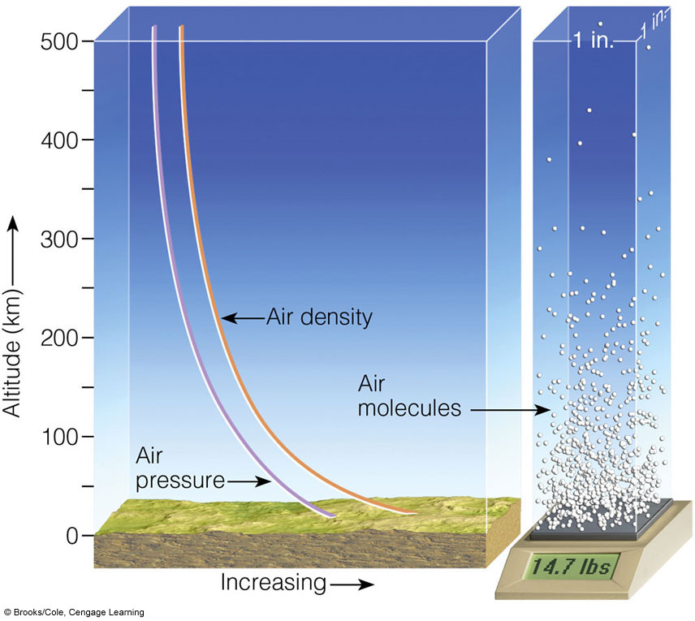

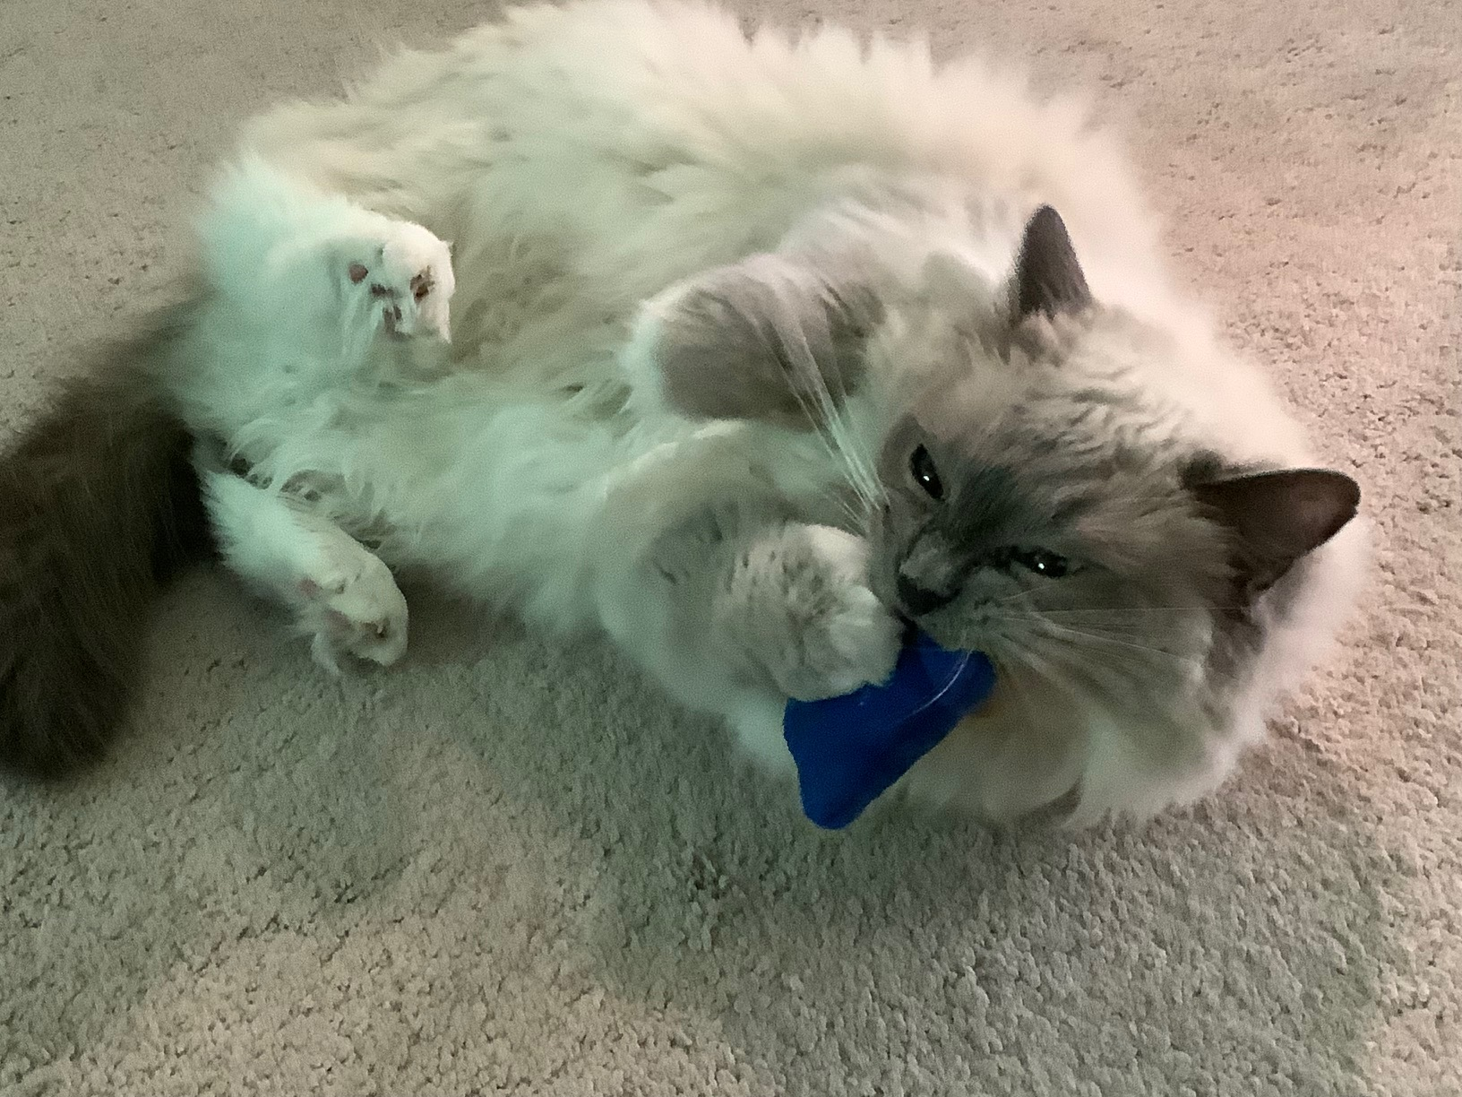
HYDROSTATIC BALANCE

Slide 5
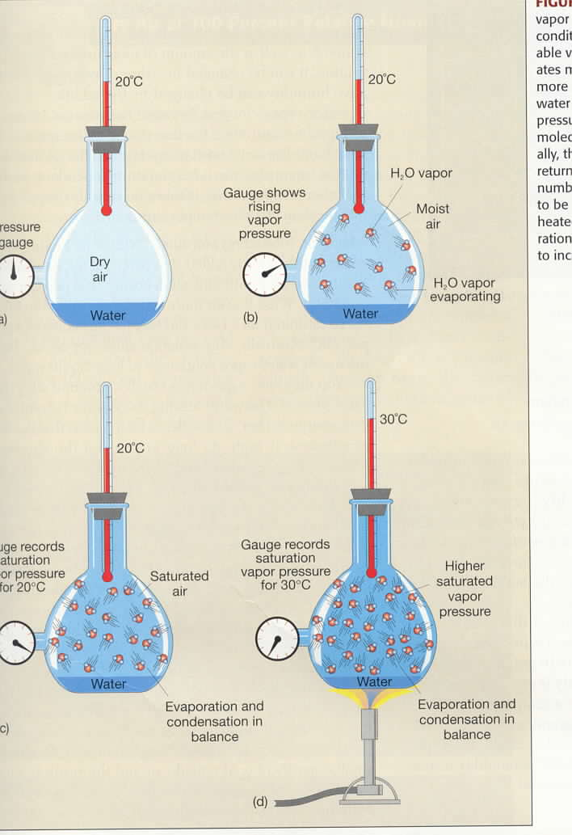
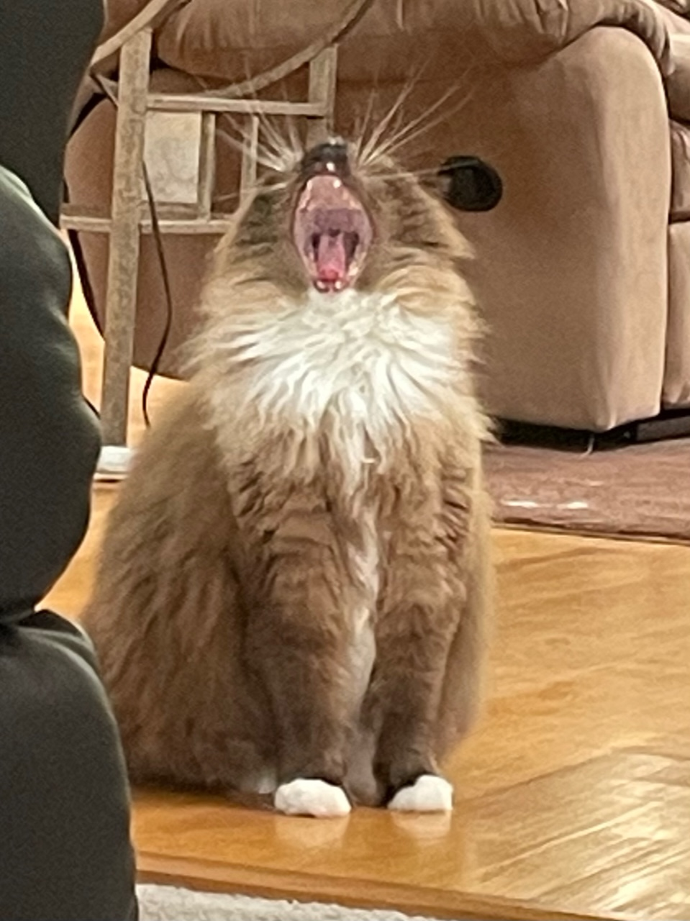
Vapor Pressure
and
Temperature
e = vapor pressure
e_{s} = saturation
vapor pressure
e_{s} = e_{s}(T)
(e_{s} is only a function
of T)

Slide 6
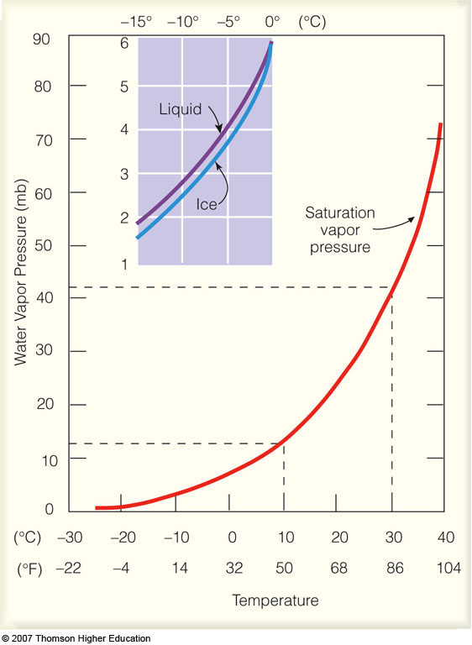
Saturation
Vapor Pressure
and
Temperature
e_{s liquid} >= e_{s ice}
e_{s} = e_{s}(T)
supercooled
water
Notes:
Figure 4.10
Saturation vapor pressure increases with increasing temperature. At a temperature of 10°C, the saturation vapor pressure is about 12 mb, whereas at 30°C it is about 42 mb. The insert illustrates that the saturation vapor pressure over water is greater than the saturation vapor pressure over ice.

Slide 7
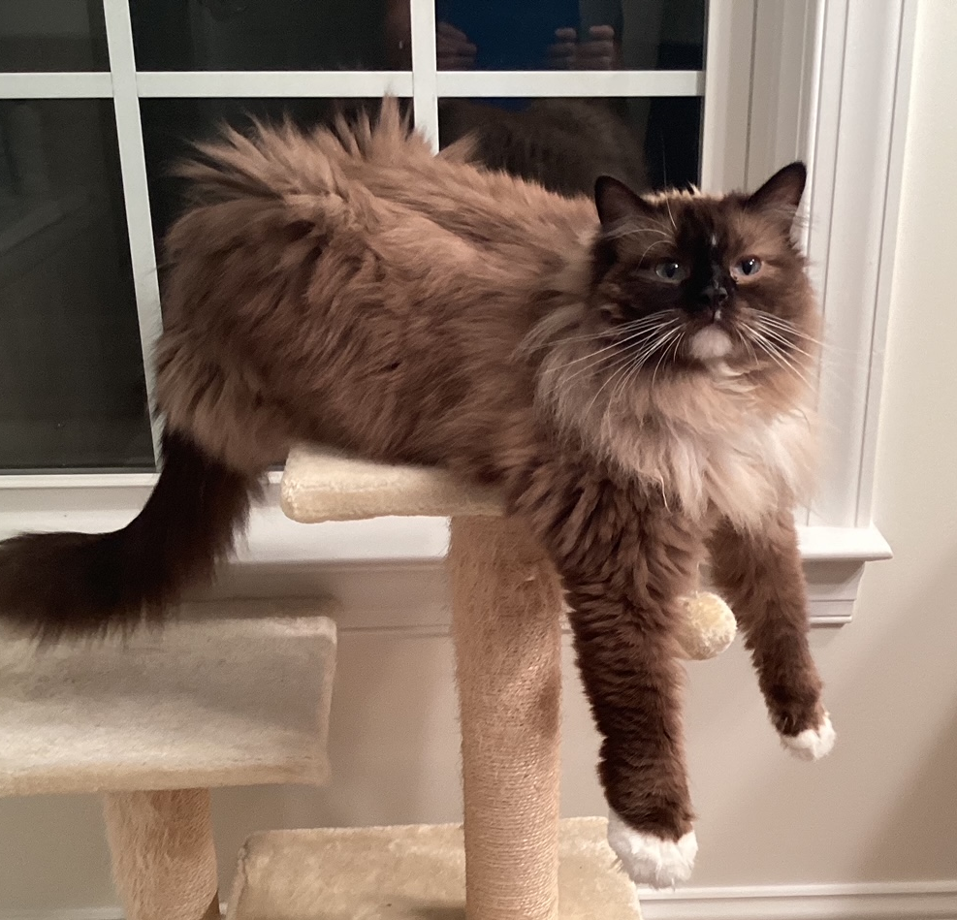
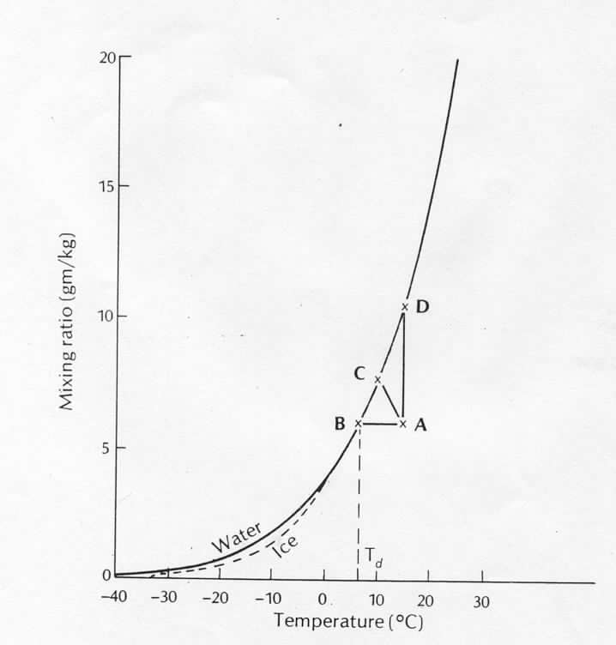
SATURATION EXAMPLES
saturation
curve (w_{s})
constant w
(unsaturated)
T

Slide 8
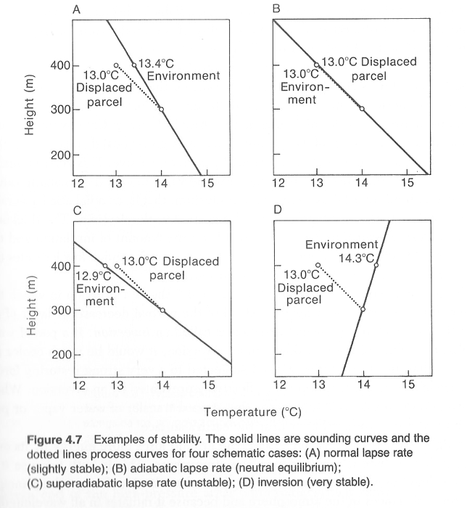
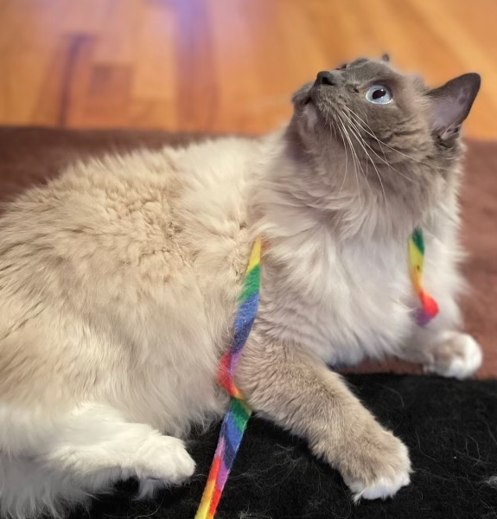
Layer
Stability
dotted line =
dry adiabatic
lapse rate
“process curve”
solid line =
observed (measured)
lapse rate
N: Chap. 4
A: p. 202, p. 222

Slide 9
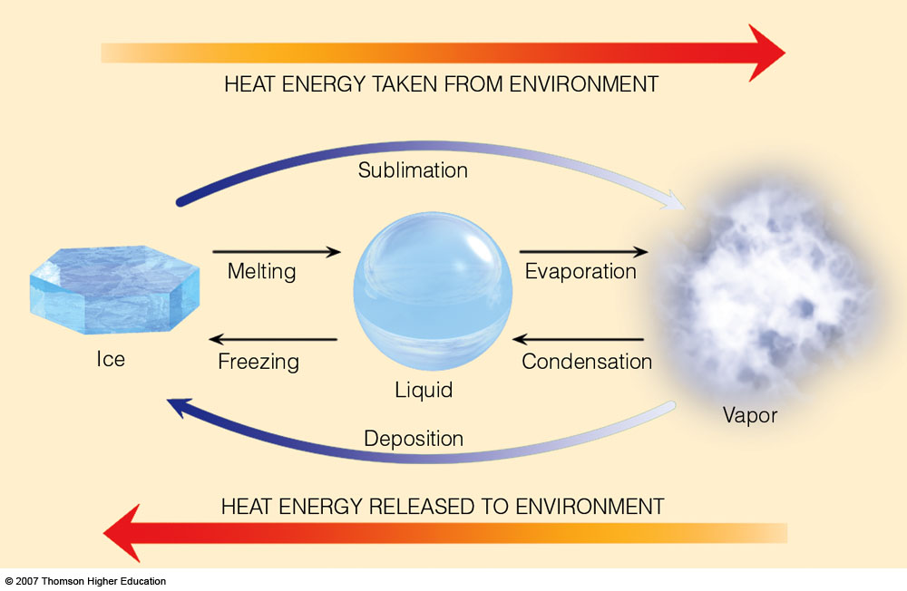
3.3 x 10⁵ J/kg
2.5 x 10⁶ J/kg
Latent heat (L) of water phase changes
Notes:
Figure 2.3
Heat energy absorbed and released.

Slide 10
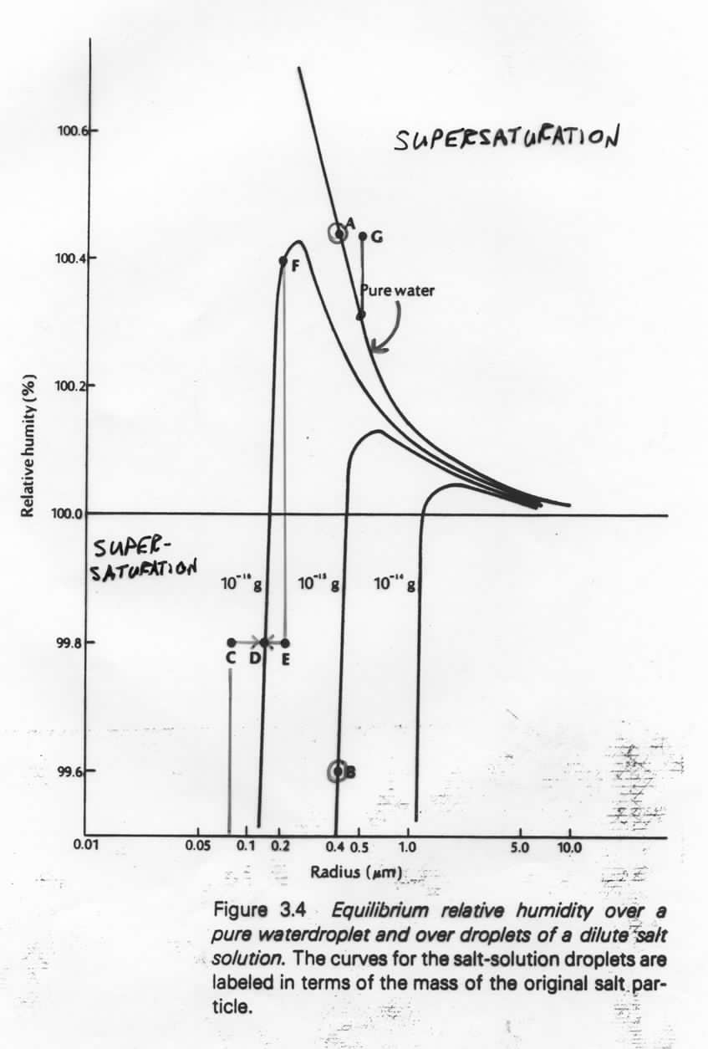

CURVATURE AND SOLUTE EFFECTS
A: r = 0.4 microns: saturated relative to pure water,
RH=100.42%
Supersaturation
B: r = 0.4 microns: w/ 10^{–15}g (solute), A is
supersaturated (equilibrium at 99.6%)
C: 10^{–16}g in solution; r=0.075 microns; RH=99.8%
supersaturated...grows to r=0.15 microns (D)
E: 10^{–16}g in solution; r=0.2 microns; RH=99.8%
unsaturated (equilibrium at 100.4% (F))
...evaporates to r=0.15 microns (D)
Super-
saturation
G: supersatured relative to both pure and solute
curves...would grow rapidly

Slide 11
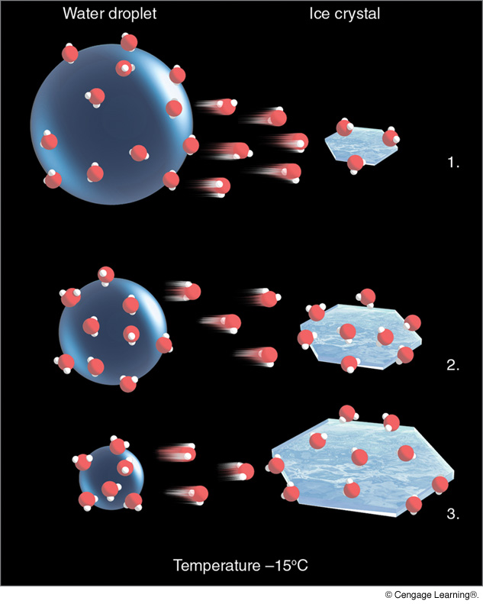
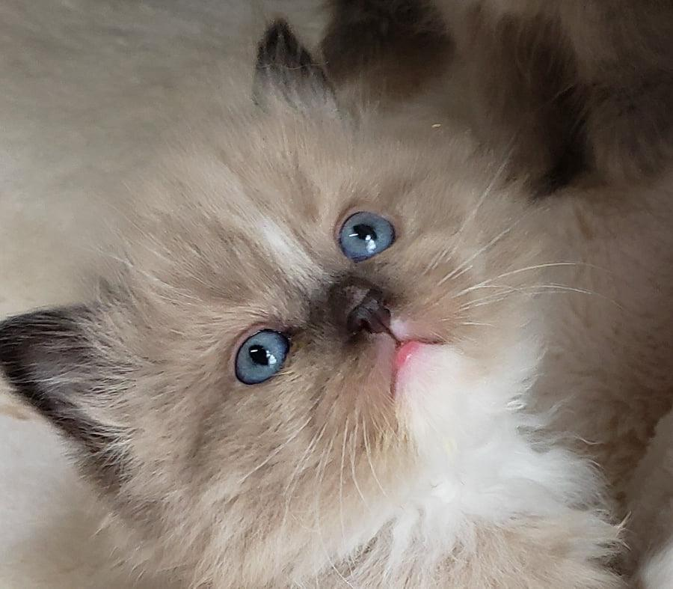
The Bergeron (Ice Crystal) Process
(N: 135–146;
A: Chap. 7)
Notes:
Figure 7.9
The ice-crystal process. The greater number of water vapor molecules around the liquid droplets causes water molecules to diffuse from the liquid drops toward the ice crystals. The ice crystals absorb the water vapor and grow larger, while the water droplets grow smaller.

Slide 12
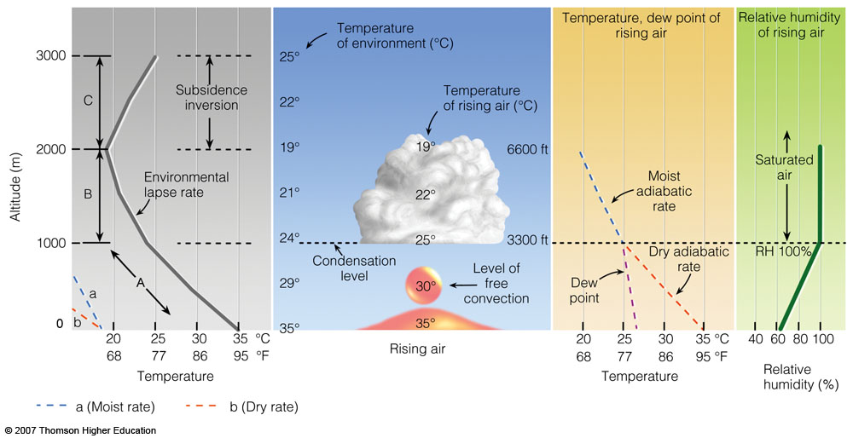
Convective Cloud Formation
Notes:
Figure 6.18
The development of a cumulus cloud.

Slide 13
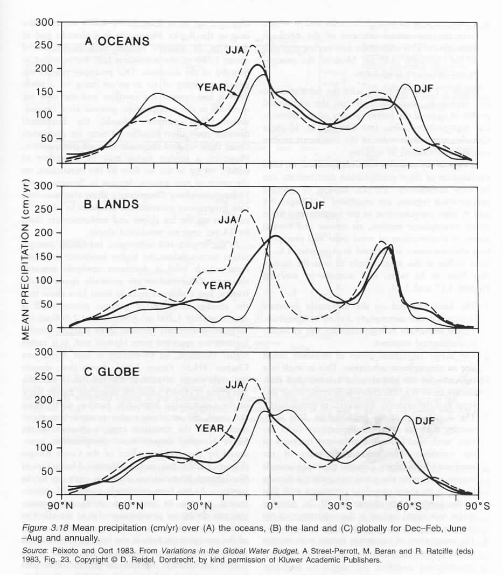


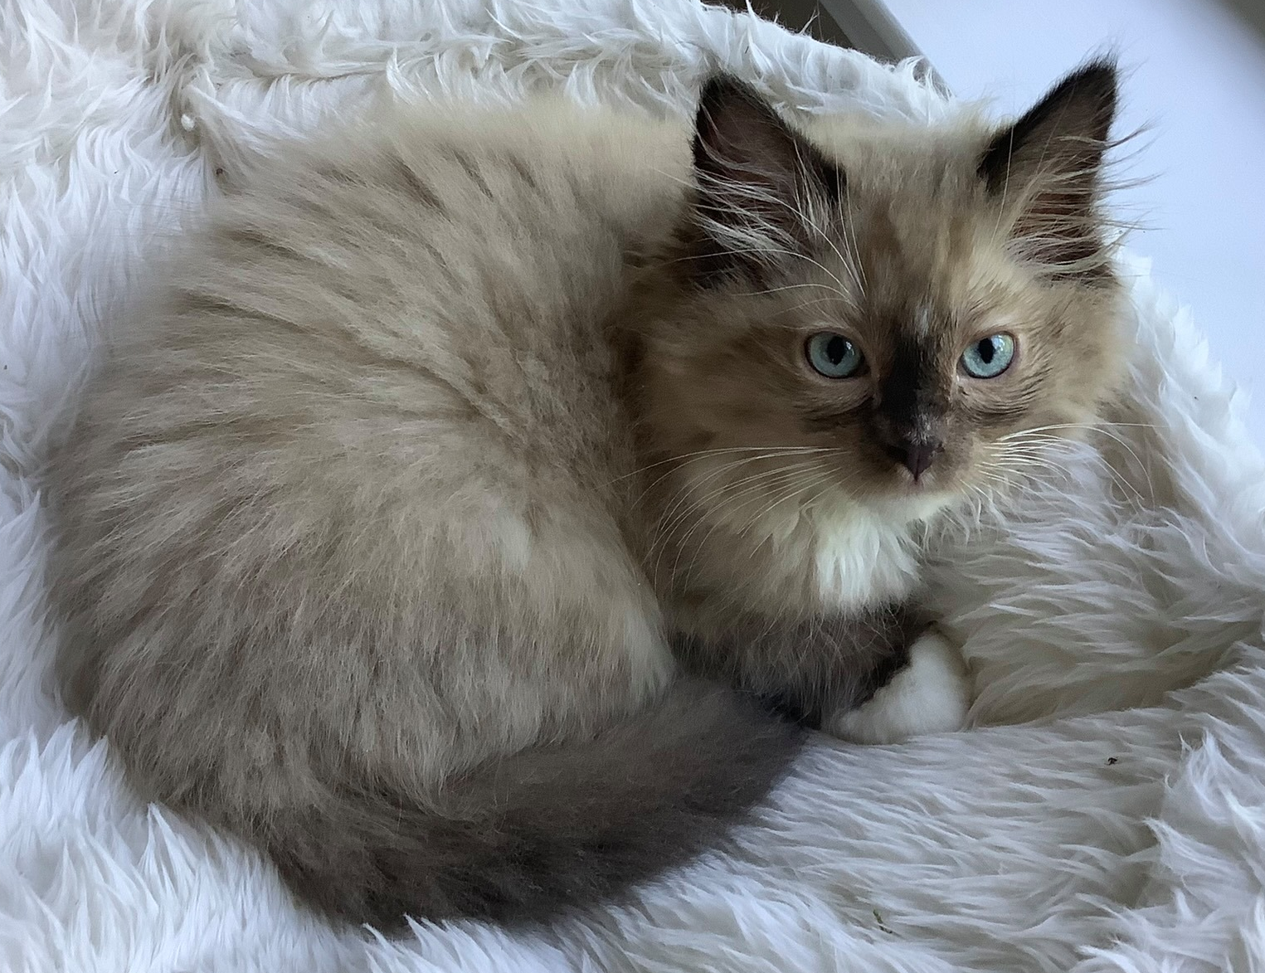
PRECIPITATION BY LATITUDE BAND
*
*S. Chile

Slide 14
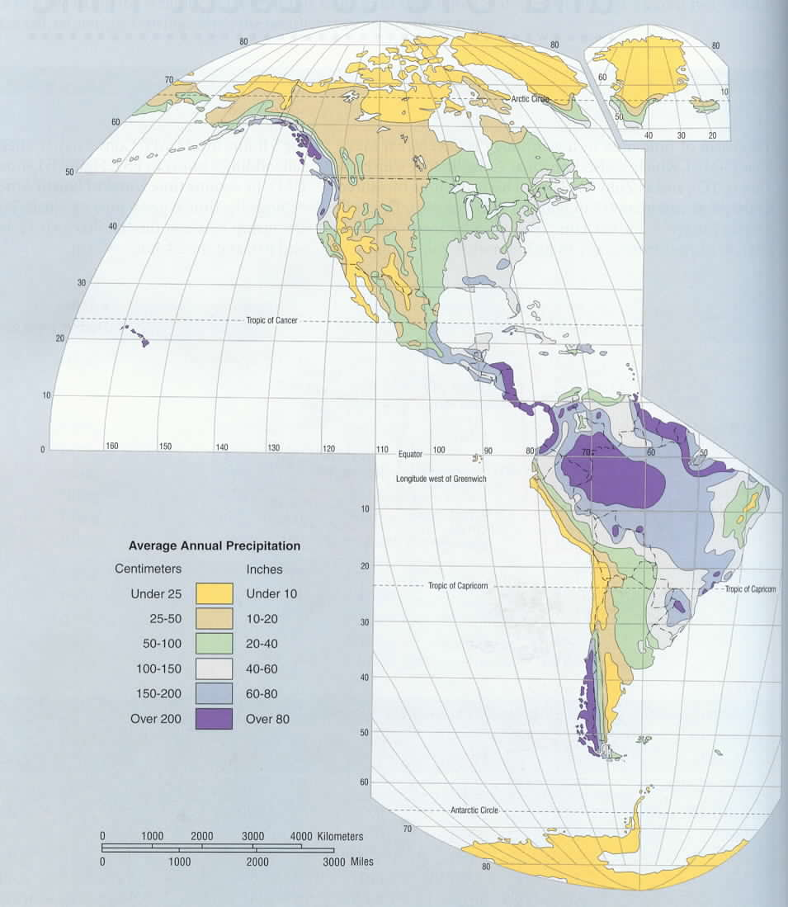
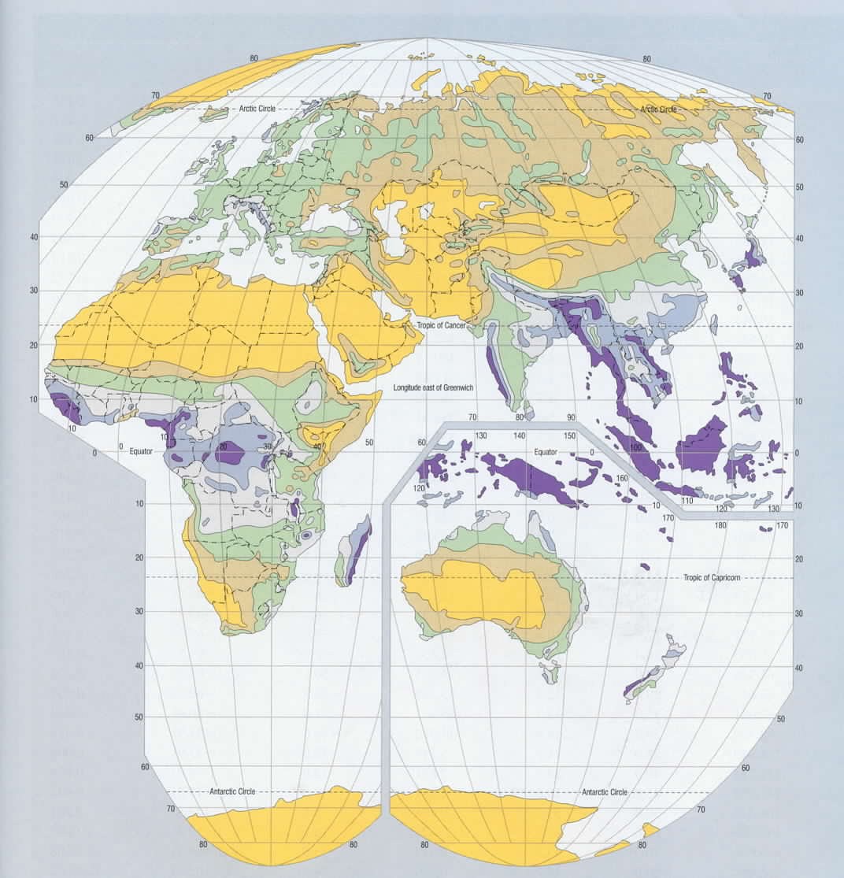
Mean Annual Precipitation

Slide 15
