Slide 1
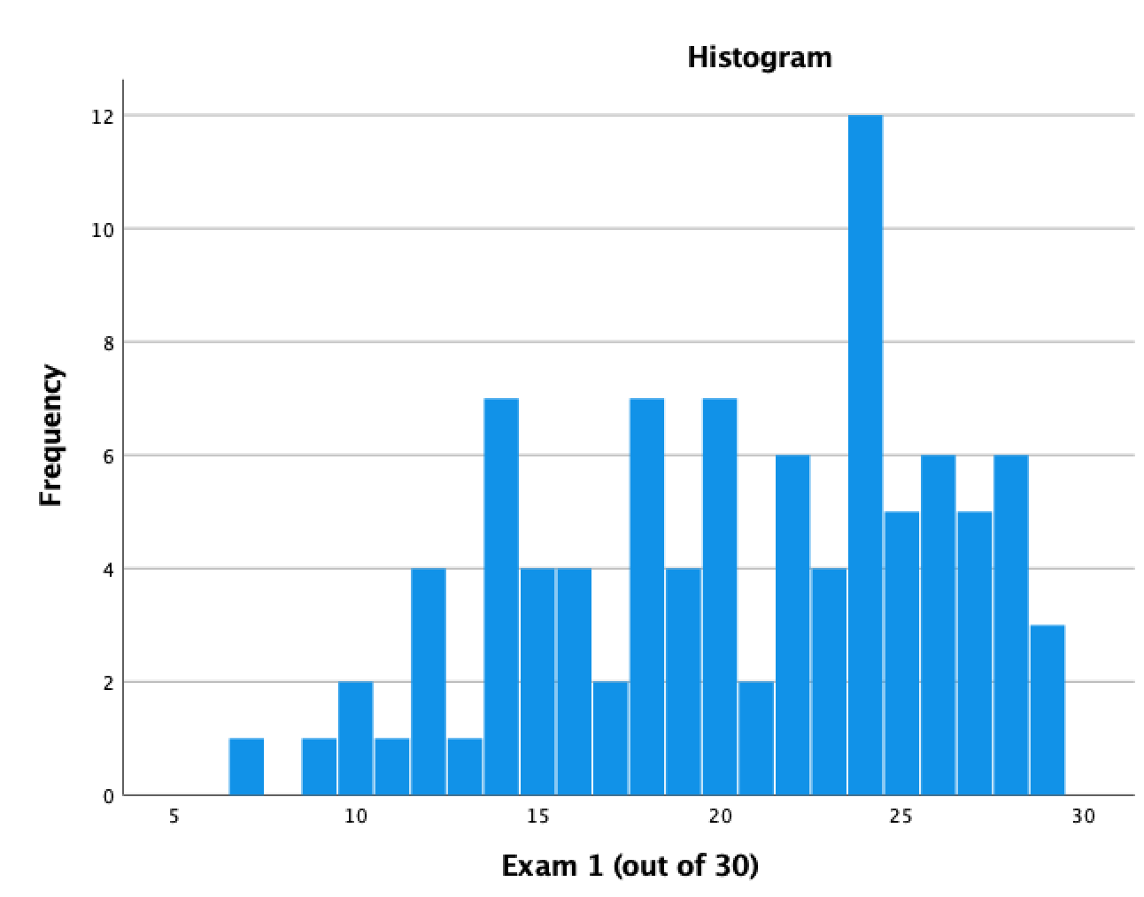
EVSC 1300—Spring, 2022
Exam 1
30 total points
Median = 22
Stn. Deviation = 5
>=27 A
22–26 B
18–21 C
13–17 D
<= 12 F

