Slide 1

ATMOSPHERIC
MOISTURE
(Chapter 4)

Slide 2
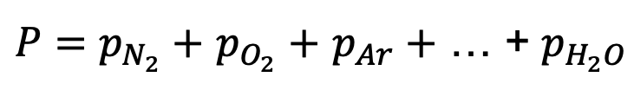
Water in the Atmosphere
All 3 phases (solid, liquid, gas) under commonly-
observed temperatures and pressures
Vapor: 0–4% by volume (@ surface)
Dalton’s Law of Partial Pressures: total air pressure
is the sum of the partial pressures of the individual constituents
$P=p_{N_{2}}+$ $p_{O_{2}}+$ $p_{Ar}+$ … + $p_{H_{2}O}$
vapor
pressure (e)
[units = millibars]

Slide 3
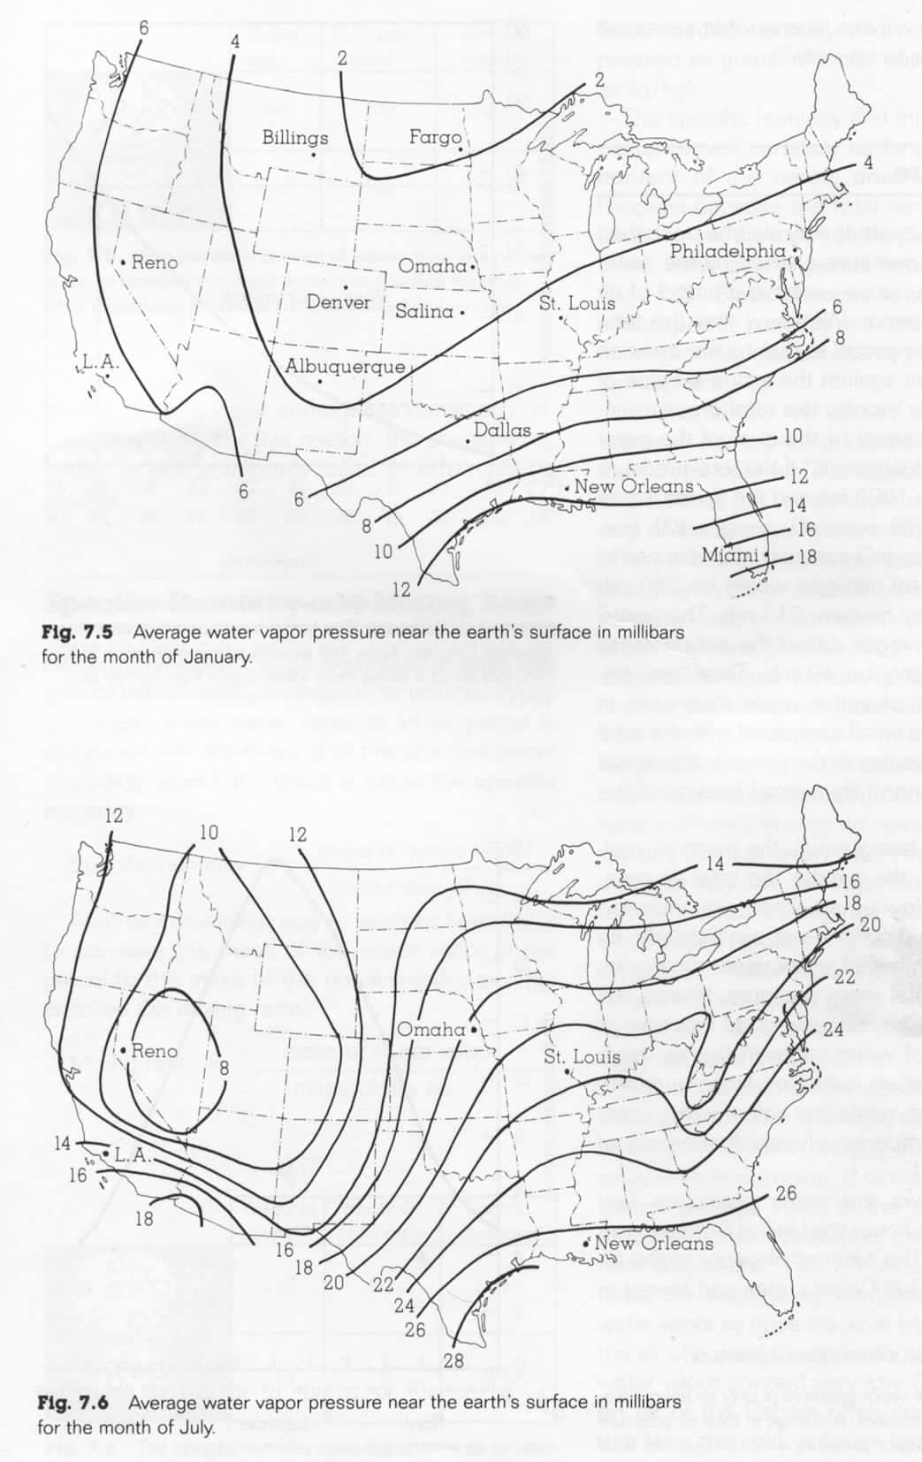
Average January Vapor Pressure (mb)

Slide 4
Average July Vapor Pressure (mb)

Slide 5
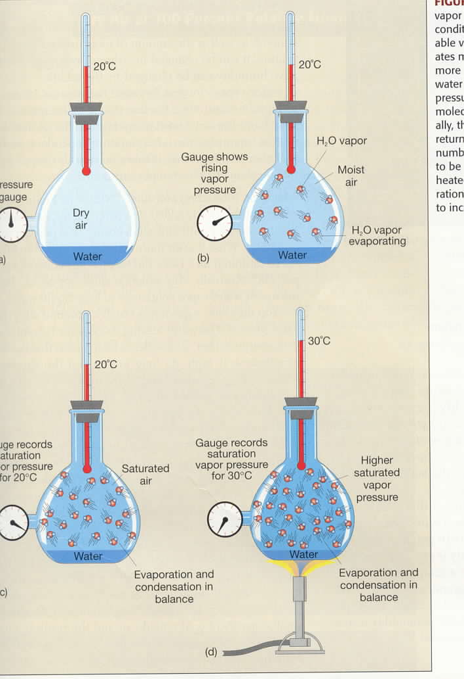
Vapor Pressure, Saturation Vapor Pressure, and Temperature
e = vapor pressure
0
Pressure
gauge
e_{s} depends only
on the temperature!
Gauge records
saturation vapor
pressure for 20°C
e_{s} = saturation
vapor pressure

Slide 6
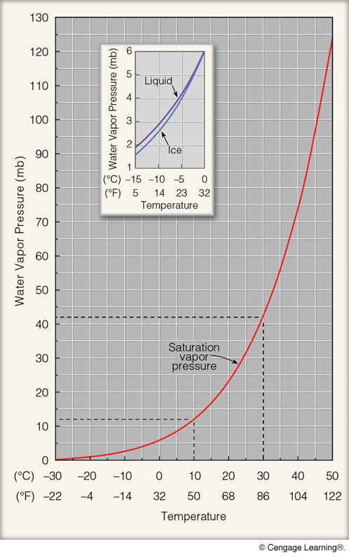
SATURATION VAPOR
PRESSURE AND
TEMPERATURE
The vapor pressure of saturated
air (the saturation vapor pressure)
depends ONLY on TEMPERATURE!
Notes:
Page: 99
FIGURE 4.10 Saturation vapor pressure increases with increasing temperature. At a temperature of 10°C, the saturation vapor pressure is about 12 mb, whereas at 30°C it is about 42 mb. The inset illustrates that the saturation vapor pressure over water is greater than the saturation vapor pressure over ice. Why would

Slide 7
Cloud Condensation Nucleii (CCN)
For cloud droplets to form, liquid water needs to condense onto something.
CCN include salt, soil particles, ash, dust,
various pollutants, aerosols, etc.
In completely pristine air, cloud formation would
be very difficult.

Slide 8
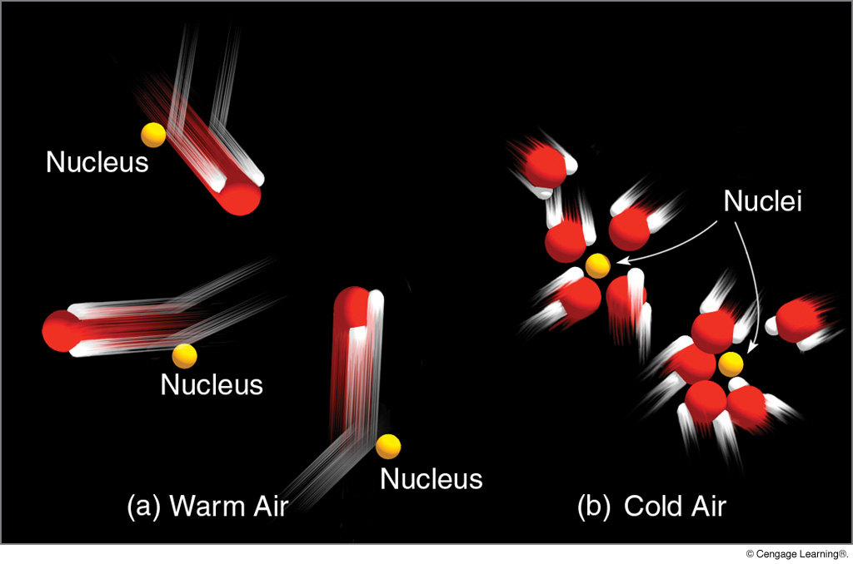
CONDENSATION AND TEMPERATURE
As air cools, condensation becomes more likely.
Notes:
Page: 96
FIGURE 4.5 Condensation is more likely to occur as the air cools. (a) In the warm air, fast-moving water vapor molecules tend to bounce away after colliding with nuclei. (b) In the cool air, slow-moving vapor molecules are more likely to join together on nuclei. The condensing of many billions of water molecules produces tiny liquid water droplets.

Slide 9
SATURATION VAPOR
PRESSURE AND
TEMPERATURE
The vapor pressure of saturated
air (the saturation vapor pressure)
depends ONLY on TEMPERATURE!
Cooling the air lowers the
saturation vapor pressure,
making condensation more
likely
Notes:
Page: 99
FIGURE 4.10 Saturation vapor pressure increases with increasing temperature. At a temperature of 10°C, the saturation vapor pressure is about 12 mb, whereas at 30°C it is about 42 mb. The inset illustrates that the saturation vapor pressure over water is greater than the saturation vapor pressure over ice. Why would

Slide 10
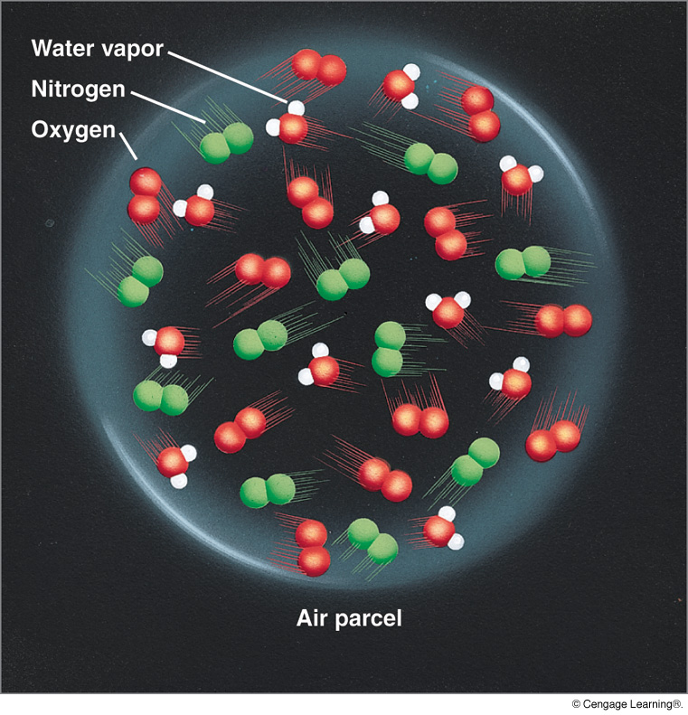
Notes:
Page: 97
FIGURE 4.6 The water vapor content (humidity) inside this air parcel can be expressed in a number of ways.

Slide 11
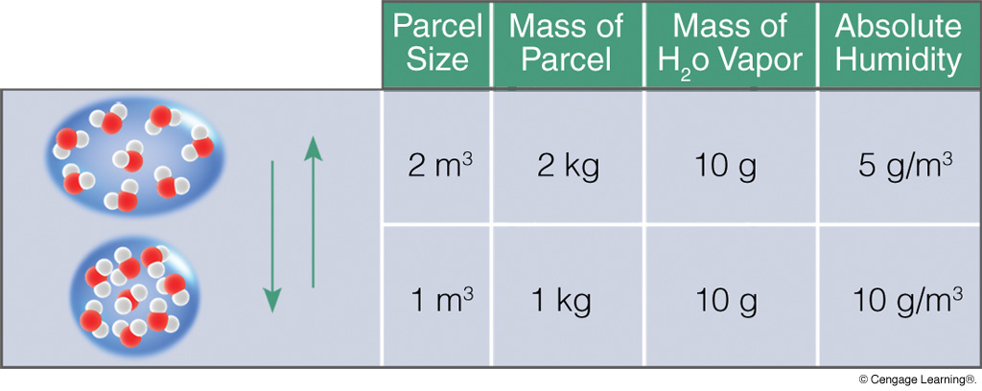
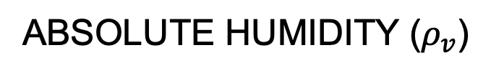
ABSOLUTE HUMIDITY ($ρ_{v}$)
Mass of water vapor per volume of air
up
Absolute humidity varies as the air’s volume (or density)
changes. Note that water vapor remains constant.
Notes:
Page: 97
FIGURE 4.7 With the same amount of water vapor in a parcel of air, an increase in volume decreases absolute humidity, whereas a decrease in volume increases absolute humidity.

Slide 12

SPECIFIC HUMIDITY (q)
Mass of water vapor per mass of air
Specific humidity is conservative for pressure (temperature) changes.
MIXING RATIO (w): Mass of water vapor per mass of dry air
Notes:
Page: 97
FIGURE 4.8 The specific humidity does not change as air rises and descends.

Slide 13
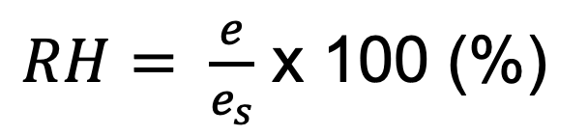
Relative Humidity (RH)
Relative humidity is the amount of water vapor in the air divided by the maximum possible amount for a given temperature.
RH measures proximity to saturation
moisture in air
$RH= \frac{e}{e_{s}}$ x 100 (%)
But e_{s} only depends
on temperature!
max possible amount
RH is NOT conservative for pressure and temperature changes.

Slide 14
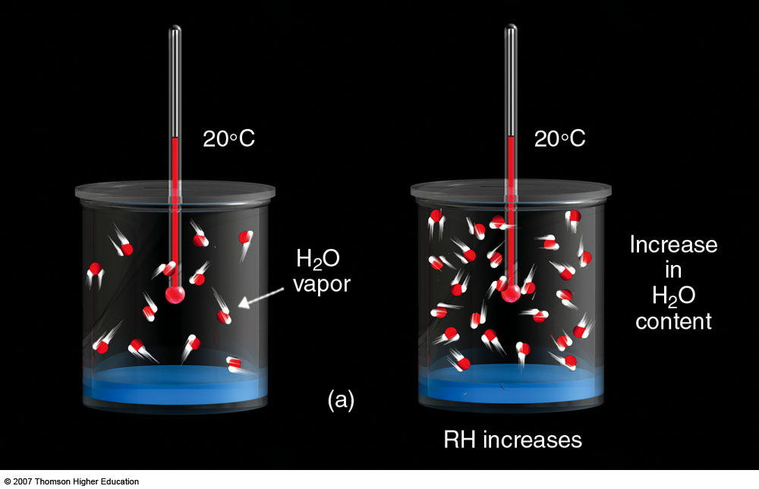
RELATIVE HUMIDITY (RH)
Assume unsaturated air
Air is closer to being saturated, so RH increases
Notes:
Figure 4.11
(a) At the same air temperature, an increase in the water vapor content of the air increases the relative humidity as the air approaches saturation.

Slide 15
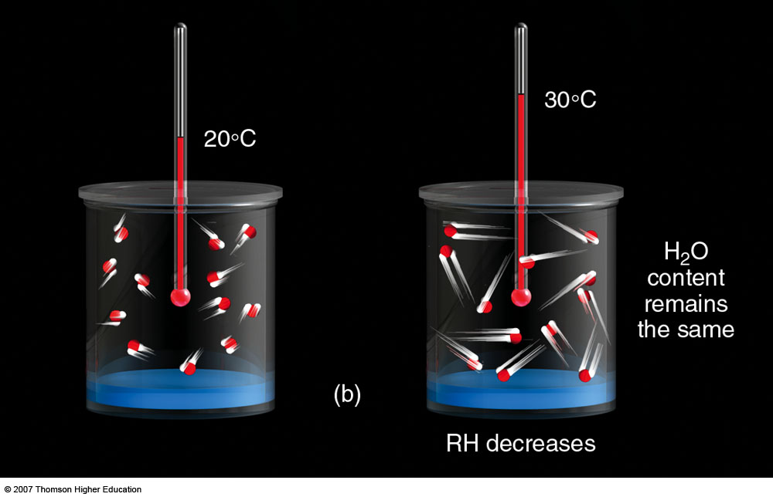
RELATIVE HUMIDITY
Despite same water content (vapor pressure), RH lowers because of higher temperature
and thus higher saturation vapor pressure.
Notes:
Figure 4.11
(b) With the same water vapor content, an increase in air temperature causes a decrease in relative humidity as the air moves farther away from being saturated.

Slide 16
SATURATION VAPOR
PRESSURE AND
TEMPERATURE
It takes a lot more
water vapor to
saturate warm air
than cold air.
Notes:
Page: 99
FIGURE 4.10 Saturation vapor pressure increases with increasing temperature. At a temperature of 10°C, the saturation vapor pressure is about 12 mb, whereas at 30°C it is about 42 mb. The inset illustrates that the saturation vapor pressure over water is greater than the saturation vapor pressure over ice. Why would

Slide 17
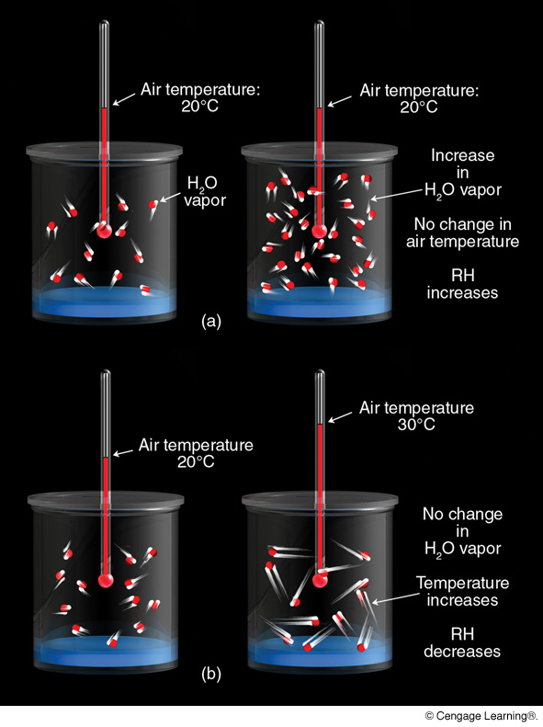
Constant
temperature,
increasing
vapor pressure
RH increases
Increasing
temperature,
constant
vapor pressure
RH decreases
Notes:
Page: 101
FIGURE 4.11 (a) At the same air temperature, an increase in the water vapor content of the air increases the relative humidity as the air approaches saturation. (b) With the same water vapor content, an increase in air temperature causes a decrease in relative humidity as the air moves farther away from being saturated.

Slide 18
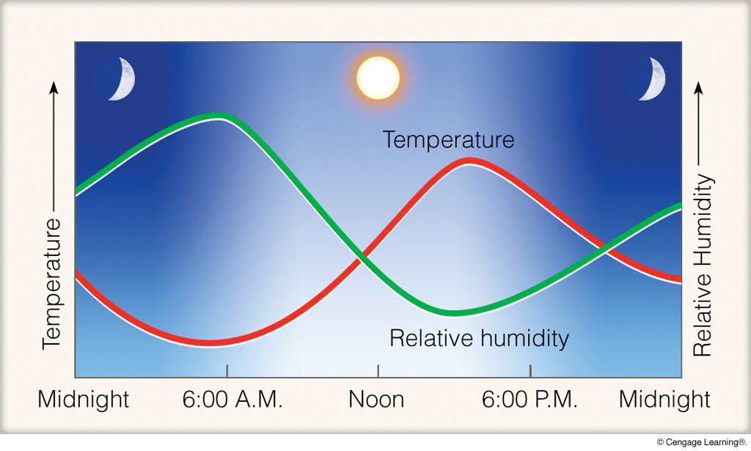
DIURNAL VARIATION OF RELATIVE HUMIDITY
RH tends to be highest when it is coldest.
Notes:
Page: 101
FIGURE 4.12 When the air is cool (morning), the relative humidity is high. When the air is warm (afternoon), the relative humidity is low. These conditions exist in clear weather when the air is calm or of constant wind speed.

Slide 19
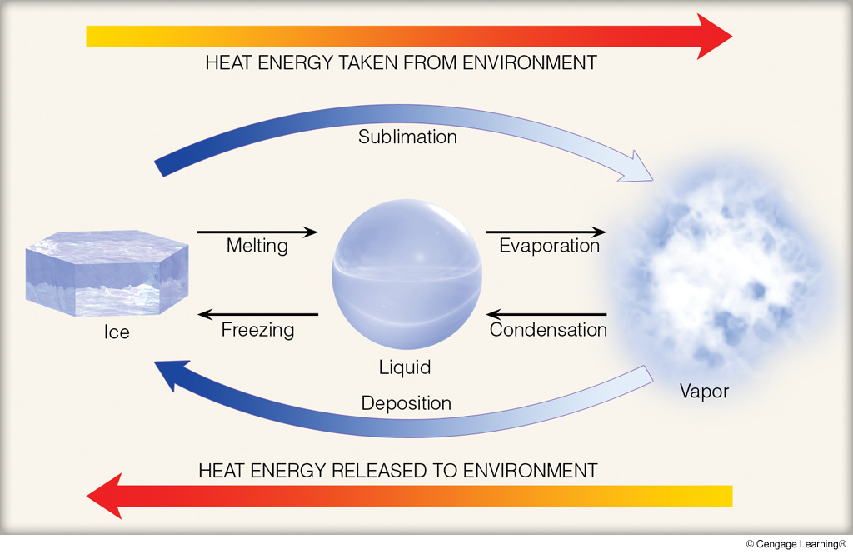
LATENT HEAT
Phase changes occur at constant temperature.
(pp. 34–35)
Notes:
Page: 35
FIGURE 2.3 Heat energy absorbed and released.

Slide 20
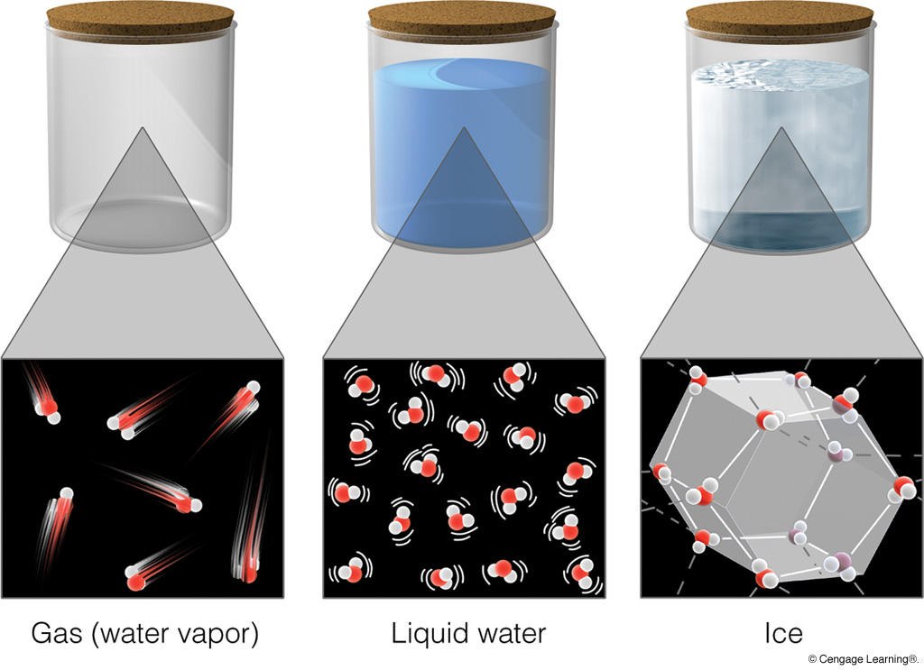
Phases of Water
Notes:
Page: 95
FIGURE 4.3 The three states of matter: water as a gas, as a liquid, and as a solid.

Slide 21
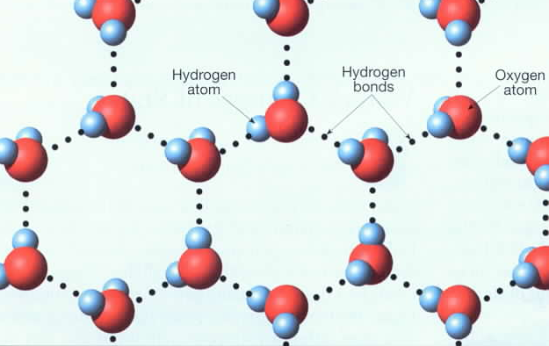
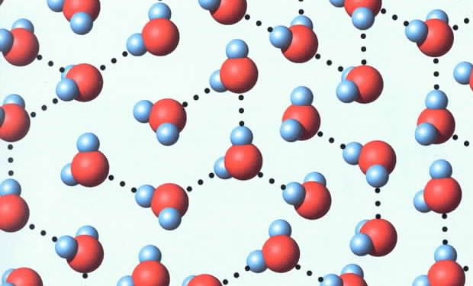
Phases of Water
ICE
LIQUID WATER
(note higher density)

Slide 22
Dew Point Temperature (T_{d})
Temperature below which any further cooling produces
condensation.
T ≥ T_{d}
 | Td (°F) | T(°F) | RH (%)
midnight | 50 | 60 | 70
3 a.m. | 50 | 55 | 83
6 a.m. | 50 | 50 | 100
9 a.m. | 49 | 49 | 100
saturation
condensation
Latent heat is released and dew point drops very slowly
(or not at all) as vapor is converted to liquid. Dew forms
(or cloud droplets form in the atmosphere).
If T_{d} ≤ 32°F (0°C), it is called the frost point (T_{f}).

Slide 23
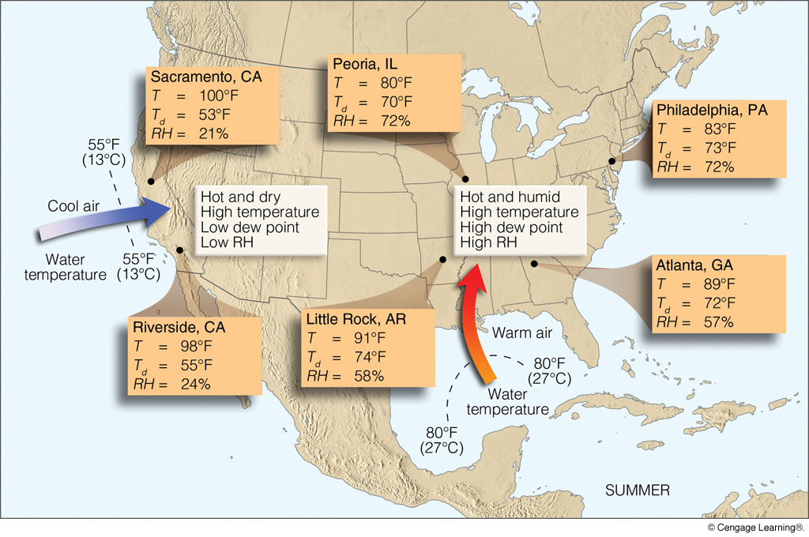
DEW POINT TEMPERATURE AND SOURCE REGION
Notes:
Page: 105
FIGURE 4.19 Air from the Pacific Ocean is hot and dry over land, whereas air from the Gulf of Mexico is hot and muggy over land. For each city, T represents the air temperature, Td the dew point, and RH the relative humidity. (All data represent conditions during a July afternoon at 3 p.m. local time.)

Slide 24
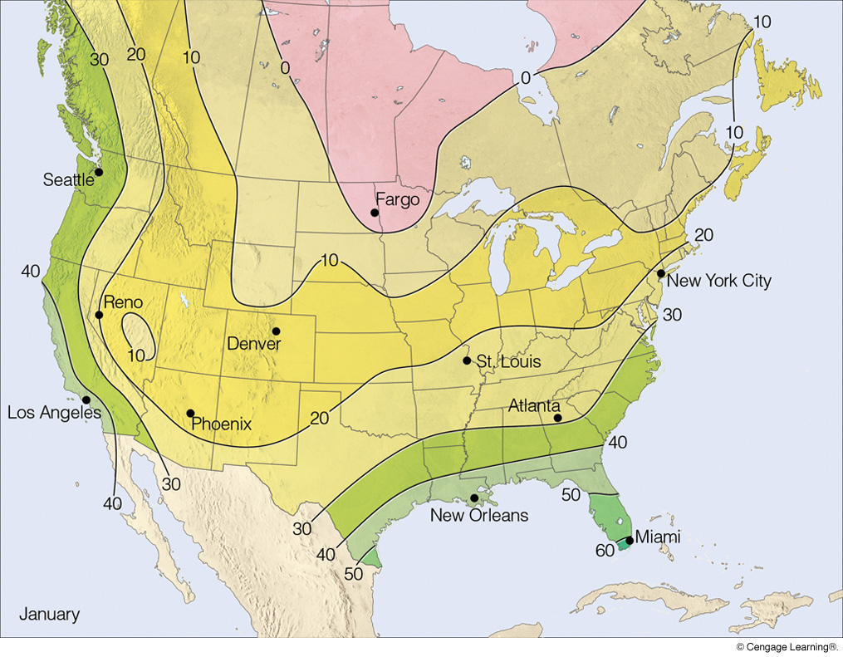
JANUARY DEW POINT TEMPERATURE
Notes:
Page: 102
FIGURE 4.14 Average surface dew-point temperatures (°F) across the United States and Canada for January.

Slide 25
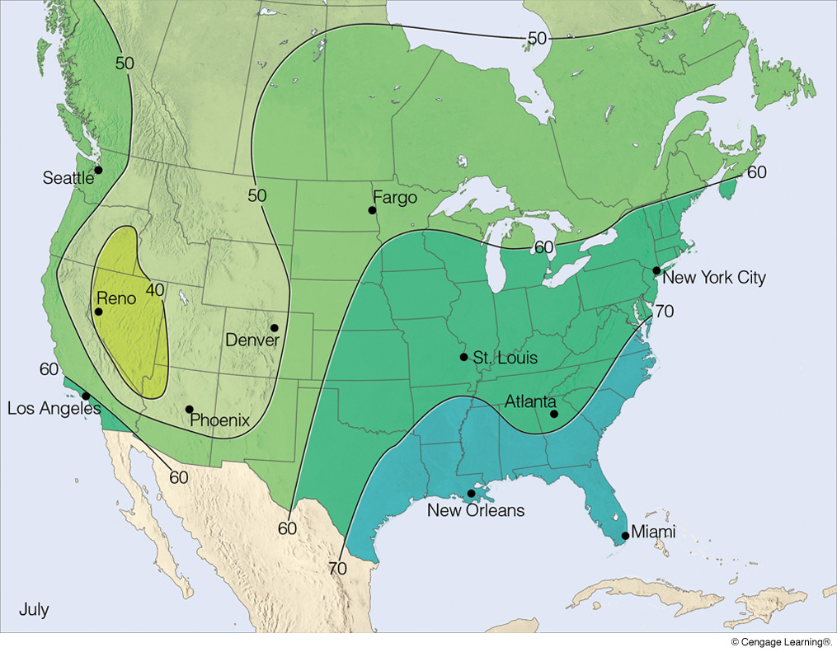
JULY DEW POINT TEMPERATURE
Notes:
Page: 103
FIGURE 4.15 Average surface dew-point temperatures across the United States and Canada (°F) for July.

Slide 26
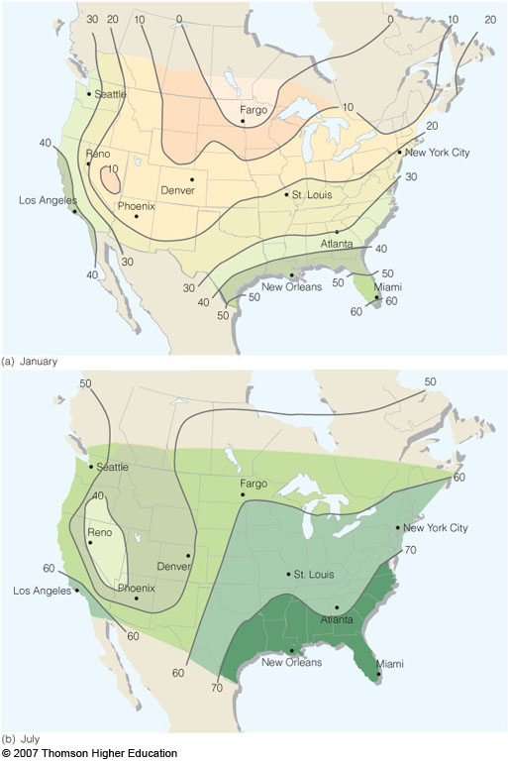
DEW POINT
TEMPERATURE
January
July
Notes:
Figure 4.13
Average surface dew-point temperatures (ºF) for (a) January and for (b) July.

Slide 27
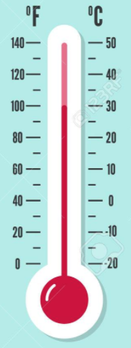
Psychrometer
Wet bulb temperature (T_{w}):
lowest temperature attained
by evaporating water into the air
T
T_{w}
Evaporation removes heat
From the air and the
temperature drops
(evaporation is a cooling
process that removes
latent heat from the air)
wind
wet fabric
T ≥ T_{w}
dry bulb
wet bulb
T minus T_{w} = wet bulb depression
large value = dry air
T minus T_{d} = dew point depression

Slide 28
Summary of Humidity Variables
Vapor pressure (partial pressure of water vapor) [units = mb]
Saturation vapor pressure (vapor pressure of saturated air) [mb]
Absolute humidity (mass of vapor per volume of air [g/m³]
Specific humidity (mass of vapor per total mass of air) [g/kg]
Mixing ratio (mass of vapor per mass of dry air) [g/kg]
Relative humidity (proximity to saturation) [%]
Dew point temperature (temperature at which condensation
occurs via cooling) [degrees]
Frost point temperature (dew point below freezing) [degrees]
Wet bulb temperature (temperature at which condensation
occurs via evaporation) [degrees]
Dew point depression (temperature minus dew point temp.) [degrees]
Wet bulb depression (temperature minus wet bulb temp.) [degrees]

Slide 29
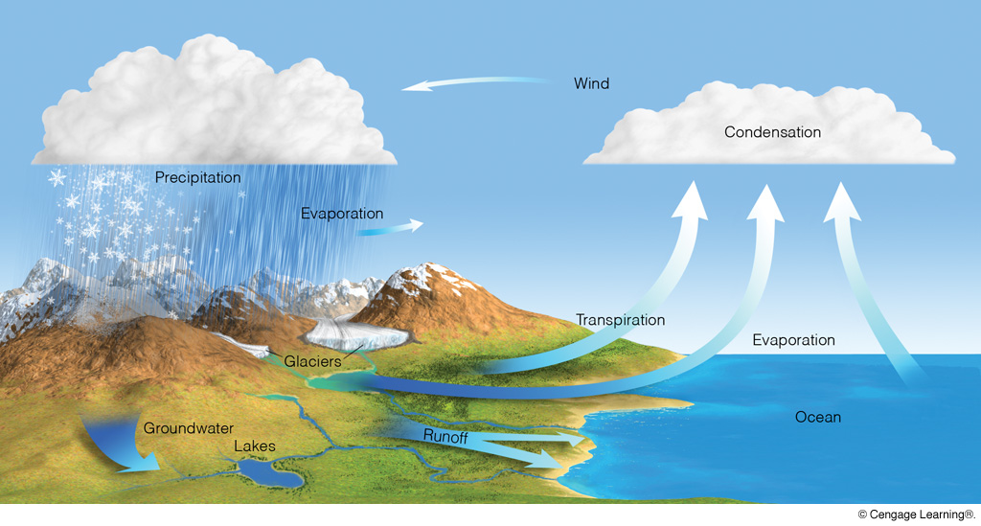
HYDROLOGIC CYCLE
Notes:
Page: 94
FIGURE 4.1 The hydrologic cycle.

Slide 30
Quick Summary—Humidity (Chapter 4):
Water exists in all three phases under normal conditions on Earth.
Phase changes occur at a constant temperature, with latent heat being taken in from the air or released to the air.
The vapor pressure of saturation depends only on air temperature.
The easiest way to saturate air is to cool it, thus lowering the amount of vapor needed to saturate it.
The numerous variables used to characterize humidity levels are all designed to suit different purposes.

