Slide 1
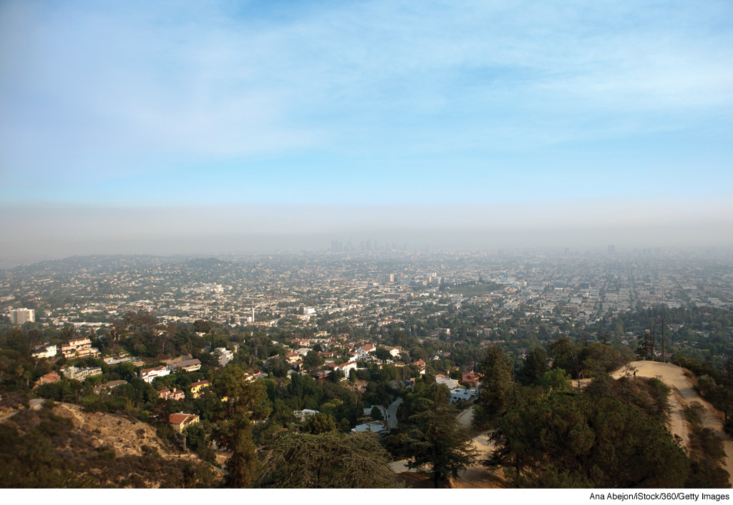
AIR
POLLUTION
(Chapter 19)
Notes:
Page: 540
Figure 19.4 Haze, smoke (particulate matter), and other pollutants cover the Los Angeles skyline during the summer of 2009.

Slide 2
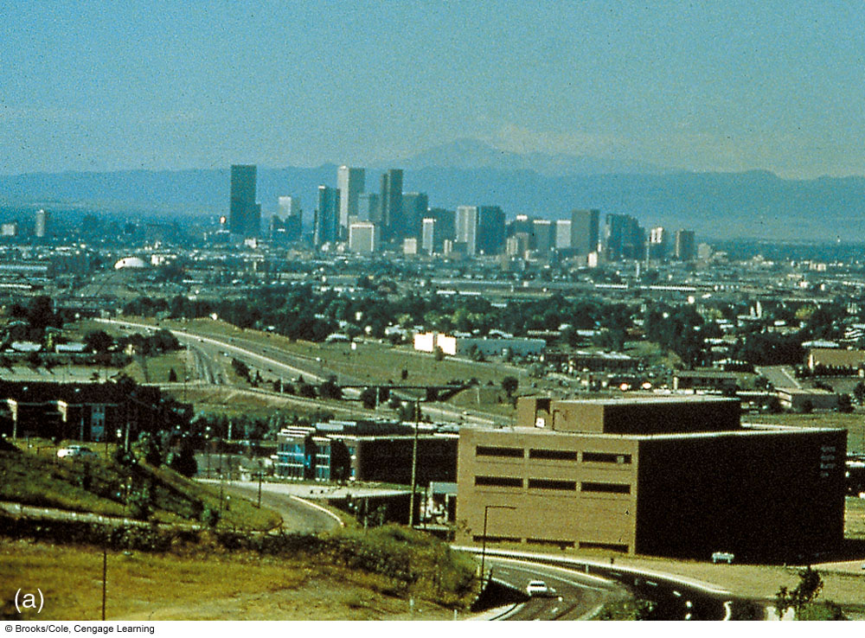
Notes:
ACTIVE FIGURE 18.3 (a) Denver, Colorado, on a clear day, and (b) on a day when particulate matter and other pollutants greatly reduce
visibility. Visit the Meteorology Resource Center to view this and other active figures at academic.cengage.com/login

Slide 3
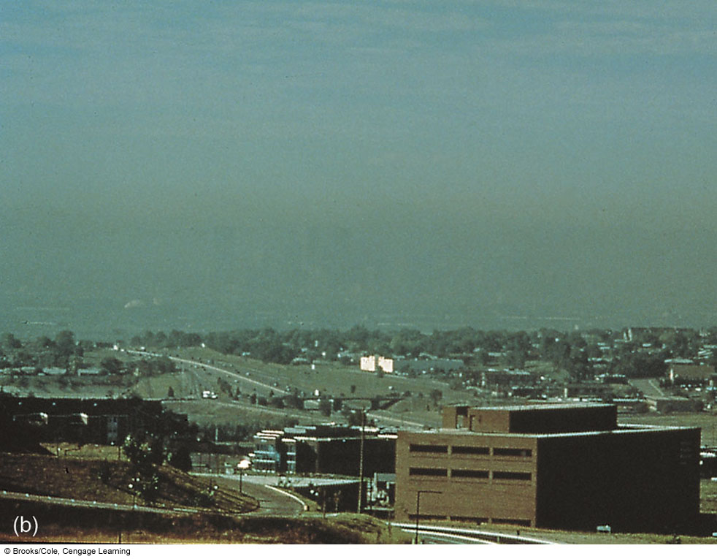
Notes:
ACTIVE FIGURE 18.3 (a) Denver, Colorado, on a clear day, and (b) on a day when particulate matter and other pollutants greatly reduce
visibility. Visit the Meteorology Resource Center to view this and other active figures at academic.cengage.com/login

Slide 4
Pollutant: high enough concentrations to
threaten people/plants/animals,
threaten structures, or
toxify an environment
Natural and human-induced
Fixed and mobile sources
Primary pollutant: directly emitted into atmosphere
(e.g., particulate matter)
Secondary pollutant: forms via some chemical reaction
(e.g., ozone)

Slide 5
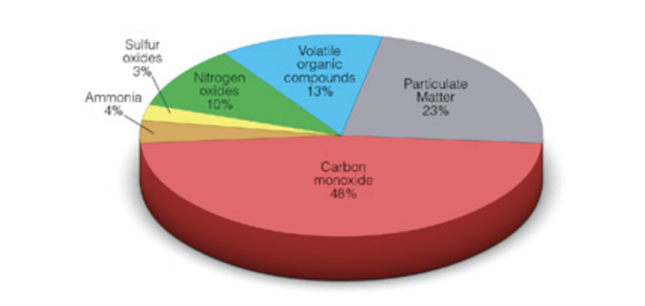
United States Primary Pollutants
NOx (NO, NO₂)
VOCs
PM (PM₁₀, PM_{2.5})
SO₂, SO₃
NH₃
CO
Notes:
Page: 539
Figure 19.3 Estimates of emissions of the primary air pollutants in the United States on a per-weight basis as of 2013. (Data courtesy of United States Environmental Protection Agency.)

Slide 6
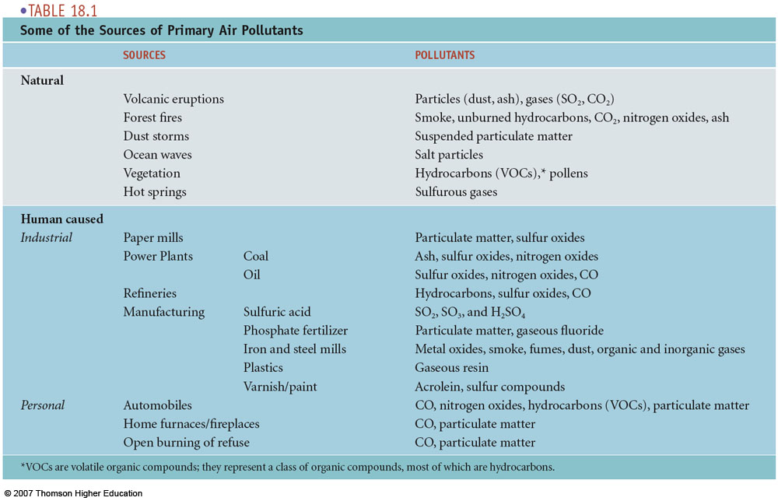
Sources of Primary Pollutants

Slide 7
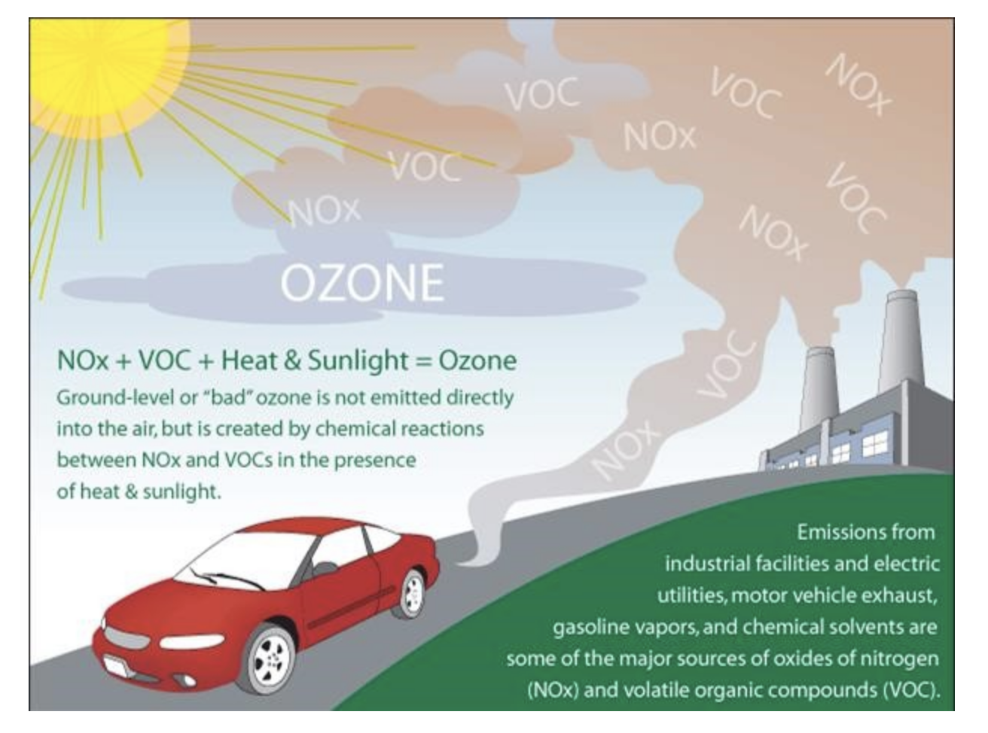
OZONE (O₃) FORMATION
High pressure, light winds, summer (high temperatures)

Slide 8
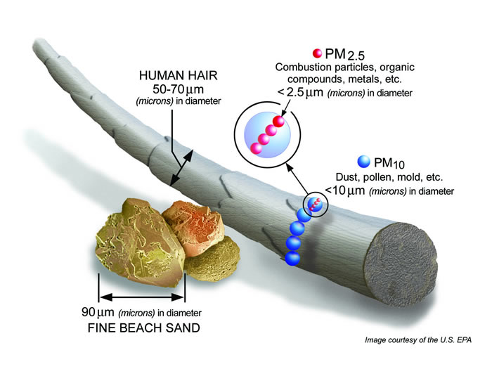
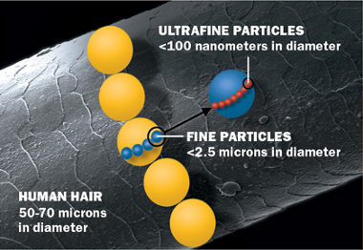

Particulates

Slide 9
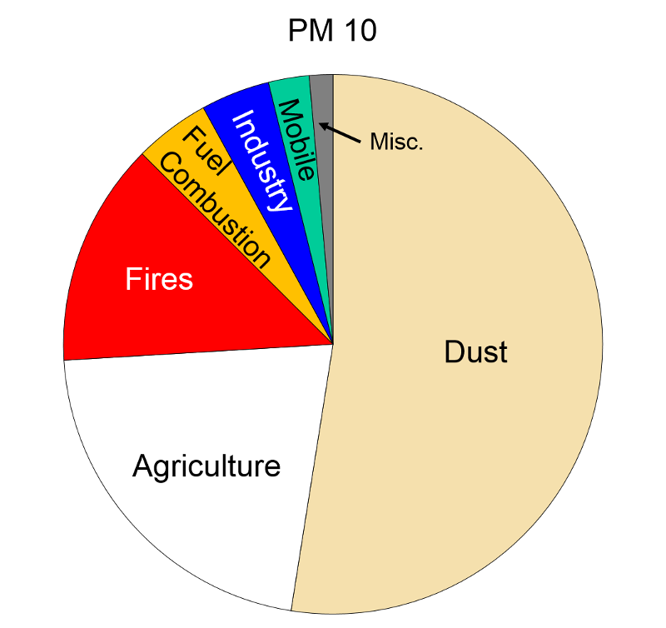
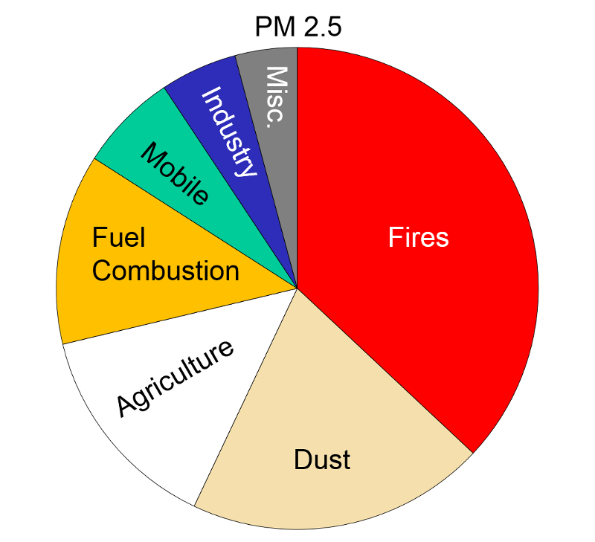
Sources of Particulate Matter
(SOURCE: EPA)
Removed via:
Wet deposition (precipitation)
Dry deposition (settling out)

Slide 10
POSSIBLE HEALTH IMPACTS
Particulate Matter
PM10 particles are small enough to enter the lungs
decreased lung function;
aggravated asthma;
development of chronic bronchitis;
irregular heartbeat;
nonfatal heart attacks;
premature death in people with heart or lung disease
“People with heart or lung diseases, children and older adults are the most likely to be affected by particle pollution exposure. However, even if you are healthy, you may experience temporary symptoms from exposure to elevated levels of particle pollution.”
(SOURCE: EPA)

Slide 11
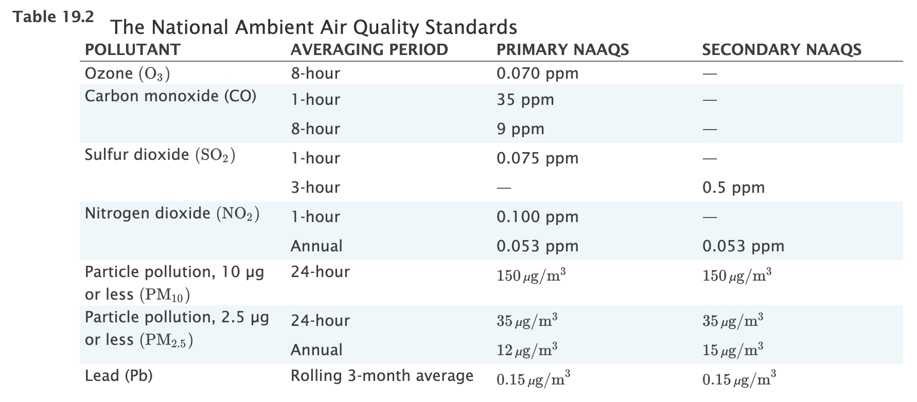
U.S. National Air Quality Standards
Primary NAAQS: health of
sensitive populations (e.g.,
asthmatics, children, elderly)
Secondary NAAQS: public
welfare protection (e.g., visibility,
damage to crops, vegetation,
buildings, animals)

Slide 12
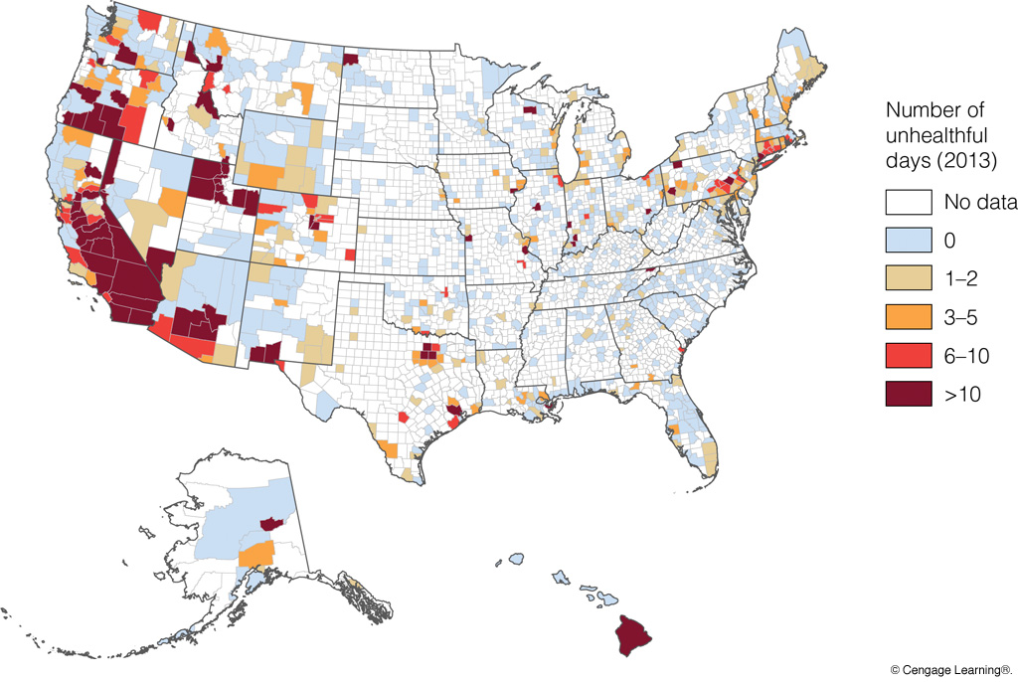
Non-attainment Areas (2013)
CO, SO2, NO2, O3, PM
Notes:
Page: 549
Figure 19.13 The number of unhealthful days (by county) across the United States for any one of the five “criteria pollutants” (CO, SO2, NO2, O3, and particulate matter) during 2013. (Data courtesy of United States Environmental Protection Agency.)

Slide 13
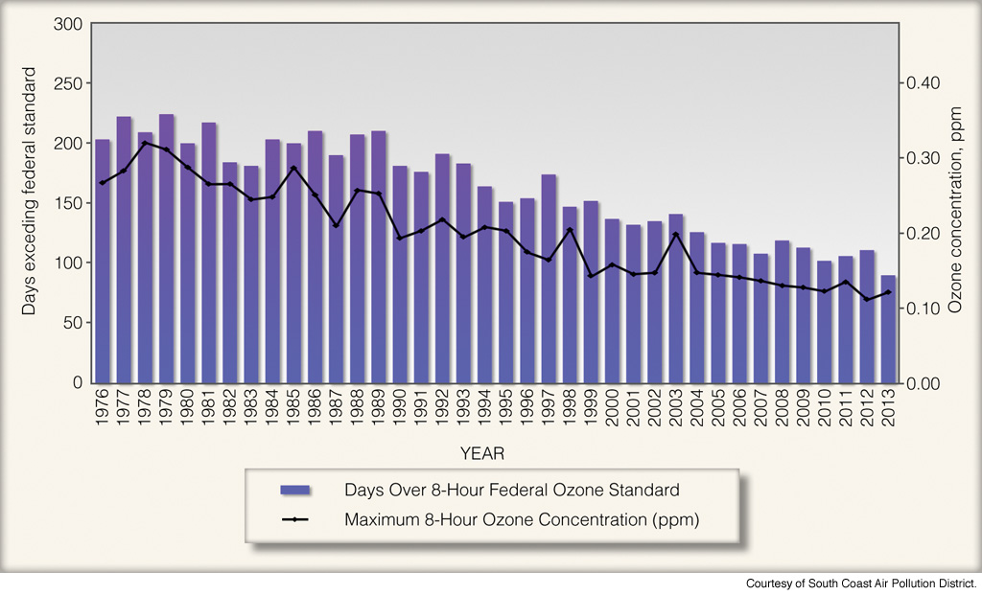
Los Angeles Ozone Pollution
Clean Air Act: 1970 (amendments in 1977 & 1990)
Notes:
Page: 550
Figure 19.14 The number of days ozone exceeded the 8-hour federal standard established in 2008 (0.075 ppm) and maximum 8-hour ozone concentration (ppm) for Los Angeles and surrounding areas in the South Coast air basin. (Courtesy of South Coast Air Pollution District.)

Slide 14
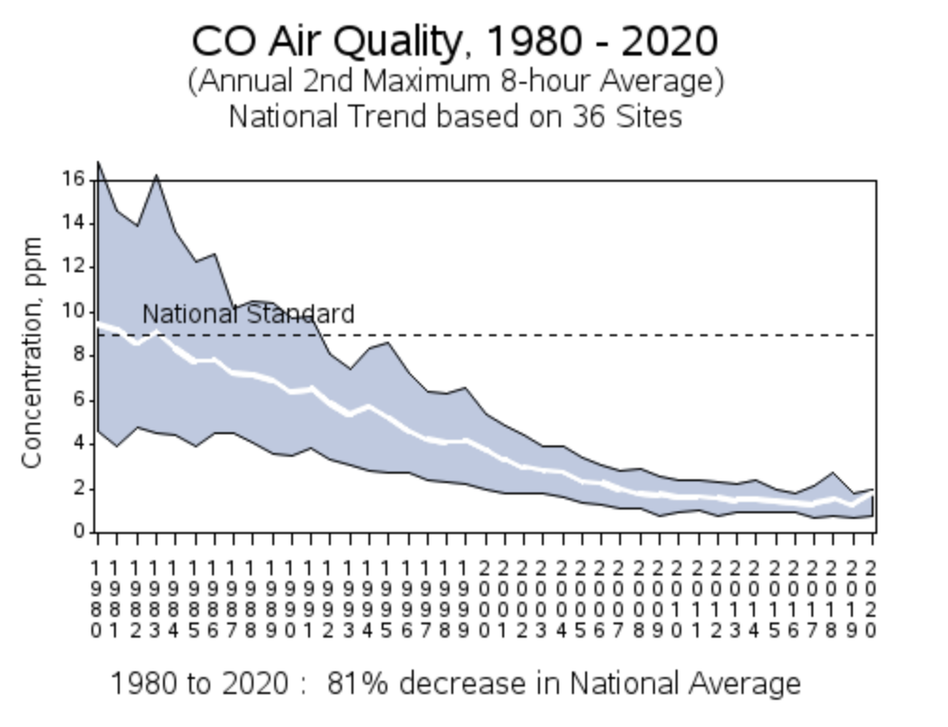
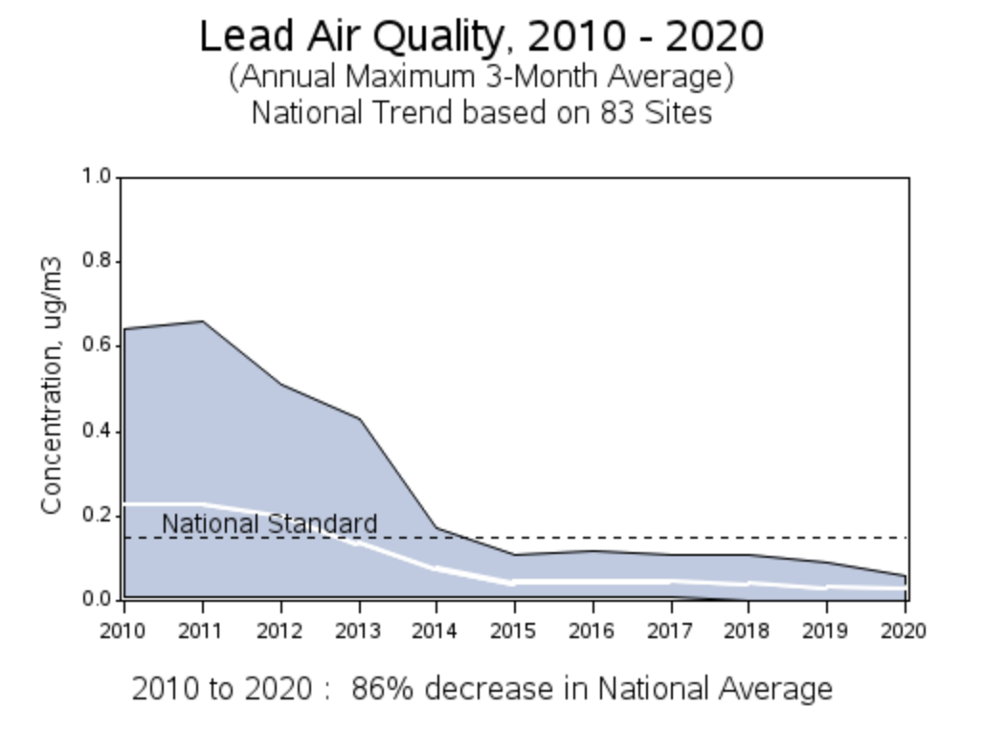
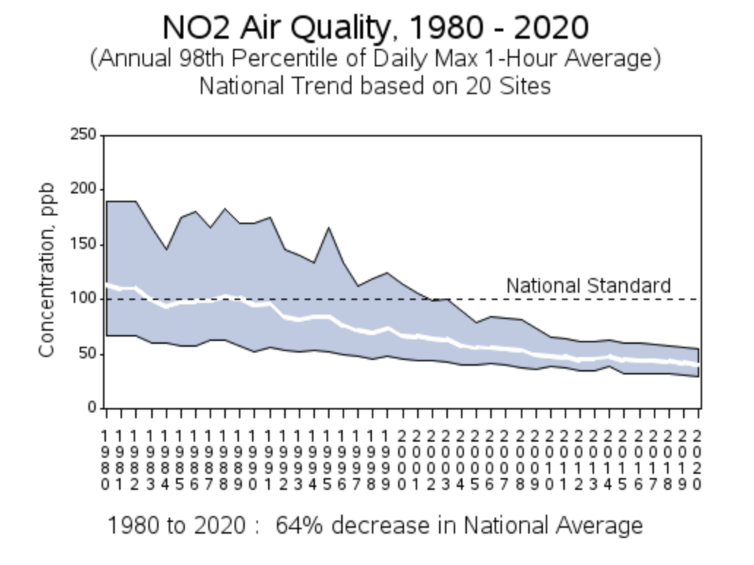
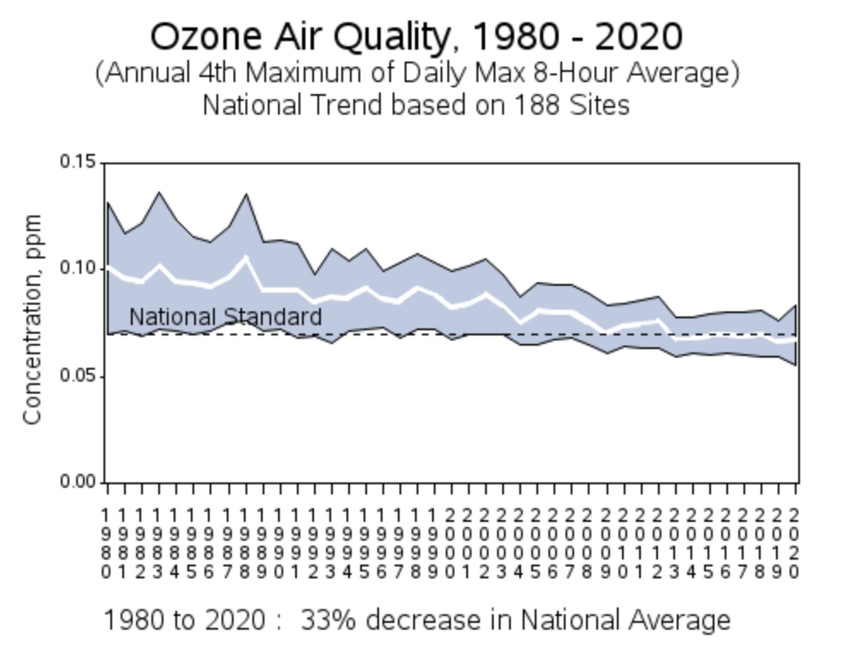
U.S.
Emissions

Slide 15
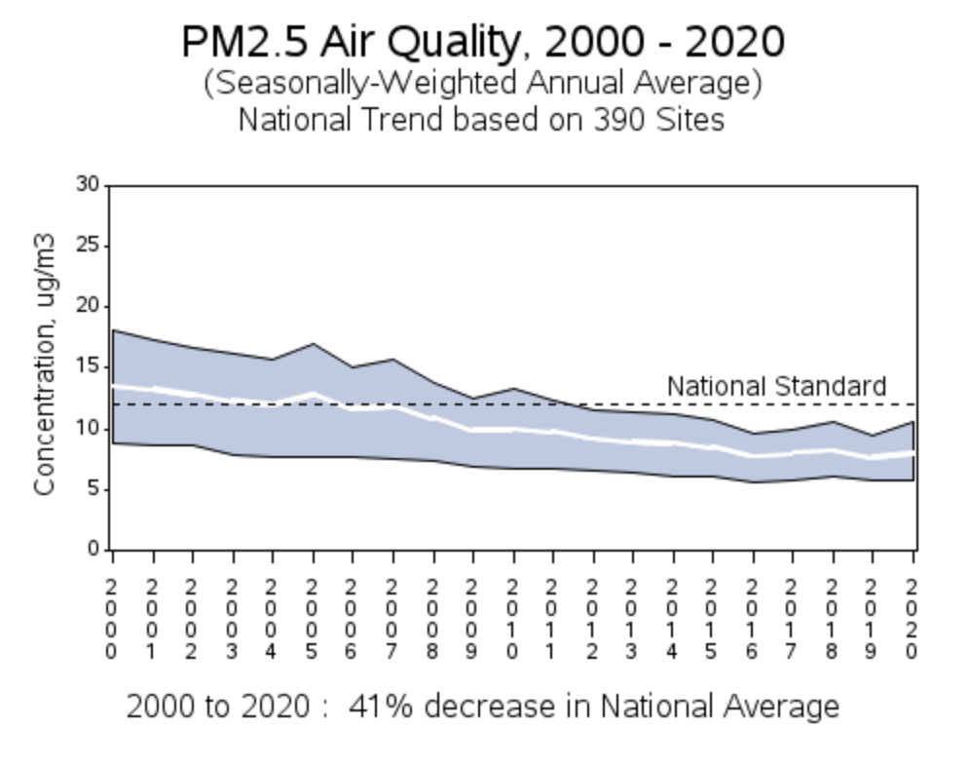
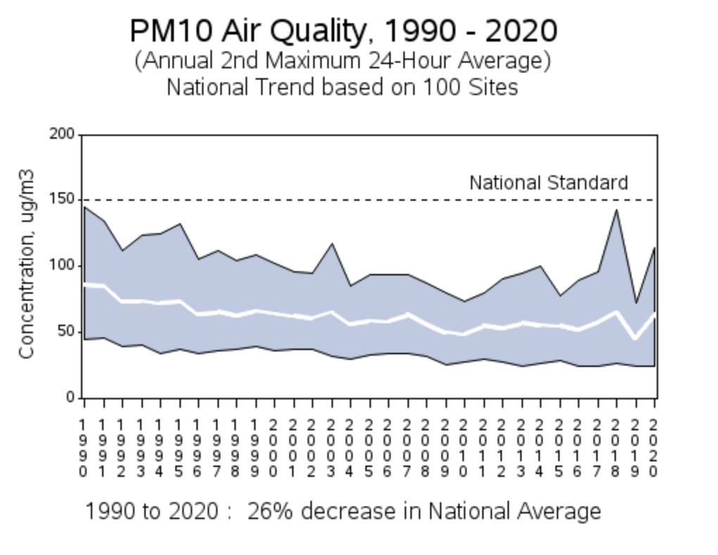
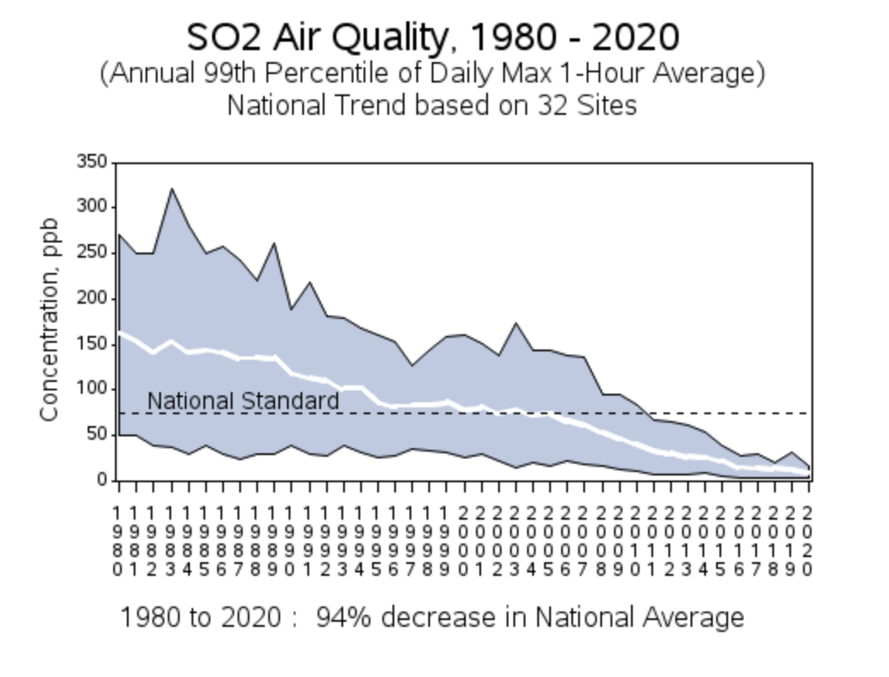
U.S.
Emissions

Slide 16
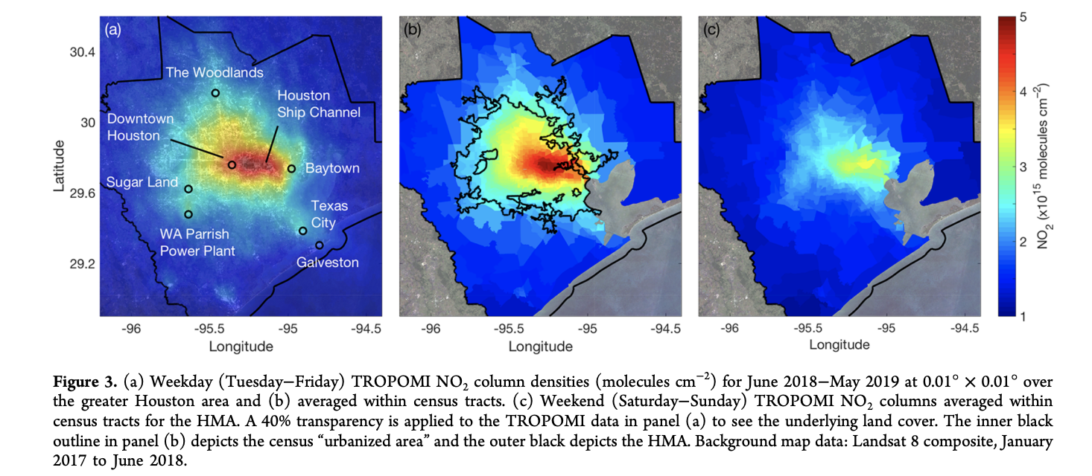
Houston NO₂
(Demetillo et al., 2020)
Nitrogen dioxide concentrations are not evenly dispersed
across the greater Houston metropolitan area.

Slide 17
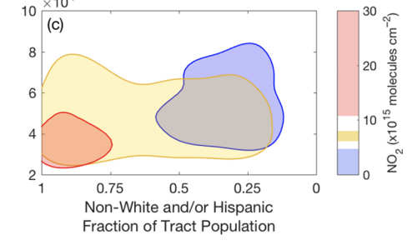
Exposure Disparities
Household Income
NO₂ exposure is higher in census tracts with lower
income and a high non-White/Hispanic fraction
(Demetillo et al., 2020)

Slide 18
Non-attainment Areas (2013)
The industrial Northeast and Midwest emit more pollutants.
Why is air quality so poor in southern California?
CO, SO2, NO2, O3, PM
Notes:
Page: 549
Figure 19.13 The number of unhealthful days (by county) across the United States for any one of the five “criteria pollutants” (CO, SO2, NO2, O3, and particulate matter) during 2013. (Data courtesy of United States Environmental Protection Agency.)

Slide 19
Air Quality Factors
Wind
Atmospheric stability
Stack height (for power plants)
Amount of pollutant emitted
“The solution to pollution is dilution.”

Slide 20
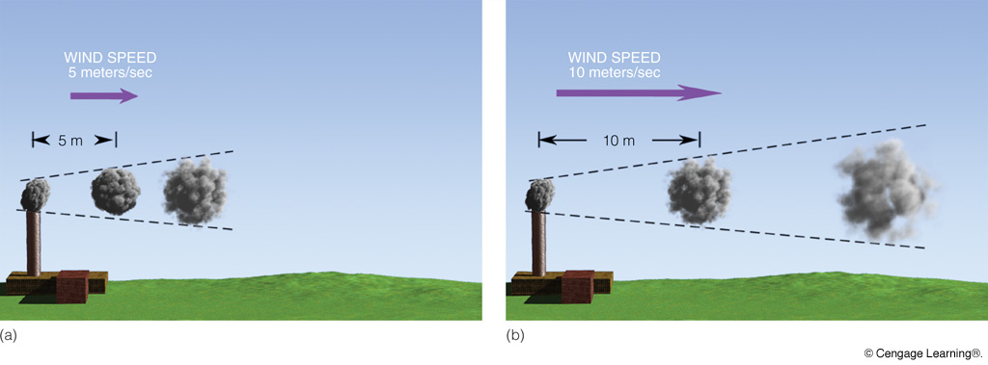
Wind Speed and Air Quality
Notes:
Page: 551
Figure 19.15 If each chimney emits a puff of smoke every second, then where the wind speed is low (a), the smoke puffs are closer together and more concentrated. Where the wind speed is greater (b), the smoke puffs are farther apart and more diluted as turbulent eddies mix the smoke with the surrounding air.

Slide 21
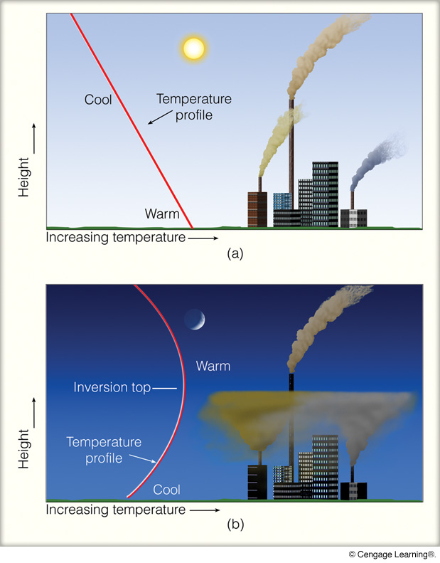
Diurnal Temperature Structure and Air Quality
Afternoon—
Unstable
Pollutants
disperse
Night—
Surface Inversion
Stable
Pollutants from
short stacks
are trapped
below inversion
Notes:
Page: 551
Figure 19.16 (a) During the afternoon, when the atmosphere is most unstable, pollutants rise, mix, and disperse downwind. (b) At night when a radiation inversion exists, pollutants from the shorter stacks are trapped within the inversion, while pollutants from the taller stack, above the inversion, are able to rise and disperse downwind.

Slide 22
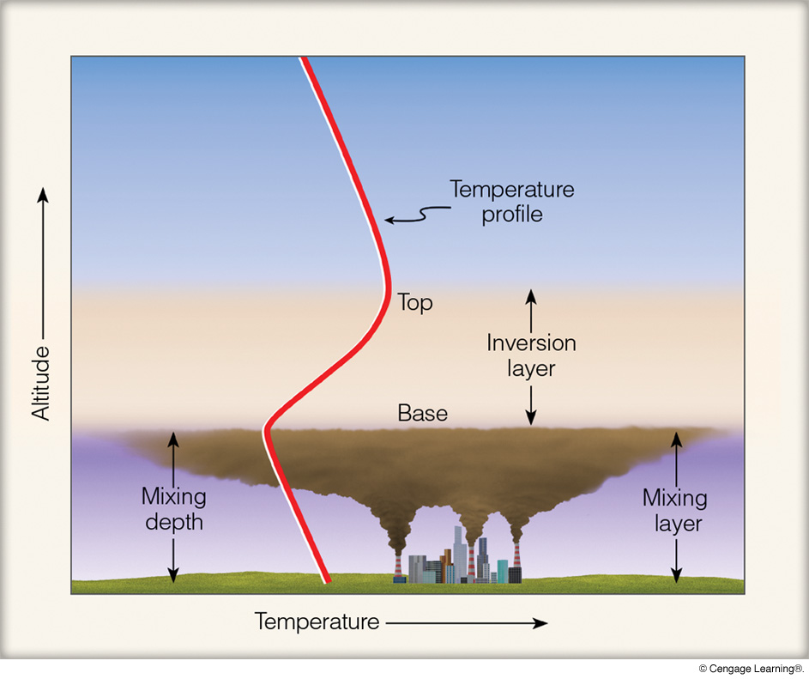
Inversion is a “Lid” or “Cap”
Notes:
Page: 552
Figure 19.17 The inversion layer acts as a lid on the pollutants below. If the inversion lowers, the mixing depth decreases and the pollutants are concentrated within a smaller volume.

Slide 23
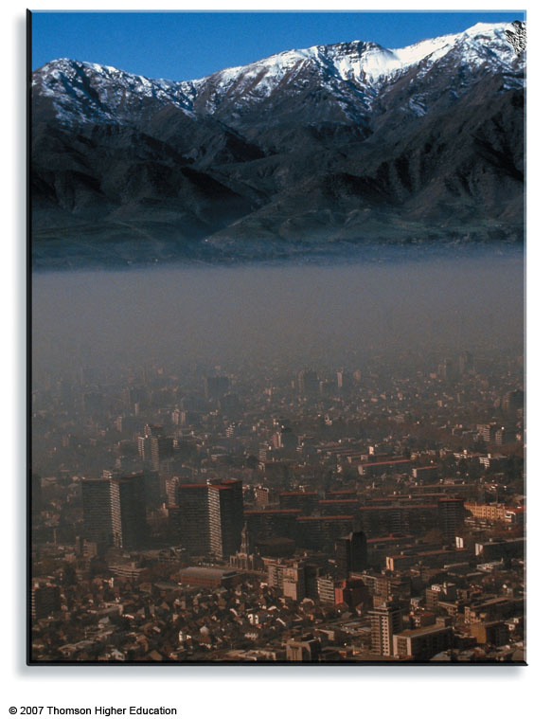
0
Inversion
Mixing
Layer
Notes:
A thick layer of smoke and haze covers Santiago, Chile.

Slide 24
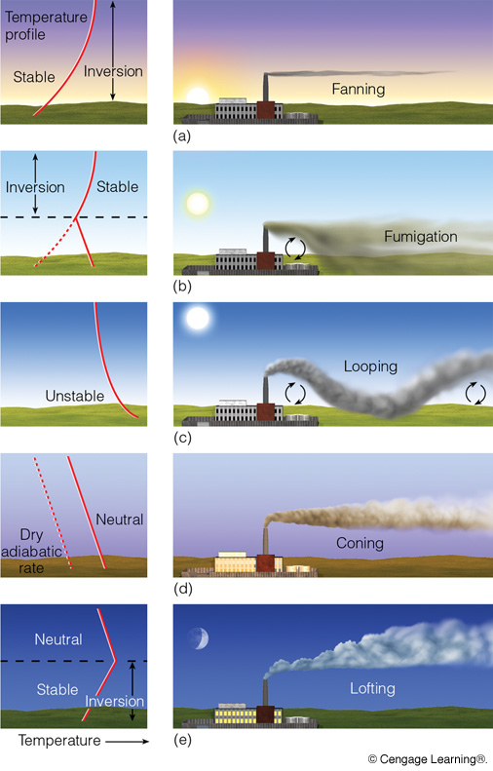
inversion; light
winds, horizontal
spreading
Early morning
sfc. warming;
rising air mixes
pollutants toward
surface
Late morning
unstable; rising
and sinking
motions
Afternoon
transition between
stability conditions;
diffusion, light winds
Early evening
inversion forming;
some smoke above
stack carried upward
while inversion
deepens
Night
Notes:
Page: 553
Figure 3 As the vertical temperature profile changes during the course of a day (a through e), the pattern of smoke emitted from the stack changes as well.

Slide 25
Air Pollution Potential
Factors that make some locations vulnerable to poor
air quality
Multiple pollution sources
Valley
Stationary anticyclones
Light surface winds (anticyclones)
Inversions are frequent (anticyclones)
Clear skies (anticyclones)
Sunlight (anticyclones)

Slide 26
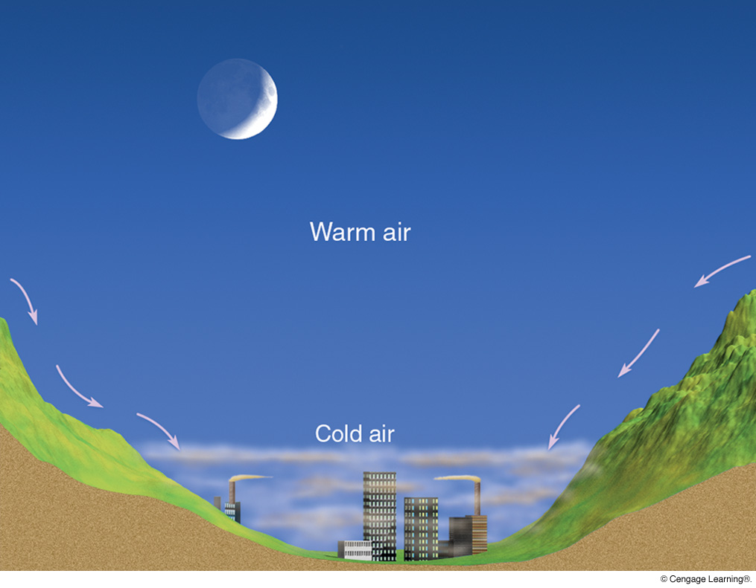
Pollutants Concentrate in Valleys at Night
Notes:
Page: 554
Figure 19.20 At night, cold air and pollutants drain downhill and settle in lowlying valleys.

Slide 27
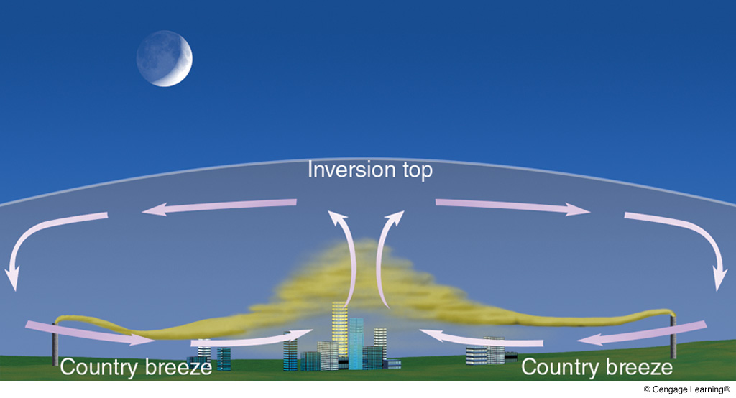
Urban Heat
Island
Notes:
Page: 557
Figure 19.23 On a clear, relatively calm night, a weak country breeze carries pollutants from the outskirts into the city, where they concentrate and rise due to the warmth of the city’s urban heat island. This effect may produce a pollution (or dust) dome from the suburbs to the center of town.

Slide 28
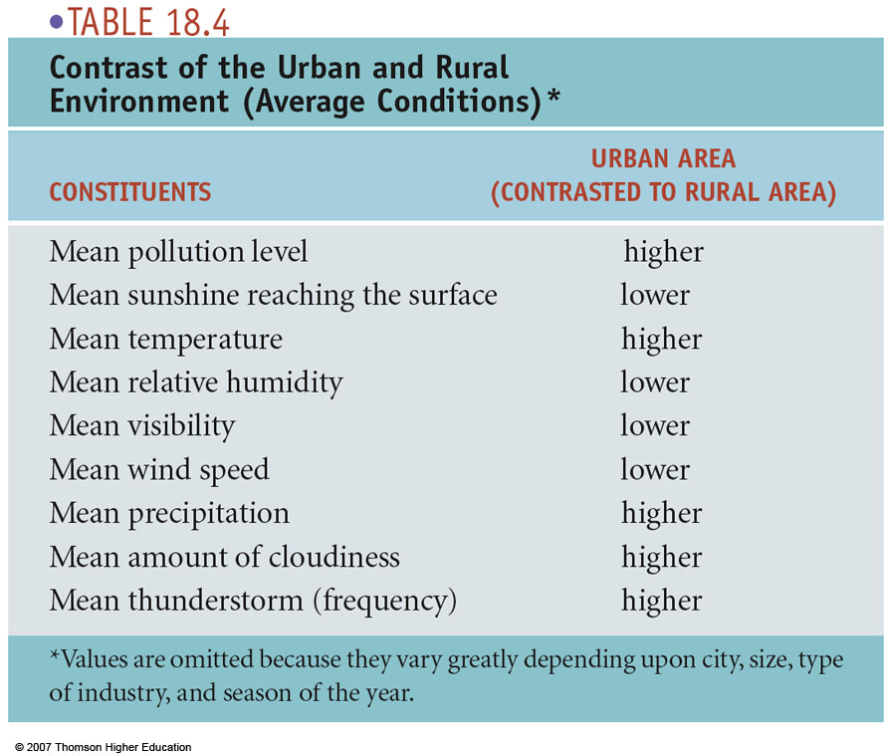
9

Slide 29
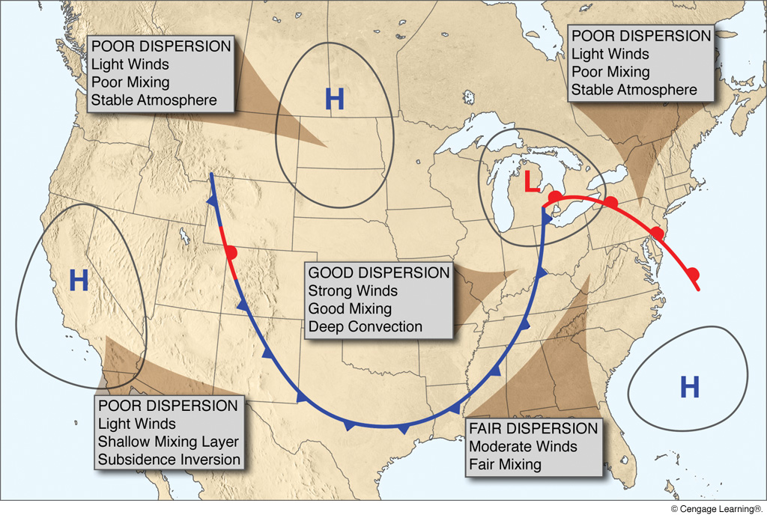
Synoptic Weather and Air Quality
Notes:
Page: 555
Figure 19.22 Weather patterns associated with poor, fair, and good air pollution dispersion.

Slide 30
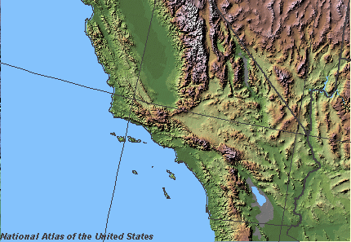
SOUTHERN CALIFORNIA
Cold ocean current
H

Slide 31
Quick Summary—Air Pollution (Chap. 19):
Pollutants are aerosols (natural & anthropogenic) in high enough concentrations to threaten the biosphere or structures
U.S. air quality has improved markedly over the past 50 years
Atmospheric conditions significantly impact the extent to which pollutants are concentrated
Poor air quality is associated with anticyclones (light winds, inversion, clear skies, and high temperatures)

